Slide 1
Feedback
Assessment criteria
Evaluation throughout the project
Log on and pull up your feedback, look back at the project
Upload the feedback to your digital space
Add three comments on how you will improve from your feedback

Slide 2
Sequencing

Slide 3
What will we look at today?
Saving your work correctly and allocating folders
Using audio
Compression
Reverb
Automation

Slide 4
Saving your work
PLEASE, PLEASE, PLEASE SAVE EACH LOGIC PROJECT IN ITS OWN FOLDER… THIS IS NEEDED FOR WHEN YOU SUBMIT YOUR WORK…..
ORGANISE YOUR OWN FOLDER IN MEDIA DRIVE NOW!!!

Slide 5
Bob Marley
Open your project

Slide 6
What is EQ?
EQ is used to boost / reduce frequencies
Can be considered as ‘highlighting’ certain frequencies you want and reducing frequencies that you don’t want
EQ stands for equalizer

Slide 7
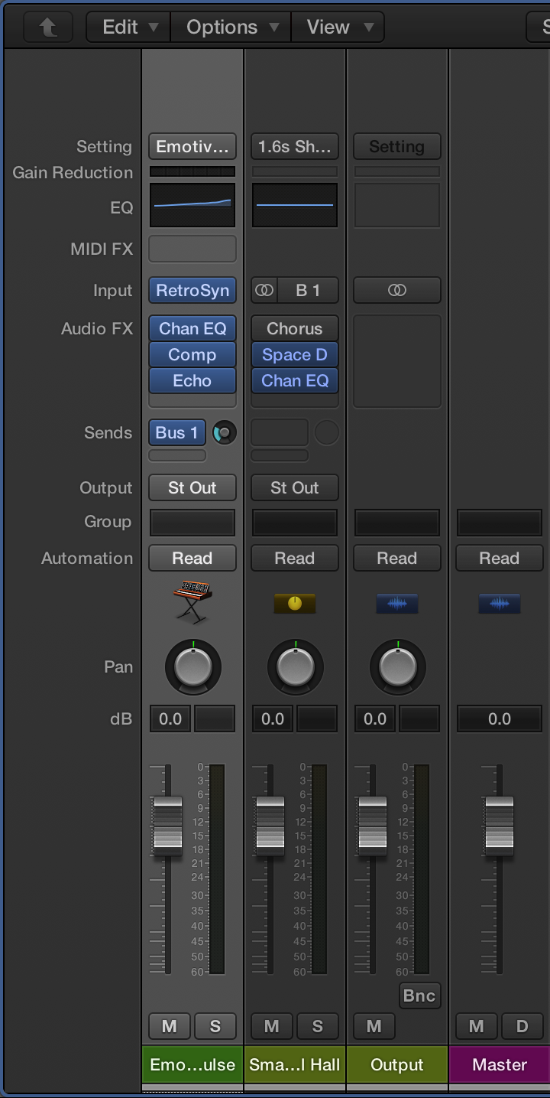
Where is Channel EQ in Logic?
Channel EQ – this is located in the individual channel

Slide 8
What are the different terms?
There are three main aspects you need to know:
High / low pass
Shelf

Slide 9
High pass filter / low pass filter
High pass filter (HPF)
Allows the high frequencies pass
Low pass filter (LPF)
Allows the low frequencies pass

Slide 10
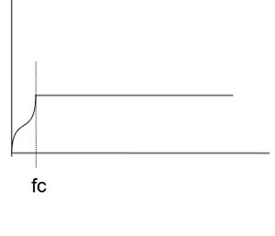
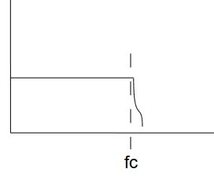
High / low pass filter graphs….
High pass filter example
Low pass filter example

Slide 11
Shelving filter
A shelving filter is used to boost frequencies near the frequency cutoff
IT IS NOT THE SAME AS A HIGH / LOW PASS FILTER
A low shelf is used commonly in EQing guitar and vocals

Slide 12
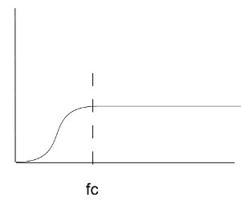
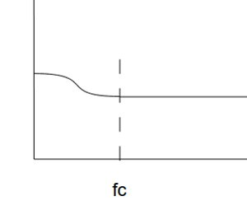
Low shelf filter

Slide 13
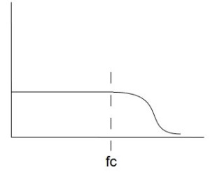
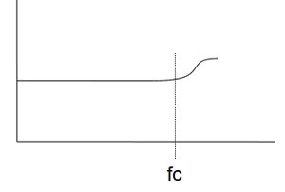
High shelf filter

Slide 14
Where are the shelf filters?
Low shelf filter
High shelf filter

Slide 15
What are the differences?
High / low pass filters are only used to allow certain frequencies through, which are unaltered
High shelf filters are used to boost frequencies above the cutoff
Low shelf filters are used to boost frequencies below the cutoff

Slide 16
What is Analyzer
This is a graphical image of the frequencies for the audio sample you are using. It gives you an idea of what frequencies are being used in the audio

Slide 17
What do the numbers mean?
FREQUENCY – how high / low the sound is in pitch
GAIN / SLOPE – how much dB it is increased / reduced
Q – how wide / narrow the filter is

Slide 18
HINTS
Don’t overdo all frequencies – this can lead to it sounding unnatural and distorted
Work on the ‘problem’ areas only
USE YOUR EARS – keep your volumes reasonable… it’s not a rave!

Slide 19
Compression
Why use it in the first place?
Compression is used to help reduce / avoid the dynamics in the song varying too much. It will control the loud parts of the signal and trying to make it punchier and rounder with the quieter parts.
There is no magic solution…. Just keep experimenting

Slide 20
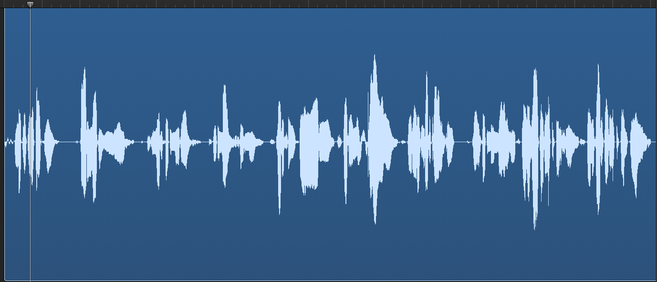
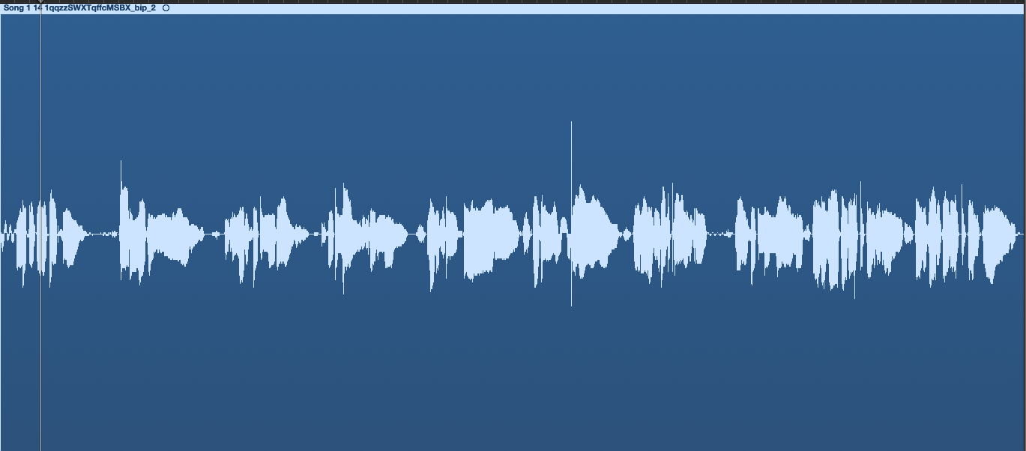
Before
After

Slide 21
Compression can be found in the channel strip (audioFX)
This will then give you a drop down menu

Slide 22
Where to find the compressor in Logic Pro X
It is situated in the individual channel.
Bring up the mixer
Audio FX
Dynamics
Compressor
Stereo

Slide 23
What are the different settings / parameters?
Threshold
Ratio
Attack
Release
Knee
Gain (auto gain should be off)

Slide 24
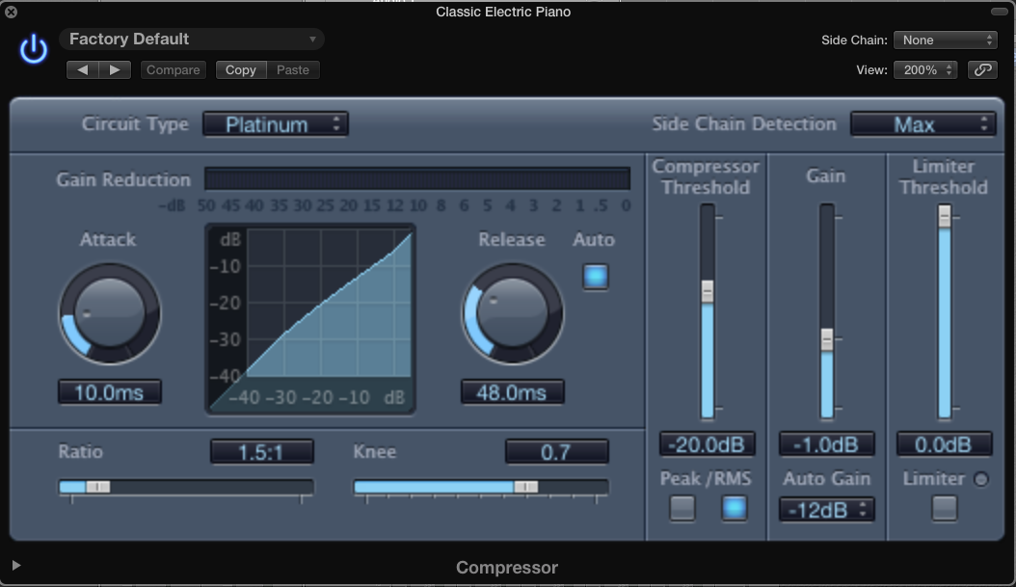
MAKE SURE YOU TURN AUTO OFF FIRST!!!!

Slide 25
Threshold
What does this do
You are telling the compressor what the limit (threshold) is before it works. Ideally you should start at the top and SLOWLY work downwards, so that the negative numbers increase…. Always use your ears.
The more you increase the threshold, the more gain reduction is applied
A good reference is reducing the gain by 6dB

Slide 26
Ratio
What does this do
This is how much of the compressor is applied once the threshold has been met. The higher the ratio, the harder the compressor works…. Look at the graph on the next slide

Slide 27
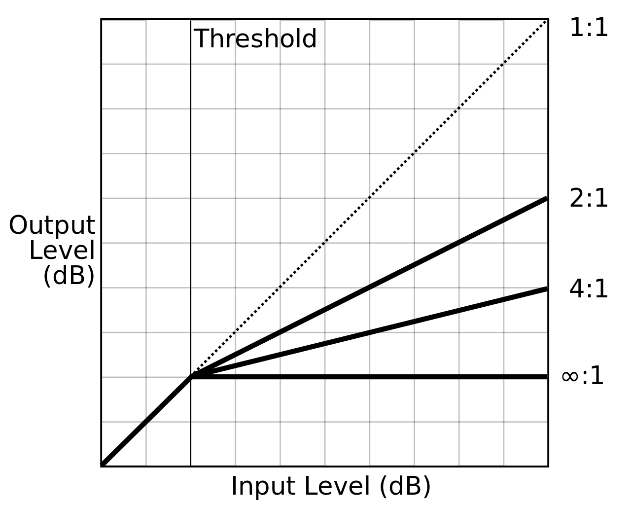

Slide 28
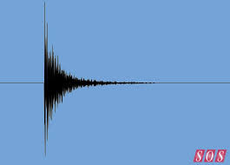
ATTACK!!
What does this do
This is how quickly you want Logic (or any DAW) to start compressing. It works in ms (milliseconds) The higher the attack value the longer it takes the compressor to work
For example
0.00 ms means that it will work instantly
8.00 ms means that it will work after 8.00ms

Slide 29
Release
What does this do
This is how quickly you want Logic (or any DAW) to stop compressing once it has fallen below the set limit. It works in ms (milliseconds) The higher the release value the longer it takes the compressor to stop working
For example
0.00 ms means that it will stop instantly
6.00 ms means that it will stop after 6.00ms

Slide 30
Knee
What does this do?
This is how smooth or abrupt compression is used when it is near the threshold. You will notice that the curve will be smoother the higher the knee is.

Slide 31
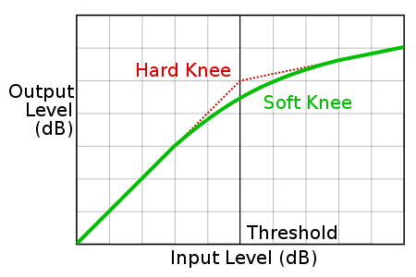

Slide 32
Gain
What does this do
This is how much you increase / decrease the overall output to the main mix itself. You can leave it at 0.00db and go back and add in more
As compression reduces the dynamic range it will inevitably sound quieter after compression, so the gain can increase the level after the compression process.

Slide 33
Automation
This is when you tell Logic in change certain elements (any type of effect, but velocity and panning), during specified times.

Slide 34
You will need to select the automation you want on the particular track
You can then select what you want it to automate (an effect, volume, panning)

Slide 35
By clicking on the line, you will add in handles, in then you can make changes.
To delete a handle, just click on the handle

Slide 36
Let’s have a go!!!
Using an Apple loop, try to utilise the different parameters to compress some audio
Extension - You should try to find a few different samples using different instruments, as they should have different compression settings

Slide 37
Intro to bus
Intro
You have spent a few weeks using different effects in Logic Pro on audio tracks. Some of you may notice that the audio and MIDI samples already have some pre-set effects on them.

Slide 38
Why use a bus
Sometimes, you may want to use the same plug ins for more than one channel. Therefore, rather than trying to go through and put the settings in again and again, you can send it to a bus, so that different channels can have the same plug ins

Slide 39
What is a bus?
A bus is another channel strip (found in the mixer) where you can use plug ins / effects, on audio or MIDI by sending it through another channel before going through the output

Slide 40
In DAW’s…. This is the process
Bus (Aux)
Audio 1
Audio 2
MIDI
Output

Slide 41
What is the point of a bus?
It can help you save time with using the same Audio FX settings – rather than creating the same settings for the different audio / MIDI tracks, you can send it to a bus
You can also rename a bus / channel to help you with knowing what is where

Slide 42
Where is a bus found?
A bus is found in the mixer or channel information called SENDS
Click on sends – then on bus – then select an empty bus. This will create you a new channel strip. REMEMBER TO INCREASE THE BUS LEVELS (WHEEL)
A direct bus can also be used by directing the audio output to a bus
Click on the output and change to the selected bus.

Slide 43
OUTPUT LEVEL… SUPER IMPORTANT
Your output level is an indicator about what the level is of your work.
You need to keep it within the GREEN and AMBER range as once it hits RED, it will alter the sound quality.
This is also applicable to each of the individual channels

Slide 44
HANDY HINT
You should not change the output level – this should always remain at 0.0db. Instead, alter the levels of the individual channels instead

Slide 45
Reverb
What is it?
The way that a sound is reflected in different environments and acoustics. You can alter the way something sounds
However, you have to be careful!! You cannot take reverb off an audio file (clean is best to work with)

Slide 46
Markers
Using markers in Logic helps you to identify sections in your work (this is very simple, but effective)
HINT – WHERE YOU PUT THE PLAYHEAD / PLAYLINE IS WHERE THE MARKER WILL START, FOR EXAMPLE, IF YOUR PLAYHEAD IS AT BAR 3, YOUR MARKER WILL START AT BAR 3

Slide 47
Layering / textures in your track
Layering and using textures is important in any type of music. You have to be creative, yet coherent your piece, as otherwise two things may happen
Too repetitive
Too many ideas

Slide 48
What is layering?
Layers are basically how many instruments / samples are being played at the same time. It can be incredibly effective when these change in sections and the transitions between sections too

Slide 49
What is texture?
Essentially, this is the different sounds (instruments) that are used and how they are incorporated
Unison (one sound)
Homophony (chordal)
Polyphony (many sounds)
Imitation (rounds)

Slide 50
Why is texture so important?
Textures (homophonic / polyphonic and all the different variants) can be used to emphasis the harmonic elements that are incorporated in the piece.

Slide 51
What is structure?
The order in which the different sections of a piece appear.
Again, if this is not planned out carefully, it can have the same result as layering
Too repetitive
Too many ideas

Slide 52
Important key facts about structure:
You should always try to work in bars of ‘4’
You can use really obvious changes to indicate new sections
Different instruments
Change in layers
Change in velocity / dynamics
Tempo change

Slide 53
Bouncing
Bouncing is where we combine all the tracks in to a finished stereo mix so we can listen on our Phone, Computer etc.
CHECK ALL LEVELS ARE NOT CLIPPING
To bounce the track set the locator markers at the very beginning and a little bit after the track ends (to capture reverb tails)
Click the bounce short cut (cmd + B)
Save as your track name
Check where it is saved
Check Destination – PCM
Mode – Offline
Check file format - Wave
Resolution - 24 bit
Sample rate - 44100
File type - Interleaved
Dither – POW 3

Slide 54
Your Track - An electronically realised composition
This could be a variety of things but it must use Logic 9 to realise it.
What I expect:
3-4min track
Focused on a genre of your choice but backed with research to ensure appropriateness
It must use sequenced MIDI and Audio (this can be samples, loops or recorded material)
Audio can be music and or noise based (you can record guitar, vocals in addition to MIDI sequences)
It must be original but you may use some samples (not just a remix or resample of someone else’s work)
You should consider Tempo, Structure, Texture, Dynamics, Rhythm, Melody and Harmony
There should be no musical errors
It should be mixed to an appropriate standard that is clear and balanced with effects and Equalisation
It should be interesting (please)

