Slide 1
Sequencing

Slide 2
Recap from last week
Recap MIDI recording and editing
Recap on quantizing – what is the purpose?

Slide 4
What we are covering today
Using audio and manipulating audio
  Splicing audio
  Pitch shift (you can add in some chipmunk sounds) and correction
  Speed up / slow down
  Fade in / fade out of audio
  Automation (MIDI and audio)
  Reverse

Slide 5
Create a new folder in your folder. Name it audio sampling
EVERYTIME YOU START A NEW PROJECT, YOU SHOULD HAVE A NEW FOLDER AND NAME IT APPROPRIATELY …. THIS IS SUPER IMPORTANT!
YOUR MAC IS OPEN TO ALL STUDENTS WHO USE THAT PARTICULAR MAC

Slide 6
Splicing audio
Splicing or cutting audio is an important skill to master. It is just as important to use your eyes as well as your ears. If you cut on the waveform, you will get something called clipping (this can not be removed)
HINT – you should try to cut on ascending waves

Slide 7
Use the scissors tool to help with cutting a section of your track
ZOOM = SHORTCUT = CTRL + ALT and then draw a small portion
Select Scissors tool in the right click box, then press cmd to use.

Slide 8
Cut where the wave form crosses the zero (straight line)
Remember to return to the pointer tool afterwards (release cmd)
Listen to see if it is a cut in the right place…

Slide 9
This is called ‘non-destructive editing.’ What this means is that even if you make a mistake, you can still undo the process and redo.
If this was tape… you would not be so lucky
Choose a sample and then try to cut out short samples to create a bit of a track

Slide 10
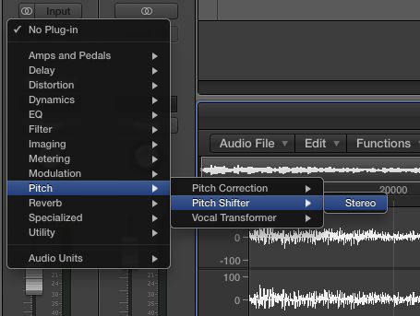
Pitch shifter (found in plugins)
This is a method which can be used to alter the pitch of audio by specific steps (semitones)…
Found in audio FX

Slide 11
Pitch flex
The wonderful aspect of audio is that it is more realistic than MIDI. However, there is the obvious disadvantage of pitching.
However, you can correct this (this is not the same as auto tune)
Follow the demo and add it into your track. It is not always necessary to complete this, but can make a real difference if there is a lot of discrepancy

Slide 12
Pitch shifter and Pitch flex
Bob Pitch Shift Automation
So we can chop up a sample and apply pitchshift automation to make it more interesting.

Slide 13
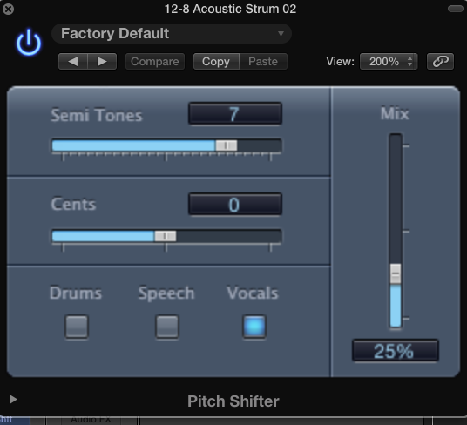
You can adjust the different settings to alter the pitch of your audio
Semi-tones (up or down in pitch)
Mix – how much of the original sound is included

Slide 14
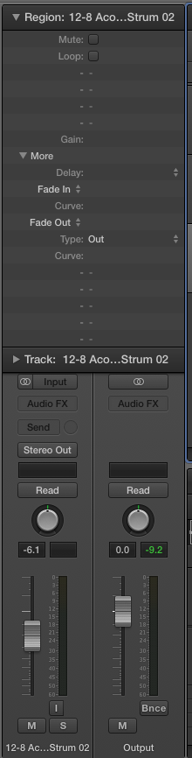
Fade in / Fade out
Fade in / fade out in audio can be a good way to help with the dynamics at the beginning and end of a track.
(Use the menus in the channel strip)

