Slide 1
Sequencing

Slide 2
What is this unit about?
The main elements to this unit
Using MIDI in Logic
Using Audio in Logic
Using sequencing software to create a professional product

Slide 3
Why is this unit useful?
You will get to use some of the basic skills in Logic, to help you become more familiar with using a DAW (Digital Audio Workstation) to then help you with the rest of the course.
DAW’s are an integral piece of music making in todays music environment, it is essential that you can use them even at a basic level
Of course, there are many of you who know how to use DAW’s / Logic, but it will also be down to the musicality of a piece

Slide 4
1 – Saving work
It is ideal for you to sit in the same place every lesson, especially if you are working on Logic.
You need to log in to the computer to ensure your work is saved
You should also save your work on your own hard drive to ensure it is saved and backed up.
It is your responsibility not to lose your work.
Follow the instructions from your tutor, as this will help you with saving your work correctly using the college system

Slide 5
2 – Creating folders
You must organise and title your work appropriate and consistently, as this will help you with finding your work in a later session.
Follow the instructions from your tutor. Please create one on Local drive and one in your own drive
Alsdfaskfh – not a good title name!
MIDI drum beat sample – much better!
The majority of students lose work due to not labelling work properly, it will also speed up finding work.

Slide 6
Logic Pro
The basic principal of DAW is the same, regardless of what software you use. However, it is the skill of applying different aspects, which is where the creativity and techniques start to build

Slide 7
Layout
Logic Pro may look very confusing at first but once you understand each aspect of the layout it will make far more sense.

Slide 8
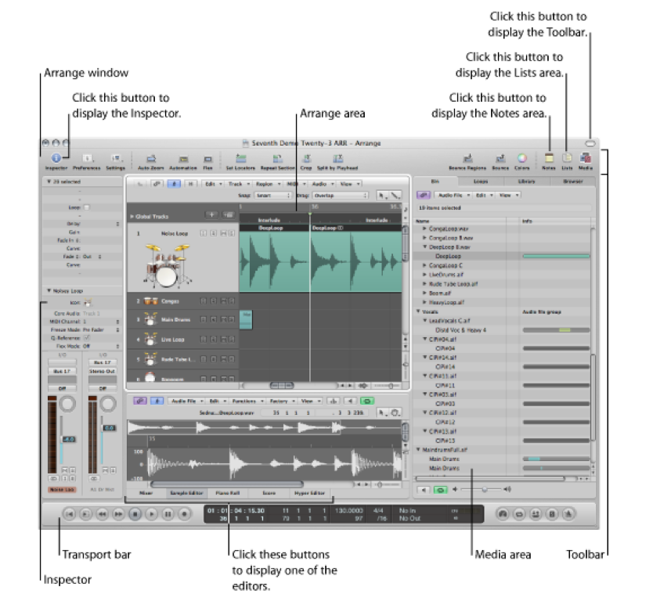
Layout

Slide 9
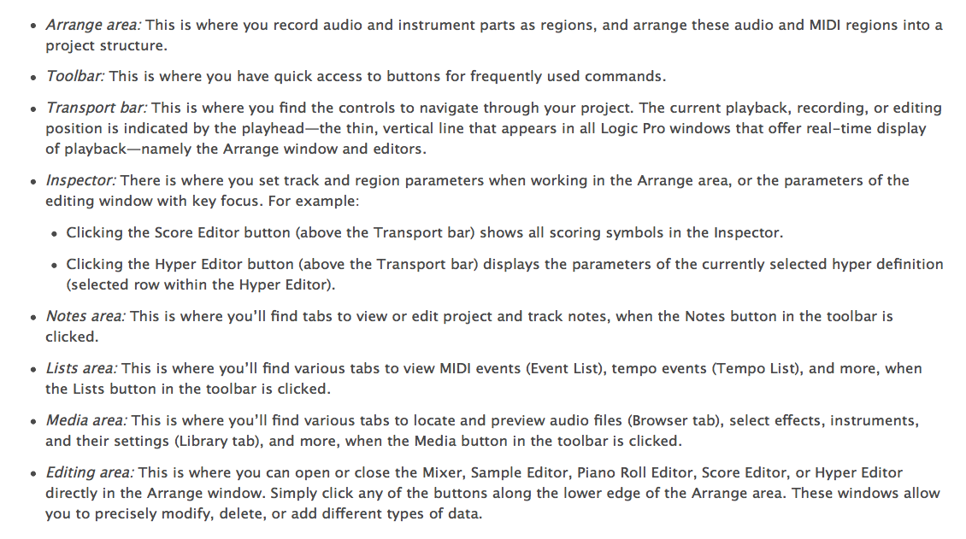

Slide 10
Logic Guide
This section is not much use as we can control most of these with key commands
The preferences and settings are useful to set up Logic.
The inspector turns the sidebar off and on.
Automation is switched with the A key
Locators are switched with C key
Crop and Split by pressing cmd and then clicking

Slide 11
Logic Guide
Bounce combines all the tracks in to a final mix as Wave or Mp3.
Colours changes the colours of tracks.
Notes – you can add notes on a track or a project.
Lists – We will look at later, very useful.
Media – The audio library, loops and instrument browser where you can select the instrument or the samples you want to use.

Slide 12
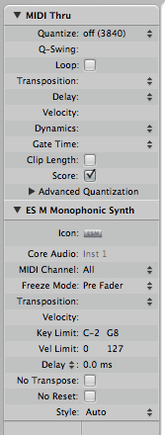
Logic Guide
This section allows us to edit the Midi or Audio track we
Have selected. We have a variety of things we can quickly
do to the audio or midi track. This is quite useful.

Slide 13
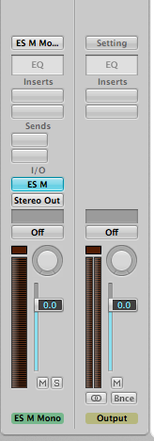
Logic Guide
The small mixer provides us with a small mix of the track
selected and the main output (what goes to your headphones
or speakers)
We can adjust
EQ
Insert Effects
Sends
The instrument selected (if MIDI)
Input and output routing (where the sound is coming from and
going to
Groups
Automation settings.
Pan
Volume
Mute/Solo tracks

Slide 14
Logic Guide
Transport bar
Rewind to the beginning of the track (return key also does this)
Play from selection
Rewind
Fastforward
Stop
Play
Pause
Record

Slide 15
Logic Guide
Time/bar numbers left/right locator position
Signal in/out
Tempo
& end of song
Time signature

Slide 16
Logic Guide
Cycle (C Key)
Solo
Main Volume
Punch in
Metronome

Slide 17
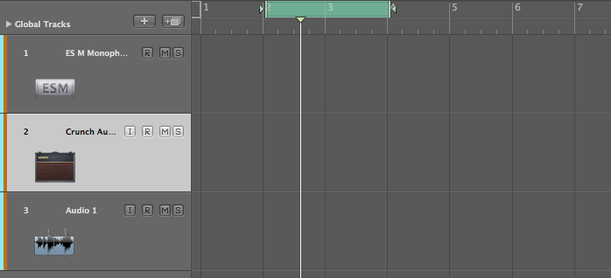
Logic Guide
Add Track
Cycle
Bar
MIDI Track
Audio Track
Left Click/Right click selection tool (press cmd for right click)

Slide 18
Software Instruments
Open a new project
Select a software instrument track
On the channel strip i/o click and hold
A list of software plug ins will appear
Scroll down and select ‘Ultrabeat’ and let go of mouse
Now click on the I/O and change it to ES2 (stereo)

Slide 19
Creating Beats
Follow the hand out task

Slide 20
MIDI or audio
MIDI is a connection protocol, we use it in Logic to create music through the use of a MIDI keyboard
We can create a drum track, keyboard part, string section etc through the use of MIDI and easily copy, paste and edit parts to fit the song or composition.
MIDI is very small data and requires little storage space and will easily save with your project

Slide 21
MIDI or audio
Audio is a recording made from the real world
This could be anything played in to the microphone, singing, guitar, noise, sounds etc
Audio is hard to edit once it has been recorded we can cut parts out but it is hard to change once it has been recorded.
Audio is large in size and requires more storage space and will needs to be saved with your project otherwise it will get lost (save in a folder)

Slide 22
Note lengths

Slide 23
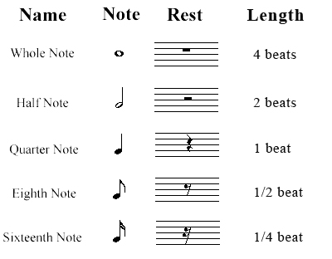

Slide 24
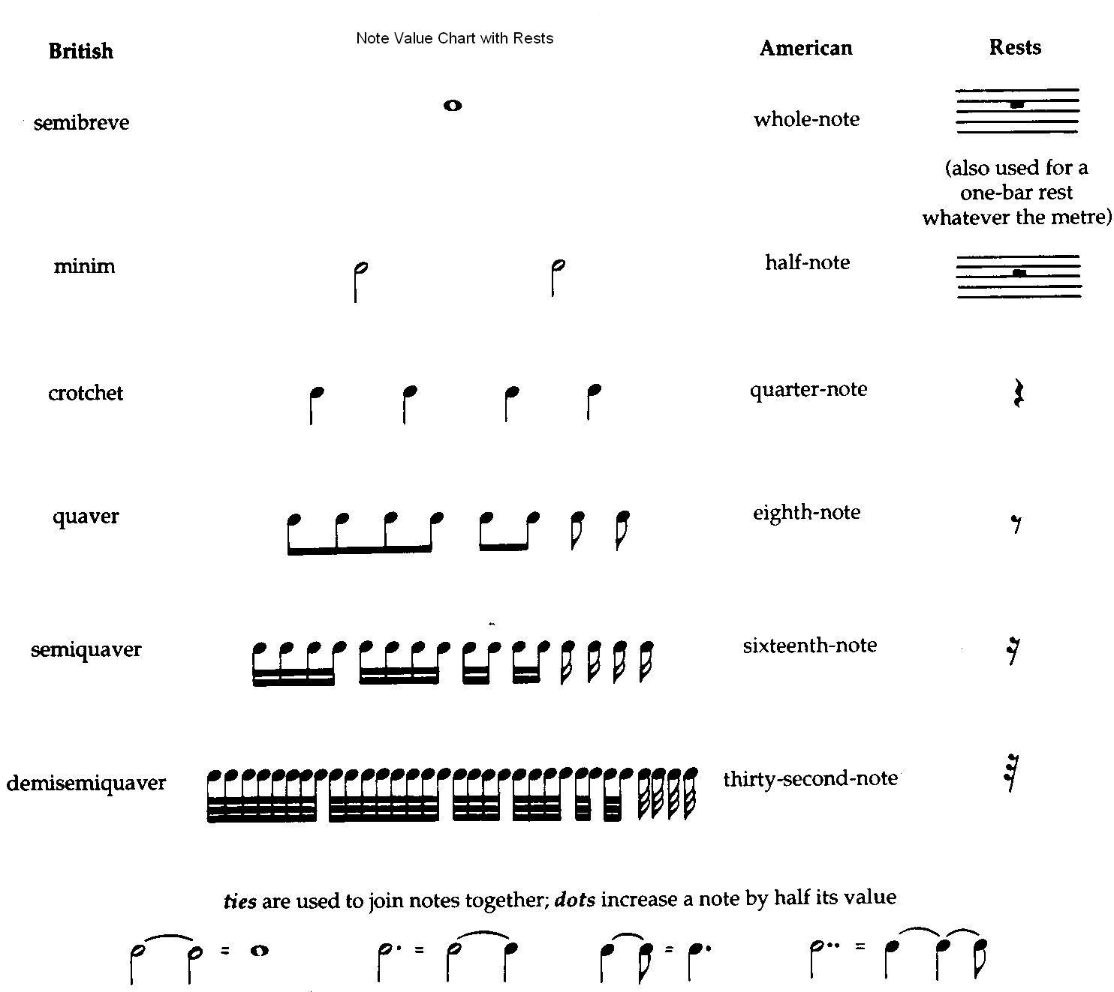

Slide 25
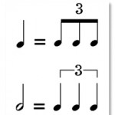
Triplets
3 quaver triplets are equivalent to 1 crotchet (1 beat)
3 crotchet triplets are equivalent to 1 minim (2 beats)

Slide 26
DIVISION
The Division number is a key part of input MIDI data.
See below /16
The number defines the type notes that you can enter in as MIDI
So if it set to 16 only up to16th notes can be entered
So if it is 8 only 8th notes can be added

Slide 27
Task
1.
In Logic create these phrases…
2.
3.
Using only the C note create these rhythms
Done those? Create your own!

Slide 28
Recording midi
Set up the tempo
Turn the click on
Record in a MIDI region with a simple chord pattern
Now Quantise it to the nearest beat.
Cut it to a loop and now duplicate it
Now create an extended loop (make sure snap is set to absolute value)

Slide 29
creating midi
Create a MIDI region
now write in a simple drum pattern by drawing notes
Lets make a song.
Copy tracks or create new ones
Think about the melody, harmony and rhythm and the sounds and timbre that suit.

Slide 30
Tempo

Slide 31
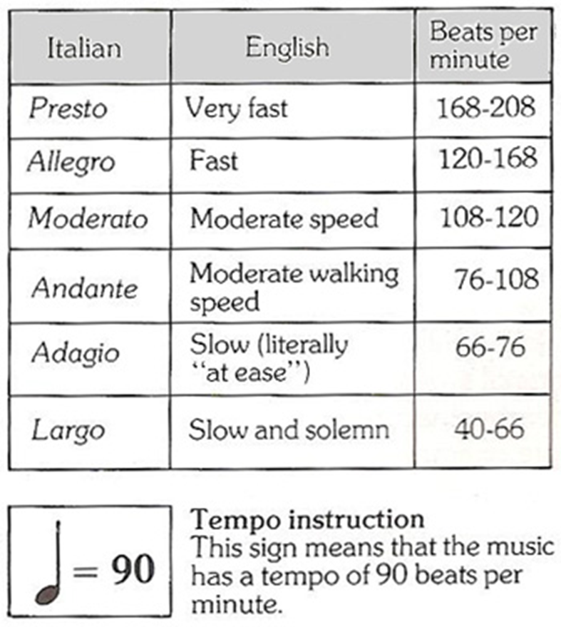
Drum & Bass, Thrash Metal
Breakbeat, Pop, House, Rock
Metal, RnB, Grooving
Hip-hop, drum step, folk
Reggae, Dub, Chillout
Very, very slow

Slide 32
Experiment
Experiment with the tempo function in Logic
See the contrasting effects tempo has upon rhythms

Slide 33
Time Signature

Slide 34
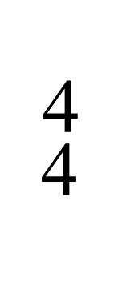
Time Signatures
Top number dictates how many notes there are in a bar
The bottom number represents the length of the notes used in a bar
This means that in a bar of 4/4 there are 4 crotchets in a bar of music

Slide 35
Time Signatures
Tell you how to interpret the music’s rhythms and the pulse of the music

Slide 36
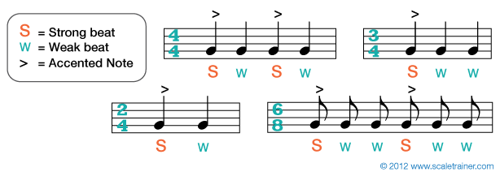
Strong and weak…
All music is created from a relationship of strong and weak beats

Slide 37
What do these time signatures means?
3 / 4
6 / 8
2 / 2
5 / 4
3 / 8

Slide 38
Final Task
Start creating possible drum/percussion tracks for your piece
You are more than welcome to start introducing melodic and harmonic ideas
Experiment with note lengths, tempo and time signature
Don’t forgot about velocity or quantize!!!

Slide 39
Task
Create a rhythm in these time signatures…
4/4
3/4
6/8
2/4
5/4
7/4

Slide 40
TOday
Different elements to add in today…
Bars / beats
Tempo
Metronome
Velocity (MIDI) – using tools and playing in
Length of notes
Quantizing
Rhythm (drums)
Looping / copying MIDI data

