Slide 1
Electrical Installation

Slide 2
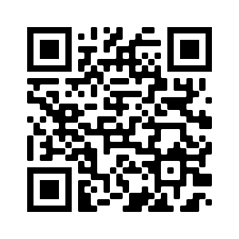
QR Code Link
Please scan this code
PADLET

Slide 3
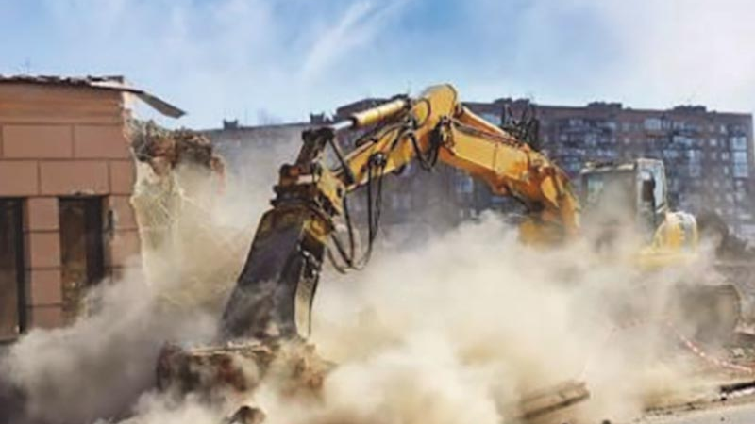
Dust and Pollutants at Work

Slide 4
Dust and Pollutants at Work
What are the main risks associated with dust and pollutants at work?
List 3 main risks and their effects on health

Slide 5
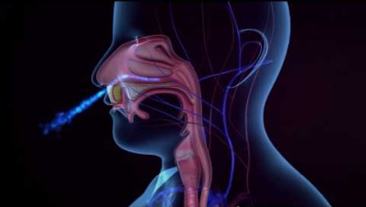
Dust and Pollutants at Work

Slide 6
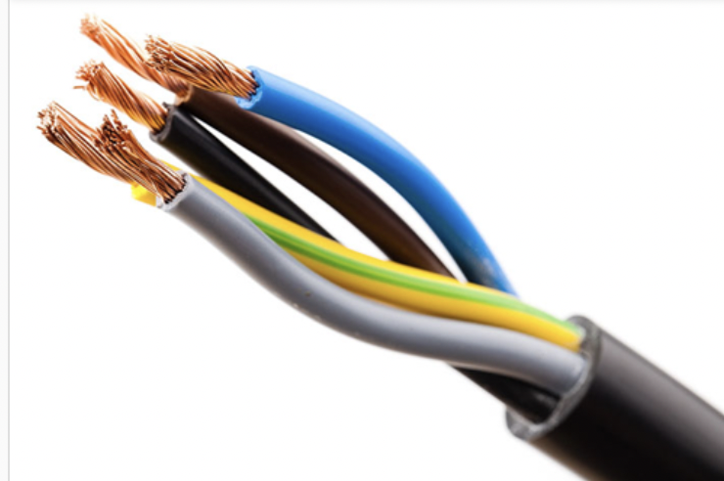
Kahoot

Slide 7
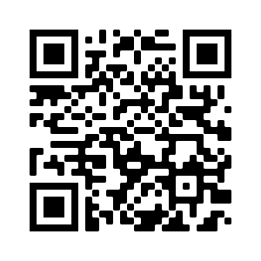
Timeline of Installation Process

