Slide 1
UAL Level 3 Extended Diploma in Creative Practice:
Welcome to
Art, Design and Communication

Slide 2
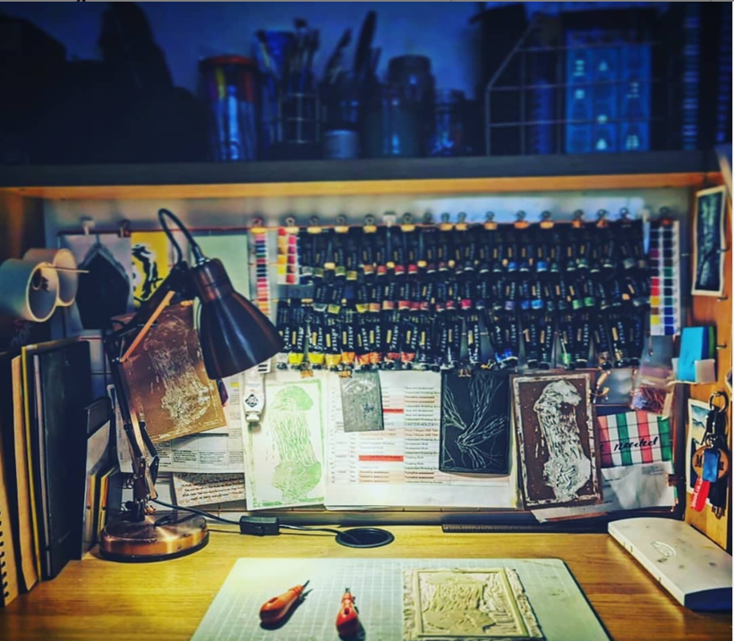
Hello there…..

Slide 3
How we will communicate with you….
College Email….

Slide 4
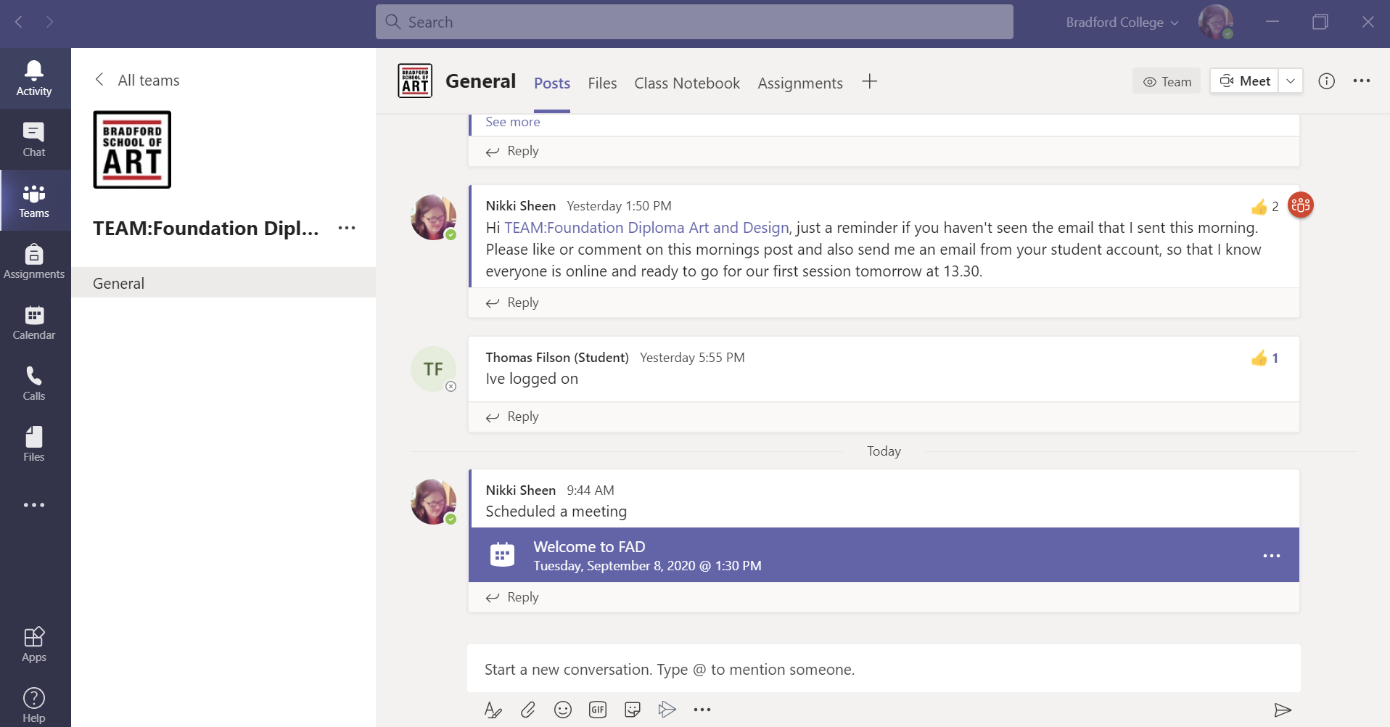
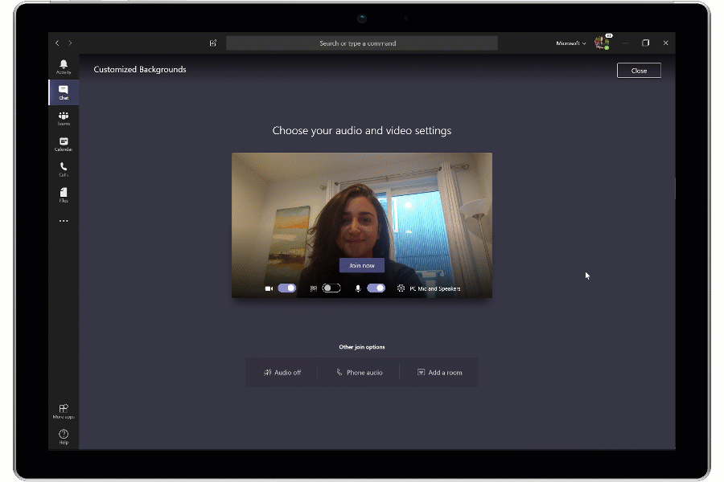
How we will communicate with you….
Microsoft Teams…..

Slide 5
(Online) Etiquette…..
1. Be respectful.
2. Be aware of strong language, all caps, and exclamation points.
3. Be careful with humour and sarcasm.
4. Yes, grammar and spelling matter.
5. Cite your sources.
6. Don’t post or share (even privately) inappropriate material.
7. Be forgiving.

Slide 6
How we will communicate with you….
Face to Face……

Slide 7
College Email and IT Systems
Access your college email and IT systems
Wifi – Instructions to access college wifi can be found at; https://learningresources.bradfordcollege.ac.uk/it-services/connecting-to-wifi/
Student Email – You can access your student email account at; https://outlook.com/bradfordcollege.ac.uk , you will find login instructions on online at; https://www.bradfordcollege.ac.uk/support/students/it-support/college-email-and-it-systems/
Student Portal - This is where you can access your timetable, update personal details and apply for a student bursary etc. To registers/access your student portal visit; https://learnerportal.bradfordcollege.ac.uk/
www.bradfordcollegesu.co.uk bradfordcollegeplus bradcollplus
Notes:
Activity – Ask students to register/access important IT systems using a phone/tablet/laptop
It is important that students know how to access student email and systems as soon as possible, further help and information can be found online at; https://www.bradfordcollege.ac.uk/support/students/it-support/college-email-and-it-systems/
Getting started
Once you have enrolled at Bradford College, you will need to login to your college email account.
To login to your college email:
1. Go to: https://outlook.com/bradfordcollege.ac.uk
2. Input your username. Your username is your 8-digit student/enrolment number, followed by @bradfordcollege.ac.uk.
Here’s an example: 12345678@bradfordcollege.ac.uk
3. Input your password. Your password is the first letter of your first name, date of birth (six digits, such as 1st September 1995 would be 01/09/95), and the first letter of your surname. Both letters should be lowercase.
Here’s an example password for Joseph Bloggs who was born on 1st September 1995, which would be 01/09/95. His password would be: j010995b
If your password isn’t working, make sure the letters are both lowercase.
Contact our Technology & Media team for help on:
01274 088411
media@bradfordcollege.ac.uk

Slide 8
Your Timetable

Slide 10
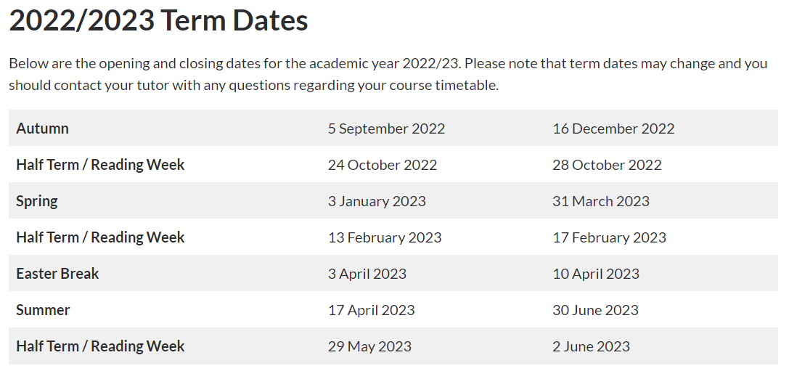

Slide 11
How the year works….
Dates (WC) | Weeks | Project
12 Sept – 11 Nov | 2-9 | Colour - Hallmark
14 Nov – 3 Feb | 10-19 | ?????????????
6 Feb- 15 May | 19-31 | ?????????????
We have moved specifications from the Applied General Diploma to the Diploma in Creative Practice: Art, Design and Communication. There are very few differences in the process you will undertake other than the units have a greater emphasis on pursuing a career in the creative industries or using your skillset within the wider working world. There are 3 Units this year. 2 Formative units and 1 Summative (FMP) UCAS points
Pass - 72
Merit - 120
Distinction - 168

Slide 12
Progression Goals UCAS / Employment
UCAS points
Pass - 72
Merit - 120
Distinction – 168
Bradford College UCAS Deadline – Mid November

Slide 13
Course Handbook…..
General Overview of the course
Course Units
Members of Staff
Will be uploaded to Teams

Slide 14
Ground Rules for your Second Year at College…..
What should they be……

Slide 15
Ready, Respectful, Safe……
Ready to Learn
Equipment / Attendance / Targets / Plans / Attitude
Respectful
Code of Conduct (Behaviour / Environment / Community)
Safe
Environment / Online / Relationships / Mental and Physical Health

Slide 17
We will put the College Specific Induction PowerPoints on Teams
Please make sure you spend some time reading through these on your own
If you have any questions about anything in these PowerPoints, please ask a member of staff.

