Slide 1
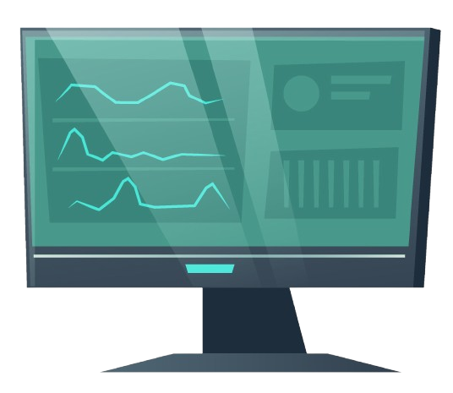
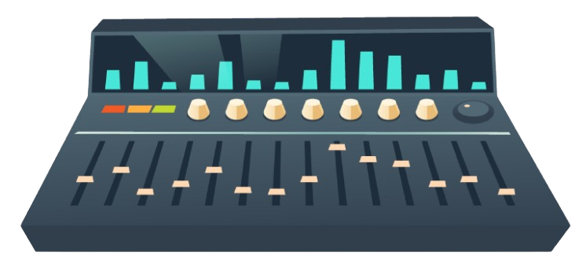
Level 3 Extended
Final Project
Cameron Rhodes

Slide 2
Why am I doing this
I want to focus on expanding the skills and knowledge I will need in my Higher Education course, Creative Music Production BA(Hons), at Huddersfield University, as this 4-year degree is in creativity and music production. I want to use what I have learned over the last 2 years but also try new tools and techniques in production to enhance my knowledge before I start my degree.

Slide 3
My Project
My Project will look at creating the intro title music for an Adventure Game called Metroid Dread. I am going to recreate the title screen theme. This relatively recent game uses less bit-crushed instruments and still holds the environmental, ‘alive’ feeling that the Metroid series has. It is one element that I would like to experiment with, perhaps touching upon the theme of ‘corruption’, where I could visit leitmotifs and melodies of other prominent tracks that sound ‘off’ or in different keys.
This will involve Researching Tools, Creating, Recording, Sampling, Mixing, Publishing, and Distribution.
I will look at utilising the skills I have gained and new music productions utilising AI Tools. I will create three versions of the track: one, I will create myself, and the second, I will use AI tools to make the tracks. I will then take the track I produced and amend it with AI tools to create a fourth track. And obtain feedback on the tracks.
I will also create additional atmospheric tracks for the game to publish the collection of tracks on music on music sites.

Slide 4
Aims & Objectives
Aims
For my final project, I will use my music production skills to create the title music for the Metroid series of games, particularly Metroid Dread. I want to redo the title screen music and make three versions. One uses the skills I have gained with tools like Ableton 12 live, but another version is created using AI-based tools – the final version will be a completely AI generated track that uses none of my expertise to make it. This will allow me to try new techniques and tools to help me in my university course.

Slide 5
Aims & Objectives
Objectives
Production
Review the current title track from Metroid Droid
Research Tools to decide on additional tools to use, especially around AI
Research health and safety and conduct a risk assessment
Liaise with the college for access to equipment
Experimenting with different production software to create tracks
Finalise tools to develop the adventure music tracks

Slide 6
Aims & Objectives
Objectives
Promotion
Research platform to use to publish tracks
Research the different social media promotion techniques
Research how to target my specific audience
Final Tracks
Mix tracks following the evaluation
Promote Publish tracks
Obtain feedback on tracks
Evaluate and Reflect on the Project

Slide 7
Resources
Access to Studio
MacBook
Ableton 12 Live
AI Tools
Mid Keyboard
Rack Synth (Korg Triton)

Slide 8
Research
I will research techniques for producing atmospheric and horror tracks in video games, leitmotifs, and ways of conveying emotion in music. I will be looking through the Korg Triton again and what its expansive library offers in hopes of finding an organic-sounding instrument. I will also look into the composer’s other works, showing evidence through articles, websites, videos, and screenshots.
With what I have proposed so far, articles and videos are the best way to learn more about this type of production. I also need to research the AI models I will be using since I am unfamiliar with how to use them.

Slide 9
Problem Solving
I know that by the time I get into the project, I will have solved the creative block I am currently having creating my tracks. I only work when I am motivated, so the lack of plans or motivation will be fixed by using the action plan I have developed.
I know that a new genre will give me problems, and in doing so, I will encounter bouts of demotivation. These are mostly mental problems, but they are still very real issues I experience – I feel that keeping contact and socialising throughout my project, updating people on it, etc, will help fight those feelings and keep me rolling.

Slide 10
Health and Safety
There won’t be many health and safety issues in this project, but I can think of a few risks that could rarely crop up when I am working:
If I am going to be plugging external things into college sockets, PAT testing would probably needed since it is unsafe to plug things in without taking safety measures.

Slide 11
Budget
I have defined my budget as follows, although I will amend it once I have evaluated the tools
Software
Landr – 15 Months Subscription £199
Sounddraw 1 Month £10
Ecrettmusic 2 Month £6
Topmedia ai-music-generator £4
Domain Registraion £12
Total £231
Iave looked at Landr for annual subscriptions; it could be much more worth it, as I will be able to use the tools in my 1st year of my university course and allows me to publish with no additional cost

Slide 12
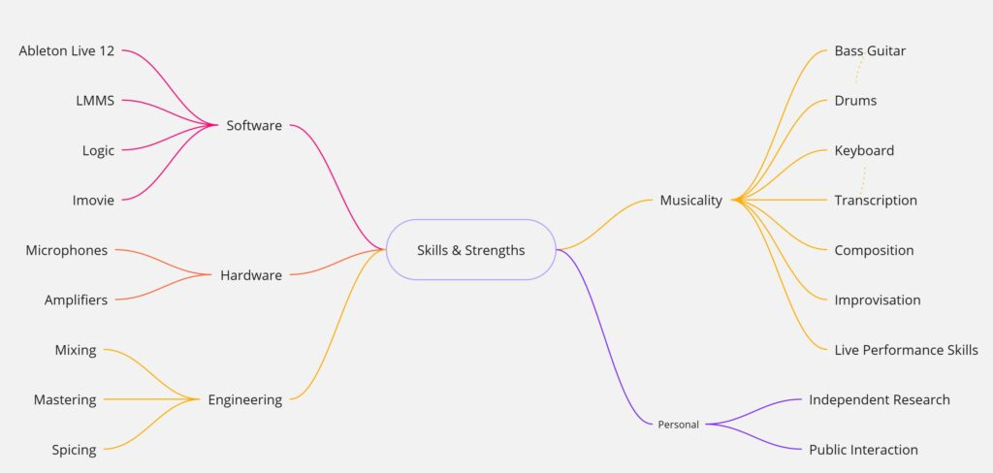
Practical Skills
Over the last 18 months, I have learnt a fair, decent array of skills. I now know that my skills primarily lie in Production, which utilises Recording, Composition, and generally working behind the scenes. This will help me create multiple versions of the same track and, in doing so, prove I have the capabilities to write my songs. I have been able to utilise a mind map and have various ways to look at my skills, but I feel it does not do it as much justice since I’ve progressed far more than single words can explain. I understand how to promote effectively as I can create both posters for offline promotion and also understand social media algorithms for the most opportune posting times to show off what I’m offering. I also have graphic design skills already; as an artist, I won’t have to rely on someone else for this.

Slide 13
Thank You

