Slide 1
Handbook Template
UAL Diploma in Performing and Production Arts

Slide 2
COVER PAGE
Name – JANE DOE
Course – PERFORMING AND PRODUCTION ARTS
Level - 3
Project Title – PROJECT 2

Slide 3
Contents Page
Many of these slides will have multiple slides if that is so label them “Pages 2 – 4” or “Pages 5 & 6”
Page ? - Budgeting Information
Page ? - Budgeting plan
Page ? - Set ideas & designs
Page ? - Costume ideas & designs
Page ? - Lighting Ideas & designs
Page ? - Sound Ideas & designs
Page ? - Marketing Ideas & designs
Page ? - Feedback - Tutor obs & peer obs / direction / verbal feedback
Page ? - My reflections
Page ? - Evaluation
Page ? - Viva
Page ? - Reference list/bibliography
(Harvard reference)
Page ? - Introduction
Page ? - Proposal
Page ? - Context
Page ? – Research
Page ? - How I have used my research
Page ? - Audition Process
Page ? - Rehearsal pictures
Page ? - Rehearsal videos
Page ? - Minutes from production meetings
Page ? - Rehearsal Notes
Page ? - Script analysis
Page ? - Risk assessments

Slide 4
INTRODUCTION (Project Title)
What is this project? A screen performance, a stage performance, a musical, a live theatre performance?
This project is a live theatre performance, which means
What have I been asked to do? (What is my role Production and performance?)
My role for the production side of the project was me focusing on Lighting, Lighting is one of the key parts of the performance, as it helps to tell the story of what is going on, I first taught the basic of the lighting board, then carried out my own personal research about it too. After trying to learn the basics of the board I then propose the idea of moving certain light angles to help the audience to not look into a black scene. Once that was done we where behind schedule for recoding all the cues. On day one of recording cues which was a Monday I worked on scene 1 to scene 20, which I hoped to get to on the Thursday I was in. Day two I programmed cues 20 to 52 this took abit of time to record as we had rehearsal going on Which took abit of my time. On day 3 I programmed 52 to 85 cues of the musi c scene of honour, this music scene was the most painful and abit joyful at the same time. It was painful because I had to update cues, record more cues in-between other cues. It was joyful at the same time because I learned how to operate the moving lights into a sequence, this helped me a lot as I only needed to press the go button the rest of the cues would go after a certain wait time, that I would of given it, finally on day 4 I finished of all 102 cues for the performance.
My other role that was given was sound, Sound is also a key part of the performance, as it would also tell the story of what is going on in the performance. In-between the rehearsals I would go over the different sound cues and note them on the script, when noting the different sound cues in the performance helps a lot as it tell when to turn on a certain track and to play it. Each track/ music would need to be on a certain level of volume this is because there is some scenes of the performance where the actors would talk over the music, or their a dramatic scene like honour.
Who is my audience? (who will see this performance?)
Our audience that will be spectating our live theatre performance will be many people, what ever age we had teachers, students, parents, Visitors.
What skills am I bringing to this production? (are they skills learnt from previous performances? Why am I bringing these skills? Why are they important?)
The skills that iw ill be bring to this production is my diligent to learn about what I need to learn about, By me being diligent i bring 100% of my brain power, I am bringing this skill as it would keep me concentrated to do my roles in the performance, This is important because it makes me a realisable person, a trust worthy person. Another skill that I would bring to the production is that I am creative, this helps the performance as we need to go over the different set design and lighting designs in the performance, the skill of being creative is important as it help me to think o f what lights I will be using for a cue.

Slide 5
PROPOSAL
Your proposal goes here.
Please annotate your proposal and tell us why you made the comments, statements or planning choices you have made.

Slide 6
CONTEXT
NOTE: PLEASE ENSURE YOU REFERENCE EVERY PLACE YOU FIND OR USE ANY IMAGE/VIDEO/OR PIECE OF RESEARCH INFORMATION
Give us a brief synopsis of the plot.
A Christmas carol tell the story of a rich, grumpy man called Ebenezer scrooge who hates Christmas, scrooge was described as a mean-sprited selfish old man. One cold Christmas eve scrooge is unkind to the people around him, he refuses to give to charity. Scrooge gets invited to spend Christmas with his nephew, freed but rudely scrooge says no. When scrooge gets home, he is visited by his old friend Jacob Marley and then 3 other ghosts. The ghosts take scrooge on a joinery through his past. Then gets shown his clerk, bob crotchet family especially his son tiny Tim who is very ill but full of spirit. The ghost then takes him to see his nephew Fred’s Christmas celebrations - which he had been invited to, but rebuffed. Finally, The Ghost of Christmas Future terrifies Scrooge by showing him visions of his own death…
The ghosts’ journey through time teaches Scrooge the error of his ways. When he wakes up on Christmas Day he is full of excitement, and buys the biggest turkey in the shop for the Cratchit family before spending the day with his nephew, full of the joys of Christmas.
What are some of the circumstances that occur in this script/story/production?
One circumstance that many occur during the story is that the audience sees all of the poor family's grieving, individuals hungry/ children cant afford food t eat. We see if your not a high-class family, those family's cant eat a big enough turkey, we can see the consequences of not being rich in the Victorian era leading people to be sick because people worked in the mills/factorys.
Where is this project set? What time period/year is it set?
The performance a Christmas carol is set in 1840s during the hungry forties, a period of that involved high unemployment, In 1840s London didn’t have no welfare status, no national heal services or environment laws, Which made it hard for people to live in those days.
What are the surroundings? Is it in a home/school/hospital/prison etc?
the surrounding environment of the Victorian era was Cities became crowded and dirty, with smog-filled air and polluted rivers. At the same time, however, the Victorian era also saw the rise of beautiful and ornate architecture, public parks, and gardens. During the Victorian era, poverty was a widespread problem in England. Industrialization had led to the growth of cities, and many people had migrated from the countryside to work in factories and mills. However, the rapid growth of industry had not been matched by an increase in social services, and as a result, many people lived in poverty. The working classes, in particular, often lived in overcrowded and squalid conditions, with little access to education, healthcare, or other necessities. Moreover, the lack of labor protections meant that many workers were exploited and had to work long hours for low wages. Despite these challenges, however, many poor people during the Victorian era were able to improve their circumstances through hard work and determination.
What conditions do the characters live in/experience? What conditions did the writer experience?
The conditions that many character live in are poor, cramped and crowded apartments the inner cites often inadequate heating, lighting and sanitation. Children are poorly clothed, thin and hungry, they huddle together In the cold, dark room and are described as “ dirty ragged and abject” the poor people are described as victims of social and economic inequality.
What sort of situations do the characters face
What environment do the characters experience? How does it relate to the writers environment?
The environment the characters experience is how they grew up in the Victorian era. Such as the character tiny tim, who live in a small house with out any help from the government on how he going to die, if he doesn’t get the aid he needs. It hard for tiny tim to grow up in the Victorian era as boys like him won't fit in due to the other boys will bully him

Slide 7
NOTE: PLEASE ENSURE YOU REFERENCE EVERY PLACE YOU FIND OR USE ANY IMAGE/VIDEO/OR PIECE OF RESEARCH INFORMATION
CONTEXT
What is the background of the play/ Project/ Script? What is the background of the writer?
If you are performing a singular scene or monologue, what happens before and after this scene/monologue?
Scrooge wakes up, goes to the windows see a boy and ask him what the day is. Then the boy replies with its Christmas Sir, scrooge get excited and wanted the boy to get a big turkey
What is the climate that the project is set?
What atmosphere is created by the writer?
Charles dickens creates atmosphere as cold and grey this is sighted in weather and inside of scrooges heart . External heat and cold had little influenced on scrooge
How does the writer create ambience? What language does he use to show this? Is it in the stage directions?
What is the mood of the play/scene/monologue/project? How is this shown?
What are the relationships between the characters in the scene?

Slide 8
NOTE: PLEASE ENSURE YOU REFERENCE EVERY PLACE YOU FIND OR USE ANY IMAGE/VIDEO/OR PIECE OF RESEARCH INFORMATION
CONTEXT
What themes does this scene/monologue/play/project address?
What in the overall topic that the play/scene/project is focused on?
The overall topic that the project
What social factors occurred during the time project is set?
One social factor that may occur during the project is that someone may get ill and might not turn up on the project day, this make will slows down the project as someone else needs to take the role of that person who's ill.
What social factors occurred when the project was written?
What economical factors occurred during the time the project is set? What economical Factors occurred when the project was written?
What political factors occurred during the time the project is set? What political factors occurred when the project was written?

Slide 9
TYPES OF RESEARCH
NOTE: PLEASE ENSURE YOU REFERENCE EVERY PLACE YOU FIND OR USE ANY IMAGE/VIDEO/OR PIECE OF RESEARCH INFORMATION
PRIMARY RESEARCH – First-hand evidence giving you direct access to your research topic. This could be evidenced using…
SECONDARY RESEARCH - Second-hand information that analyzes, describes, or evaluates primary sources and could be evidenced using…
TERTIARY SOURCES - Sources that identify, index, or consolidate primary and secondary sources and can be evidenced using…
Statistical results
Newspapers
Magazines
Letters of diary entries
Photographs
Audio clips
Speeches
Interviews
Books
Journal articles
Blog posts
Textbooks
Documentaries
Encyclopaedias
Dictionaries
Almanacs
Bibliographies
Indexes

Slide 10
NOTE: PLEASE ENSURE YOU REFERENCE EVERY PLACE YOU FIND OR USE ANY IMAGE/VIDEO/OR PIECE OF RESEARCH INFORMATION
RESEARCH
Charles John Huffman Dickens was an English writer and social critic. He created some of the worlds best known fictional characters and regarded by many as greatest novelist of the Victorian Era, Charles dickens has made many books such as, the famous Christmas carol, Oliver twist.
Charles john Huffman dickens was born on 7th of February 1812, and sadly passed away in 1870 in his country home gads hill place. Charles perhaps his widely known as the author of a Christmas carol, Scrooge takes on a journey to explore what Christmas is really is, going on a trip with many of the sprites, showing him the what Christmas is really true.
The early life of Charles dickens was blighted by true poverty, Confide as a small boy, Charles dickens first work in a boot factory. When Charles was born the family move to Bloomsbury to London and then Chatham in Kent where dickens spent much of his childhood. In 1821 dickens went to Giles academy in Chatham for about one year. Later that year he was twelve and he attended the wellington house academy in London. At the age of fifteen, the family have problems that required him to return to work. And so, his last “schooling “was again. Later leaving school again. He was self-teaching himself, Charles loved to read and write.
Charles dickens always dreamt of being an actor, Charles once obtained a acting audition at Covent harden in the spring time of 1832. He never attended the audition due to the bad cold. But though dickens may have missed his chance of becoming a professional actor however he never lost his loving of performing.

Slide 11
HOW HAVE I USED MY RESEARCH?
In what way have you used your research to inform your choices for the development of your character.
How have you applied your research towards the development of the overall project?
The research I have carried out has supported my overall understanding of creating an orthotic and realistic production of a Christmas carol.
In what way have you used your research to develop your skills in performing arts?
For this project I have chosen to take a more technical role rather a performing role, I am not keen in performing/ acting however I like production role of how things work in a production.

Slide 12
AUDITION PROCESS
What material did you use for your Audition?
The material I used to audition was a monologue.
(Monologue/song/dance etc…)
Why did you choose this material?
I choose this material as I get to show my best, it forces me to read lines to get used to it in the future, Ill learn more about my character.
What do you know about the character?]
My character is a child, who is poor but joyful. My character is a character you would see in the background doing little stuff in the play.
What do you know about the material’s origins (the whole play/ song/ song writers etc…)
The materials origin was a Christmas carol, where we all had to pick a big script, medium script or a small script. I picked up the small script as it was most to choose from

Slide 14
REHEARSAL PICTURES
Insert pictures from the rehearsals…
Annotate some notes on what is happening in the image and how it helped you develop.

Slide 15
REHEARSAL VIDEOS
Insert videos from the rehearsals…
Annotate some notes on what is happening in the image and how it helped you develop.

Slide 16
MINUTES FROM PRODUCTION MEETINGS
As a company we didn’t really think about the production meetings that we would have had, which may make us behind scheduled If we had production meetings we would of thought of things like props such as the carriage.
Write some notes from your production meeting/s
Level of the sound will be lowered for the audience to hear performers when the music is played.
Lighting will be rigged and angled to the right places on a Thursday.
The horse carriage will be removed from the production and be replaced with actors using umbrellas as wheels
What was discussed?
The lights will be angled on a Thursday and will be in the right places
The backdrop – window will be secured
All of the production cues will be done before Thursday,
Monday get cues 1 – 20 done, Tuesday get cues 20 - 30, Wednesday get cues 30 – how many cues.
What ideas did you put forward? Why?
The ideas I put forward was the lights been angled, we decided to do this on a Thursday.
Using the moving robos lights
Did you agree with all the ideas? If not why?
I agree with all of these ideas as 1 all lights will be in the right spots for the right times.#
Using the robos will make the scenes to look cool, and professional
How would you have done things differently?
I would have had a production meeting every week for the production, this ensures everything is up to date

Slide 17
SCRIPT ANALYSIS
If you have been given a script this is the space for analysing that script.
Include images and annotate.
Consider what the writer is trying to tell the audience?
Consider what the character is feeling?
Consider what the characters objectives (wants and needs) in the scene are?
Discuss the relationships of the characters in the scene?
Discuss what happens in the scene, where does it lead?

Slide 18
RISK ASSESSMENTS
RISK | SOLUTION
A electrical fault may acquire during the production. | Make sure water or any liquid is next to any electricals.
Light falling down. | May sure lights are secured
Background dropping on someone | Make sure all back drops are secured at all times.

Slide 19
BUDGETING INFORMATION
Include examples of budgets of other shows that are similar…
Annotate on how this could be applied to our production.
NOTE: PLEASE ENSURE YOU REFERENCE EVERY PLACE YOU FIND OR USE ANY IMAGE/VIDEO/OR PIECE OF RESEARCH INFORMATION

Slide 20
BUDGETING PLAN

Slide 21
SET IDEAS & DESIGNS
A set design is on of most important part of a production, it once of the things that will be discussed first. The set design helps telling the audience the story. The set design will influence how the actors think about their key part and move around the stage.
Different designs:
Proscenium arch is one most traditional shape for a stage , the audience will be seated facing one side of the stage, separated from each one other. This kind of traditional shape offers the designers the possibility to create a very big set design, Like the inside of a whole house although they can choose to use a simple design with a bare stage and a backdrop
Thrust is when the stage extends out into the audience, so they are siting on three sides of the stage. Many theatres in Shakespeare time were built this way. The designer will think about the many set designs and how they will be used in a thrust.
NOTE: PLEASE ENSURE YOU REFERENCE EVERY PLACE YOU FIND OR USE ANY IMAGE/VIDEO/OR PIECE OF RESEARCH INFORMATION

Slide 22
LIGHTING IDEAS & DESIGNS
Lighting is one of the key parts of a production, it communicates the mood and atmosphere and help in tell the actual story.
All theatres need lighting to illuminate the stage. Only outdoor theatres , such as globes uses natural daylights, However lighting can do so much more than showing the audience what is going in the production. Lighting help tell the story by communicating the mood and atmosphere to the audience. Lighting can also make a entirely new and strange world for the audience to experience.
Role:
- Light designer decides on what will exactly know how the lighting should be used in a production. After reading the scrip a light designer will talk to the director and other management about how lighting can strengthen their vision.
All technical effects, Can be programmed in advance by a computer, so all the operator has to do is press a button “ go “ for that the next cue can play. Every light on the stage will have a number which will correspond to numbered channels on a lighting deck, often at the back of the theatre. The lighting operator can turn all the lights on and off and putting of many effects via sliders on the deck.
The lighting department do a rig check every night before a show to make sure every single light is working right, including the one backstage that the audience cant see, But the actors and other members of the team will see, This is because everyone who is apart of the backstage needs to see what they are doing. During a performance the dep
NOTE: PLEASE ENSURE YOU REFERENCE EVERY PLACE YOU FIND OR USE ANY IMAGE/VIDEO/OR PIECE OF RESEARCH INFORMATION

Slide 23
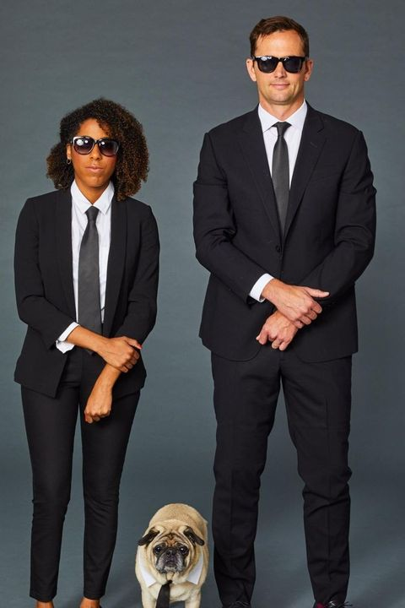
COSTUME IDEAS & DESIGNS
Costumes help the designers the create the world around the production, showing the audience when and where it is set. the designers carefully chose the right outfits, this helps with the story telling towards the audience about their characters, revealing little of all sorts of things about age, jobs, relationship with other characters and position in society.
Old or modern?
Costumes are part of the directors and designers vision for the play and are a way exploring/highlights certain issues in the play. If a play is set in the past, the designers need to decide whether they want the costumes to be from a particular historical period. Traditionally, plays set in the past set in present day or a mixture of costumes from all different period. It will all depend on the message they want the clothes to convey if a designer decides to use a authentic period costumes, this can tun the play into a fascinating and believable portrait of a particular time.
NOTE: PLEASE ENSURE YOU REFERENCE EVERY PLACE YOU FIND OR USE ANY IMAGE/VIDEO/OR PIECE OF RESEARCH INFORMATION

Slide 24
SOUND IDEAS & DESIGNS
Sound, and sound effects create a sense of place for the audience in the production. When combined with a set, costumes and lighting, the right sounds bring the play to life. Sounds play a really important part in creating the play world. Speakers are positioned all around the stage to make the noises to audience hear as three dimensional and believable as possible. If actors hear a sound coming from a television, there will be a speaker hidden inside it to amplify the tv sound. Music is vert important to the sound of a play. It will set the mood of the production and it will tell the audience the story, for example we have the Christmas carol to do. So we get Christmas songs and effects, The music in the production will tell the audience its about Christmas.
NOTE: PLEASE ENSURE YOU REFERENCE EVERY PLACE YOU FIND OR USE ANY IMAGE/VIDEO/OR PIECE OF RESEARCH INFORMATION

Slide 25
MARKETING IDEAS & DESIGNS
As soon as a production is chosen for the performance schedule, marketing and press people will be informed to start thinking about what sort of audience. People in charge of marketing will put posters in a public place like bus stops or trains or colleges. When seeing a poster about a production visually effect way of telling people about a play. The image on the poster will have been chosen to tell people something about the play instantly and also to convey the overall mood. The image will be discussed and agreed with the director.
As well creating a great poster, College will be emailing people who have seen one of the plays before and telling them about new shows that will be happing. College will make sure the play is featured in the college newspaper, magazines websites and blogs.
NOTE: PLEASE ENSURE YOU REFERENCE EVERY PLACE YOU FIND OR USE ANY IMAGE/VIDEO/OR PIECE OF RESEARCH INFORMATION

Slide 26
FEEDBACK – TUTOR & PEER OBS/DIRECTION/VERBAL FEEDBACK
Include images of your Tutor/peer observations
Annotate and reflect on the feedback and development points.
Reflect in more detail on the targets set and how you plan to achieve them.

Slide 27
MY REFLECTIONS – Week 1
What did I learn?
What went well?
What could I have done better?
How will you use this?
How is this going to help you in the future?
How has your research influenced your work today?

Slide 28
MY REFLECTIONS – Week 2
What did I learn?
What went well?
What could I have done better?
How will you use this?
How is this going to help you in the future?
How has your research influenced your work today?

Slide 29
MY REFLECTIONS – Week 3
What did I learn?
What went well?
What could I have done better?
How will you use this?
How is this going to help you in the future?
How has your research influenced your work today?

Slide 30
MY REFLECTIONS – Week 4
What did I learn?
What went well?
What could I have done better?
How will you use this?
How is this going to help you in the future?
How has your research influenced your work today?

Slide 31
MY REFLECTIONS – Week 5
What did I learn?
What went well?
What could I have done better?
How will you use this?
How is this going to help you in the future?
How has your research influenced your work today?
Add more weeks if needed or split into individual days if preferred.

Slide 32
EVALUATION
What progress has been made?
What have you learnt from the project
What skills have you developed?
Were the desired project objectives achieved?
Is every team member satisfied with the result?
What could have been done better?
What would you do differently next time?
Set smart targets for the next project

Slide 33
VIVA
Your viva evaluation is a change to evaluate the overall process in a verbal capacity as a group.
You will be given a range of questions to discuss on camera to contribute towards your overall digital submission.
This always takes place at the end of the production process.
Add an image of your viva or copy and paste your questions and answers here.

Slide 34
REFERENCE LIST/BIBLIOGRAPHY
One slide list of links to research evidence/websites/books/videos etc...
Labelled like this...
Book: Martin, K. (2019) The queen of hearts. New York: Berkley.
Blogs: Butterfield, L. (2019) ‘Research spotlight: I want to get high enough up the chain to pull others over the wall with me’, Oxford science blog, 1 November. Available at: http://www.ox.ac.uk/news/science-blog (Accessed 5 November 2019).
Website: Raiford, T. (2015) 20 amazing dog breeds from England. Available at https://puppytoob.com/ (Accessed: 6 November 2019).
Links to Harvard Referencing guides/support...
Guide to referencing using the Harvard system (bradford.ac.uk)
FREE Harvard Referencing Generator & Guide | Cite This For Me
FREE Citation Machine: Accurate & Easy-to-Use | Cite This For Me

Slide 35
THE FOLLOWING SLIDES CONTAIN…
EXTRA TIPS FOR REFLECTIVE WRITING
SOME HELPFUL BOOKS TO READ
THE GRADING MATRIX, TO HELP YOU INCLUDE THE CORRECT ELEMENTS
SOME IMPORTANT INFORMATION FOR ANY FURTHER GUIDANCE.

Slide 36
FURTHER GUIDANCE - Reflective Writing
‘It is not sufficient to have an experience in order to learn. Without reflecting on this experience it may quickly be forgotten, or its learning potential lost.’ (Gibbs, 1988, p9)

Slide 37
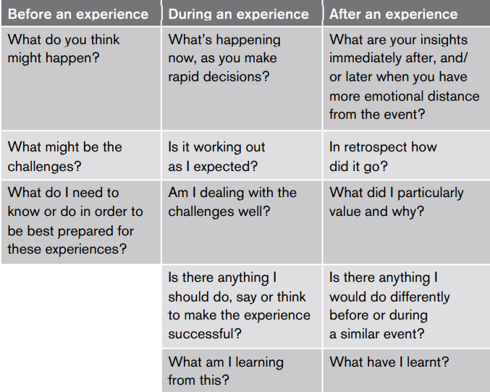
Reflection before, during and after a learning process (Schön, 1983)

Slide 38
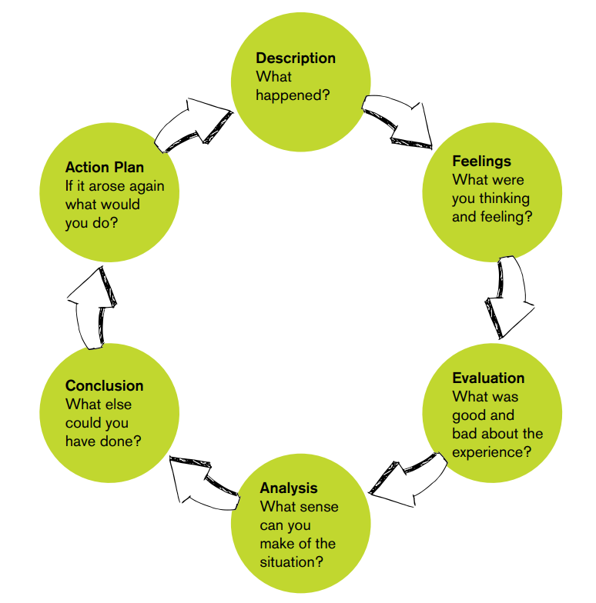

Slide 39
Scrapbook Guidance – Hints and suggestions
1) All scrapbooks should be submitted in PowerPoint format. If you would like to use include drawings, sketches etc then please photograph these and embed them into your scrapbooks.

Slide 40
Scrapbook Guidance – Hints and suggestions
2) You must follow Harvard Referencing processes and include this in your all of your submissions. This is an essential requirement at this level.

Slide 41
Scrapbook Guidance – Hints and suggestions
3) Meet all deadlines – Late submission without a pre-arranged extension will result in your not receiving feedback and simply a grade. Uncommunicated failure to submit your work may result in the withdrawal from your course.

Slide 42
Scrapbook Guidance – Hints and suggestions
4) Plagiarism – If work is expected to be plagiarised, you will be taken through the disciplinary process which may result in your losing your place on the course.

Slide 43
Suggested Reading
An Actor Prepares by Constantin Stanislavski
Stanislavski: An Introduction- Jean Benedetti
Impro by Keith Johnstone
Plays One- John Godber

Slide 44
True of False by David Mamet
Things I Know to be True- Andrew Bovell
The Complete Brecht Toolkit- Stephen Unwin
Theatre Games – Clive Barker

Slide 45
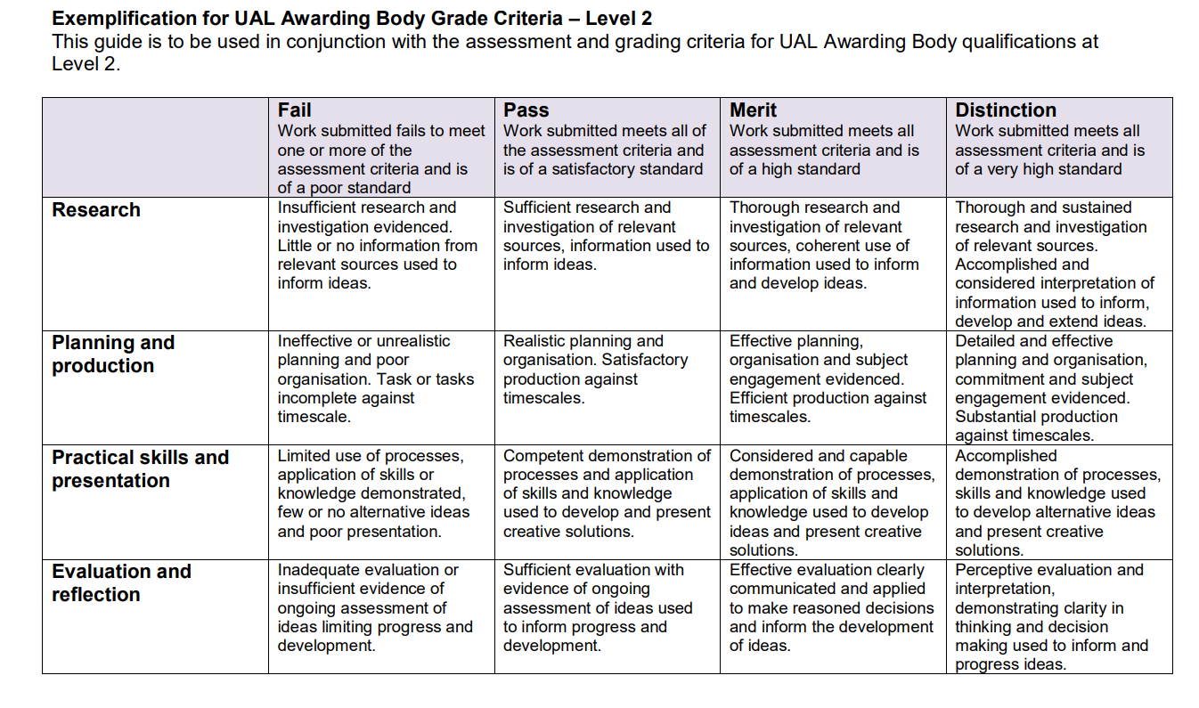

Slide 46
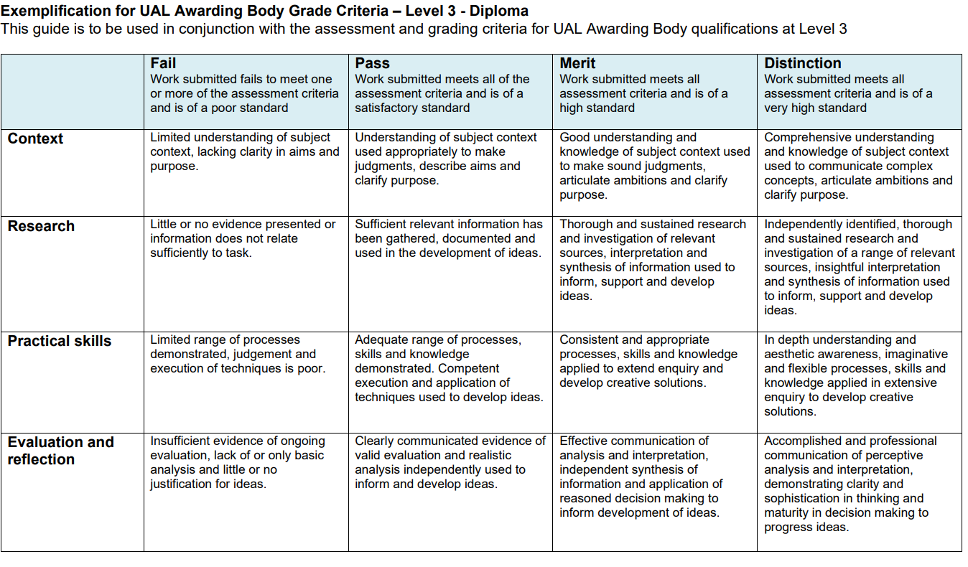

Slide 47
Submit your scrapbook on Monday 27th September for feedback to s.sutton@bradfordcollege.ac.uk and s.hindle@bradfordcollege.ac.uk
Please note – we are looking at your work in progress, we are not expecting perfection at this stage.
Please direct all scrapbook questions to s.hindle@bradfordcollege.ac.uk
or
s.sutton@bradfordcollege.ac.uk
Alternatively contact us on Teams – Sara Sutton or Steph Hindle

