Slide 1
Handbook Template
UAL Diploma in Performing and Production Arts

Slide 2
COVER PAGE
Name – JANE DOE
Course – PERFORMING AND PRODUCTION ARTS
Level - 3
Project Title – PROJECT 1

Slide 3
Contents Page
Many of these slides will have multiple slides if that is so label them “Pages 2 – 4” or “Pages 5 & 6”
Page ? - Budgeting Information
Page ? - Budgeting plan
Page ? - Set ideas & designs
Page ? - Costume ideas & designs
Page ? - Lighting Ideas & designs
Page ? - Sound Ideas & designs
Page ? - Marketing Ideas & designs
Page ? - Feedback - Tutor obs & peer obs / direction / verbal feedback
Page ? - My reflections
Page ? - Evaluation
Page ? - Viva
Page ? - Reference list/bibliography
(Harvard reference)
Page ? - Introduction
Page ? - Proposal
Page ? - Context
Page ? - Research
Page ? - How I have used my research
Page ? - Audition Process
Page ? - Rehearsal pictures
Page ? - Rehearsal videos
Page ? - Minutes from production meetings
Page ? - Rehearsal Notes
Page ? - Script analysis
Page ? - Teams discussions with team members
Page ? - Risk assessments

Slide 4
INTRODUCTION (Project Title)
What is this project? A screen performance, a stage performance, a musical, a live theatre performance?
The project was a stage performance, where we performed Infront of an audience.
What have I been asked to do? (What is my role Production and performance?)
If it is a project for an external company, who is the client? (Is it Dance United, Screen Yorkshire or Hallmark?)
Hallmark cards is a external company who specialise with making comedic cards for special occasions such as holidays, birthdays and many more.
They purpose is to make their cards humours and make their audience laugh, Hallmark cards audience is all people who enjoy laughing, those who enjoy having to read that they are " old "
Who is my audience? (who will see this performance?)
My audience that will be seeing the performance will be other students from many of the courses in the lister building.

Slide 5
PROPOSAL
Your proposal goes here.
Please annotate your proposal and tell us why you made the comments, statements or planning choices you have made.

Slide 6
CONTEXT
Give us a brief synopsis of the plot.
The production starts with many sketches that was related to humour, After the sketches that we did we moved on the main peace of the production which was called The teachers' lounge, the teachers' lounge was a story about the different stereotypical types of teachers on how they act in their teachers' staff room.
What are some of the circumstances that occur in this script/story/production? One circumstance that may occur in the production, is what if someone gets ill on the day of the production, so we would need people to fill in for them.
Where is this project set? What time period/year is it set?
The Production will be set in the modern day, the year will be early 2022
What are the surroundings? Is it in a home/school/hospital/prison etc?
In the surrounding areas in the project was a sofa, chairs, bean bags, tables, cups
What conditions do the characters live in/experience? What conditions did the writer experience?
The conditions that the characters: The English Pregent teacher,
What sort of situations do the characters face? What are the current state of affairs in the plot?
The English teacher was pregnant , which impacted many things such as how angry she was about everything.
What environment do the characters experience? How does it relate to the writers environment?

Slide 7
CONTEXT
What is the mood of the play/scene/monologue/project? How is this shown?
The mood in the production was Fulfilment, of how the acters acted at the end of the play, I know this because at the end of the play people were happy and relieved that the play is finish.
What are the relationships between the characters in the scene? There are many relationships between the teachers, they all are friends, they work well together, they are all supporting to each other.

Slide 8
CONTEXT
What themes does this play/project address?
One key theme that we did was when everyone is in a rushing/late to get on to their train.
What in the overall topic that the play/scene/project is focused on?
The project was focused on lateness, how the different characters acted as been in a late/rush
What social factors occurred during the time project is set?
One social factor that occurred during the time of the project was when the H.M the queen died.

Slide 9
RESEARCH
Hallmark cards is a company that specialises cards with a comedic title and make special cards for the special holidays

Slide 10
SECONDARY RESEARCH - Second-hand information that analyzes, describes, or evaluates primary sources and could be evidenced using…
RESEARCH
Books
Journal articles
Blog posts
Textbooks
Documentaries

Slide 11
TERTIARY SOURCES - Sources that identify, index, or consolidate primary and secondary sources and can be evidenced using…
RESEARCH
Encyclopaedias
Dictionaries
Almanacs
Bibliographies
Indexes

Slide 12
HOW HAVE I USED MY RESEARCH?

Slide 13
AUDITION PROCESS

Slide 14
REHEARSAL PICTURES

Slide 15
REHEARSAL VIDEOS

Slide 16
MINUTES FROM PRODUCTION MEETINGS

Slide 17
REHEARSAL NOTES

Slide 18
SCRIPT ANALYSIS

Slide 19
TEAMS MEETING NOTES

Slide 20
RISK ASSESSMENTS

Slide 21
BUDGETING INFORMATION

Slide 22
BUDGETING PLAN

Slide 23
SET IDEAS & DESIGNS

Slide 24
COSTUME IDEAS & DESIGNS

Slide 25
LIGHTING IDEAS & DESIGNS

Slide 26
SOUND IDEAS & DESIGNS

Slide 27
MARKETING IDEAS & DESIGNS

Slide 28
FEEDBACK – TUTOR & PEER OBS/DIRECTION/VERBAL FEEDBACK

Slide 29
MY REFLECTIONS – Week 1
What did I learn?
What went well?
What could I have done better?
How will you use this?
How is this going to help you in the future?
How has your research influenced your work today?

Slide 30
MY REFLECTIONS – Week 2
What did I learn?
What went well?
What could I have done better?
What are the long-term implications?

Slide 31
MY REFLECTIONS – Week 3
What did I learn?
What went well?
What could I have done better?
What are the long-term implications?

Slide 32
MY REFLECTIONS – Week 4
What did I learn?
What went well?
What could I have done better?
What are the long-term implications?

Slide 33
MY REFLECTIONS – Week 5
What did I learn?
What went well?
What could I have done better?
What are the long-term implications?
Add more weeks if needed or split into individual days if preferred.

Slide 34
EVALUATION
What progress has been made?
What have you learnt from the project
What skills have you developed?
Were the desired project objectives achieved?
Is every team member satisfied with the result?
What could have been done better?
What would you do differently next time?
Set smart targets for the next project

Slide 35
VIVA
Your viva evaluation is a change to evaluate the overall process in a verbal capacity as a group.
You will be given a range of questions to discuss on camera to contribute towards your overall digital submission.
This always takes place at the end of the production process.

Slide 36
REFERENCE LIST/BIBLIOGRAPHY
One slide list of links to research evidence/websites/books/videos etc...
Labelled like this...
Book: Martin, K. (2019) The queen of hearts. New York: Berkley.
Blogs: Butterfield, L. (2019) ‘Research spotlight: I want to get high enough up the chain to pull others over the wall with me’, Oxford science blog, 1 November. Available at: http://www.ox.ac.uk/news/science-blog (Accessed 5 November 2019).
Website: Raiford, T. (2015) 20 amazing dog breeds from England. Available at https://puppytoob.com/ (Accessed: 6 November 2019).
Links to Harvard Referencing guides/support...
Guide to referencing using the Harvard system (bradford.ac.uk)
FREE Harvard Referencing Generator & Guide | Cite This For Me
FREE Citation Machine: Accurate & Easy-to-Use | Cite This For Me

Slide 37
FURTHER GUIDANCE - Reflective Writing
‘It is not sufficient to have an experience in order to learn. Without reflecting on this experience it may quickly be forgotten, or its learning potential lost.’ (Gibbs, 1988, p9)

Slide 38
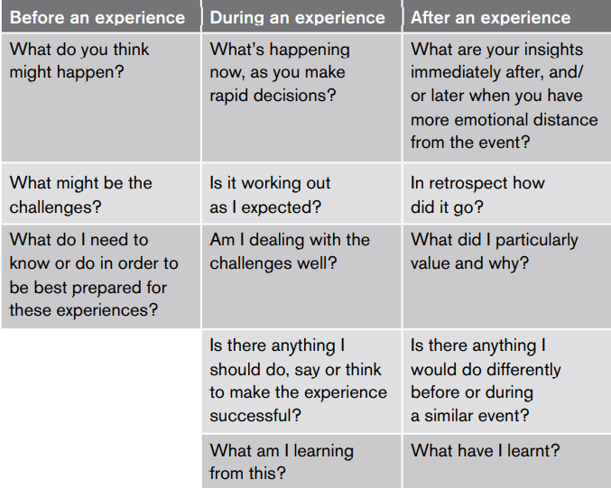
Reflection before, during and after a learning process (Schön, 1983)

Slide 39
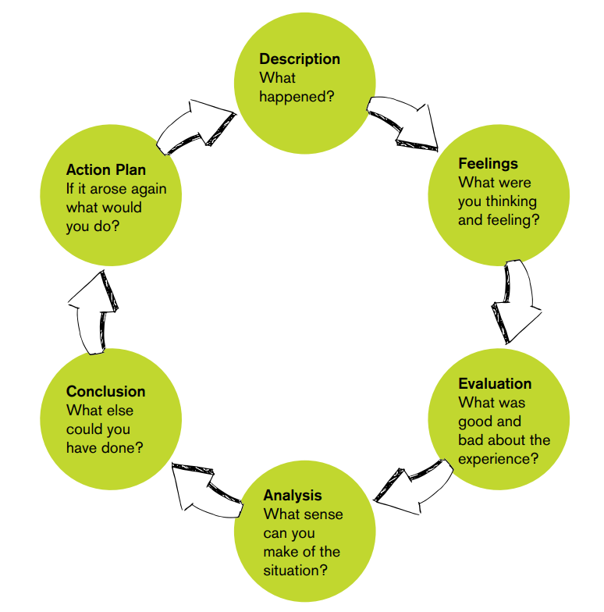

Slide 40
Scrapbook Guidance – Hints and suggestions
1) All scrapbooks should be submitted in PowerPoint format. If you would like to use include drawings, sketches etc then please photograph these and embed them into your scrapbooks.

Slide 41
Scrapbook Guidance – Hints and suggestions
2) You must follow Harvard Referencing processes and include this in your all of your submissions. This is an essential requirement at this level.

Slide 42
Scrapbook Guidance – Hints and suggestions
3) Meet all deadlines – Late submission without a pre-arranged extension will result in your not receiving feedback and simply a grade. Uncommunicated failure to submit your work may result in the withdrawal from your course.

Slide 43
Scrapbook Guidance – Hints and suggestions
4) Plagiarism – If work is expected to be plagiarised, you will be taken through the disciplinary process which may result in your losing your place on the course.

Slide 44
Suggested Reading
An Actor Prepares by Constantin Stanislavski
Stanislavski: An Introduction- Jean Benedetti
Impro by Keith Johnstone
Plays One- John Godber

Slide 45
True of False by David Mamet
Things I Know to be True- Andrew Bovell
The Complete Brecht Toolkit- Stephen Unwin
Theatre Games – Clive Barker

Slide 46
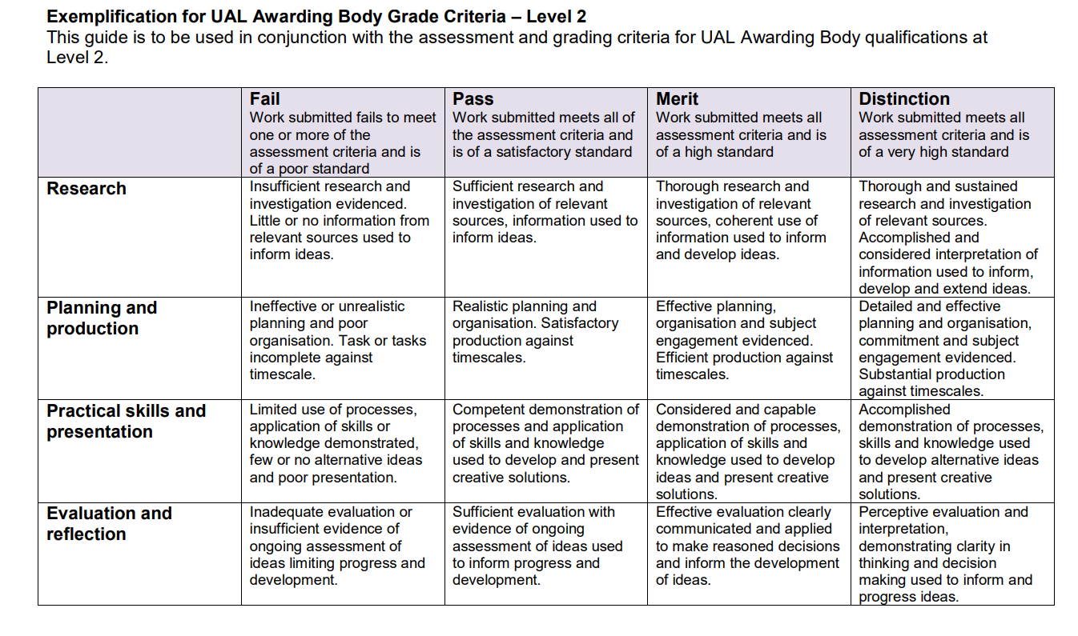

Slide 47
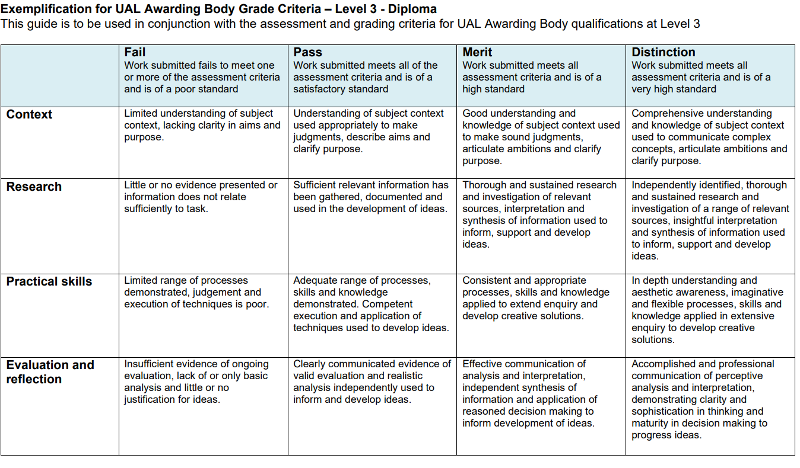

Slide 48
Submit your scrapbook on Monday 27th September for feedback to s.sutton@bradfordcollege.ac.uk and s.hindle@bradfordcollege.ac.uk
Please note – we are looking at your work in progress, we are not expecting perfection at this stage.
Please direct all scrapbook questions to s.hindle@bradfordcollege.ac.uk
or
s.sutton@bradfordcollege.ac.uk
Alternatively contact us on Teams – Sara Sutton or Steph Hindle

