Slide 1
PROJECT 5- COLLABORATIVE PROJECT HOUSE
I WILL WALK THROUGH HOW I AM GOING TO COMPLETE THIS PROJECT TO A GOOD STANDARD…

Slide 2
01
WHY THIS PROJECT?
HOUSE MUSIC HAS BEEN A PASSION OF MINE SINCE A YOUNG AGE. A COUPLE OF YEARS AGO I STARTED MY MUISC PRODUCTION JOURNEY. I THOUGHT THIS WOULD BE A PERFECT TIME TO SHOW WHAT I HAVE LEARNT OVER THE YEARS THAT I HAVE BEEN PRODUCING DANCE MUSIC, AND ALSO WHAT I HAVE LARNT THROUGHOUT THIS PROJECT.

Slide 3
WHAT IS MY PROJECT?
IN THIS PROJECT, I WILL PRODUCE, MIX, MASTER AND RELEASE A HOUSE TRACK OF MY OWN. THIS WILL ALLOW ME TO SHOW OF MY ALREADY EXISTING SKILLS, AND ALSO WHAT I HAVE LEARNT DURING MY TIME HERE AT BRADFORD COLLEGE. I AIM FOR THIS TO BE THE BEST WORK I HAVE PRODUCED YET. I WOULD ALSO LIKE IT TO BE THE MOST SUCCESFUL PROJECT I HAVE DONE YET, BOTH IN REACH AND THE REACTION I GET FROM MY LISTENERS. MY TARGET AUDIENCE IS ANYONE AND EVERYBODY THAT LIKES HOUSE MUSIC. I WANT THIS TRACK TO BE SO WELL WRITTEN THAT EVERYONE CAN ENJOY IT, EVEN IF THEY MAY NOT LISTEN TO HOUSE MUSIC.

Slide 4
RESEARCH
I WILL USE A WIDE VERIETY OF SOURCES FOR MY RESEARCH. THESE INCLUDE BOOKS, VIDEOS ONLINE, FORUMS, BLOGS AND WEBSITES. ALL OF THESE SOURCES WILL HELP ME COMPLETE MY REASRCH TO A HIGH STANDARD. I PLAN TO EVALUATE AND REFLECT ON EVERY ASPECT OF THIS PROJECT TO BETTER MYSELF AND HOPEFULLY BETTER MY FINAL GRADE. THOUROUGH RESEARCH WILL HELP ME ACHIEVE THAT.

Slide 5
CONTEXT:
HOW IS THIS RELEVERNT TO THE MUSIC INDUSTRY?
THE INDUSTRY IS EVERGROWING, WITH THOUSANDS OF TRACKS BEING RELEASED EVERY DAY. IT IS MY TURN TO TRY AND MAKE A SMALL WAVE IN THIS COMPETETIVE INDUSTRY

Slide 6
STREAMING PLATFORMS
APPLE MUSIC
AMAZON
MUSIC
THE SAME AS SPOTIFY, I CAN RELEASE IT ON AM AND GET MONEY FROM STREAMS.
IT IS THE HIGHEST PAYING STREAMING PLATFORM APART FROM ITUNES AND APPLE MUSIC
SPOTIFY
SOUNDCLOUD
AS THIS IS MY OWN TRACK WITH NO SAMPLES I CAN RELEASE IT ON SPOTIFY
I RELEASE ALL OF MY TRACKS ON SOUNDCLOUD.

Slide 7
—PAUL WELLER
“THE WAY THAT HOUSE MUSIC HAS BECOME SO WHITE AND SANTIZED OVER THE DECADES, AND THE FACT IT’S STILL GOING ON, WELL I THINK ITS SAD REALLY.”

Slide 8
AIMS
I WANT THIS TO BE AMONG MY HIGHEST PLAYED TRACKS…

Slide 9
26,072 (ALL STREAMING PLATFORMS
8,095 (ALL STREAMING PLATFORMS
5,271 (ALL STREAMING PLATFORMS)
LET’S DANCE-LUKE ANGELIS
KCK-DRM – LUKE ANGELIS
TRY GET AWAY-LUKE ANGELIS

Slide 10
A TIMELINE ALWAYS WORKS
MIX
RELEASE
MIX THE TRACK READY FOR MASTER
RELEASE THE TRACK ON ALL STREAMING PLATFORMS
1
2
3
4
5
PRODUCTION
MASTER
PROMOTE
START WITH THE PRODUCTION PROCESS.
MASTER THE TRACK READY FOR FINAL RELEASE
PROMOTE THE TRACK

Slide 11
MY METHOD’S OF PROMOTION
METHOD | Description | SUCCESS
SOCIAL MEDIA | SOCIAL MEDIA ALLOWS ME TO GET MY MUSIC OUT TO A LOT OF PEOPLE AT LOW COST. | HIGH
WOM (WORD OF MOUTH) | WORD OF MOUTH IS GREAT IF YOU HAVE A SPECIFIC TARGET AUDIENCE | HIGH-MID
ALGORITHMS | TRYING TO GET ON A SPOTIFY MADE PLAYLIST OR ON THE FEATURED PAGE OF A STREAMING PLATFORM. USUALLY DOESN’T WORK OR GETS IGNORED | LOW

Slide 12
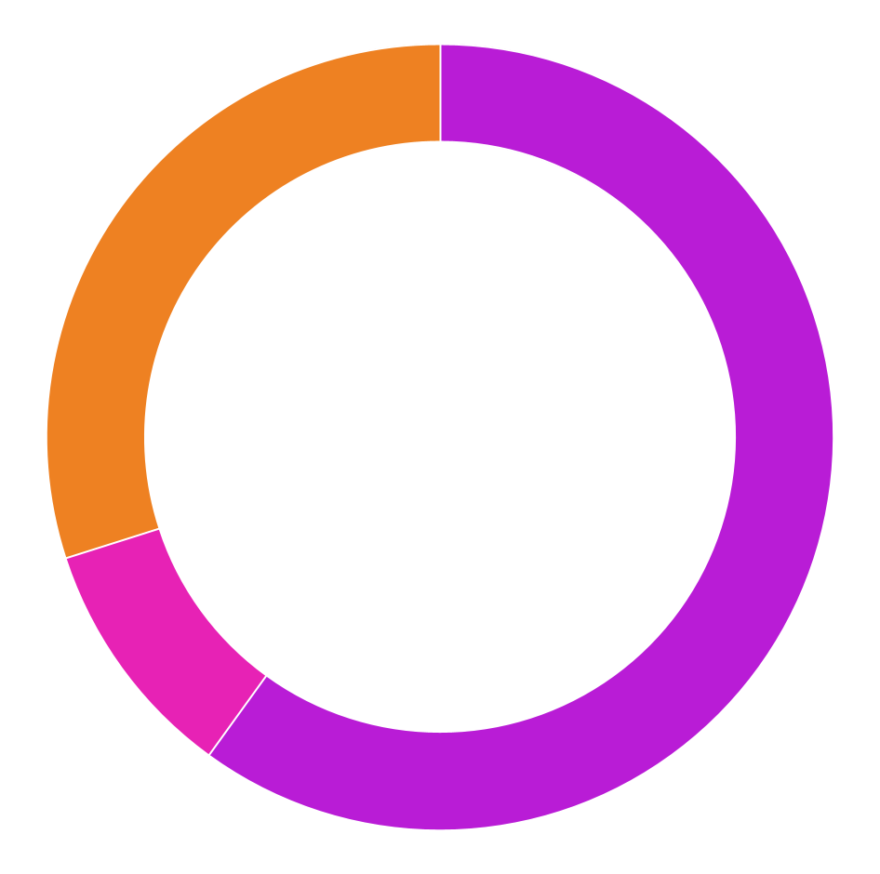
PROMOTION SUCCESS GRAPH
60%
30%
10%
SOCIAL MEDIA
MOST OF MY STREAMS COME FROM SOCIAL MEDIA
WOM ( WORD OF MOUTH)
I RELY HEAVILY ON WORD OF MOUTH TO REACH MY TRAGET AUDIENCE
ALGORITHMS
ENDING UP ON A SPOTIFY MADE PLAYLIST OR SOUNDCLOUD FEATURED PAGE

Slide 13
I HOPE THIS EXPLAINS MY AIMS AND MY GOALS FOR THIS PROJECT!
TWO STEPS BACK- LUKE ANGELIS

