Slide 1
Final Project by Omar Ali Hassan
The idea is a short Film that talks about a murder mystery.
It is going to involve around 4 or 5 actors.
The story will focus more on how corrupt the police system is and that they can bought very easily.

Slide 2
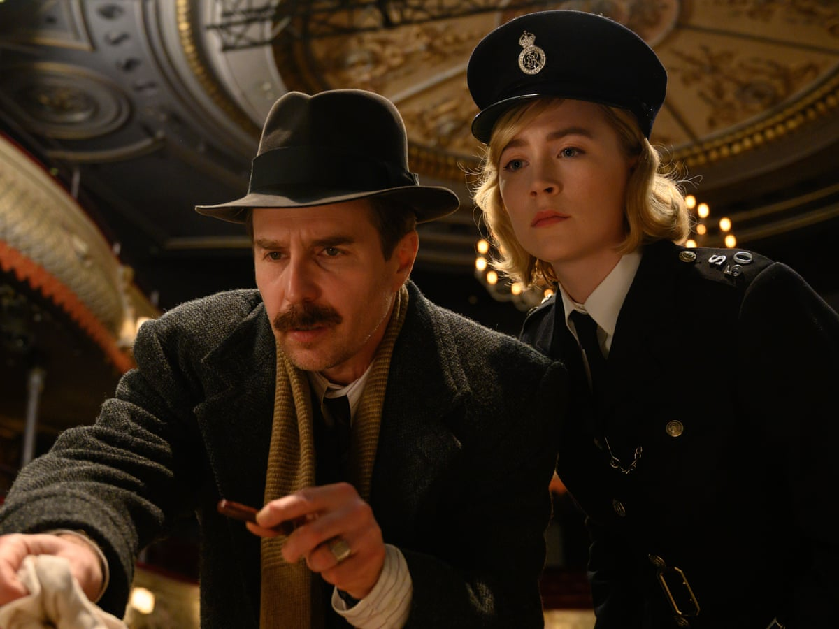
Influences
The reason I am doing this is that I like the genre and mainly how the mystery makes you suspect everyone as well as the thrill of it which will make you so hooked till you get to the final conclusion that will link everything together and most of the time has twists and turns.
Moreover, Most of my influences was from Agatha christie murder mysteries which I think are great.
The Experience for me to direct a short film like that is such an opportunity to make me know what I am doing.

Slide 3
Context.
This short film will be low budget like for example alter channel on YouTube which makes short horror movies.
This project relates to the media industry is it being a good opportunity for me to be known and maybe make more projects if the Audience like this one.

Slide 4
My idea

Slide 5
Target Audience.
The Target audience will be young people and older individuals it won’t be suitable for any children since it being Rated 15 or over.
The short film will be posted on YouTube, which will attract people who like the genre and also people who like to listen to media like this which would be more young people and adults.

Slide 6
Equipment
The equipment that I will be using is a Panasonic camera which films in 4k.
Tripod
Zoom HD 6 and zoom f2s which will be the clipper ones.
Beyer Dynamic Boom MIC.
Props.
Microsoft After Effects.

Slide 7
Timeline
March 27th | March 3rd till March 27th | March 29th till May 26th
Due Date for Task 2 | Due date for script | Production stage
March 27th | March 27th | March 29th till 14th of April
Due Date for Task 2 | Due Date For Script. | Production stage.

Slide 8
Health and Safety
All the instructions will be told by the floor manager to the cast and crew to keep them safe.
Hazard | Risk | Action taken to mitigate risk
Cars | Getting hit by a car | Watch your surroundings and be careful.
Construction Wires | Tripping over them | Look out for where your walking round
Camera 3 | if you are holding that and put your hand inn the gap you will get hurt. | Avoiding having your hand in the gap.

