Slide 1
A National Science & Media Museum Marketing Strategy Proposal Presentation Created By Harley Kavailauskas

Slide 2
Let's Start With The Foundations Of My Proposal … LIDAR & PPMS

Slide 3
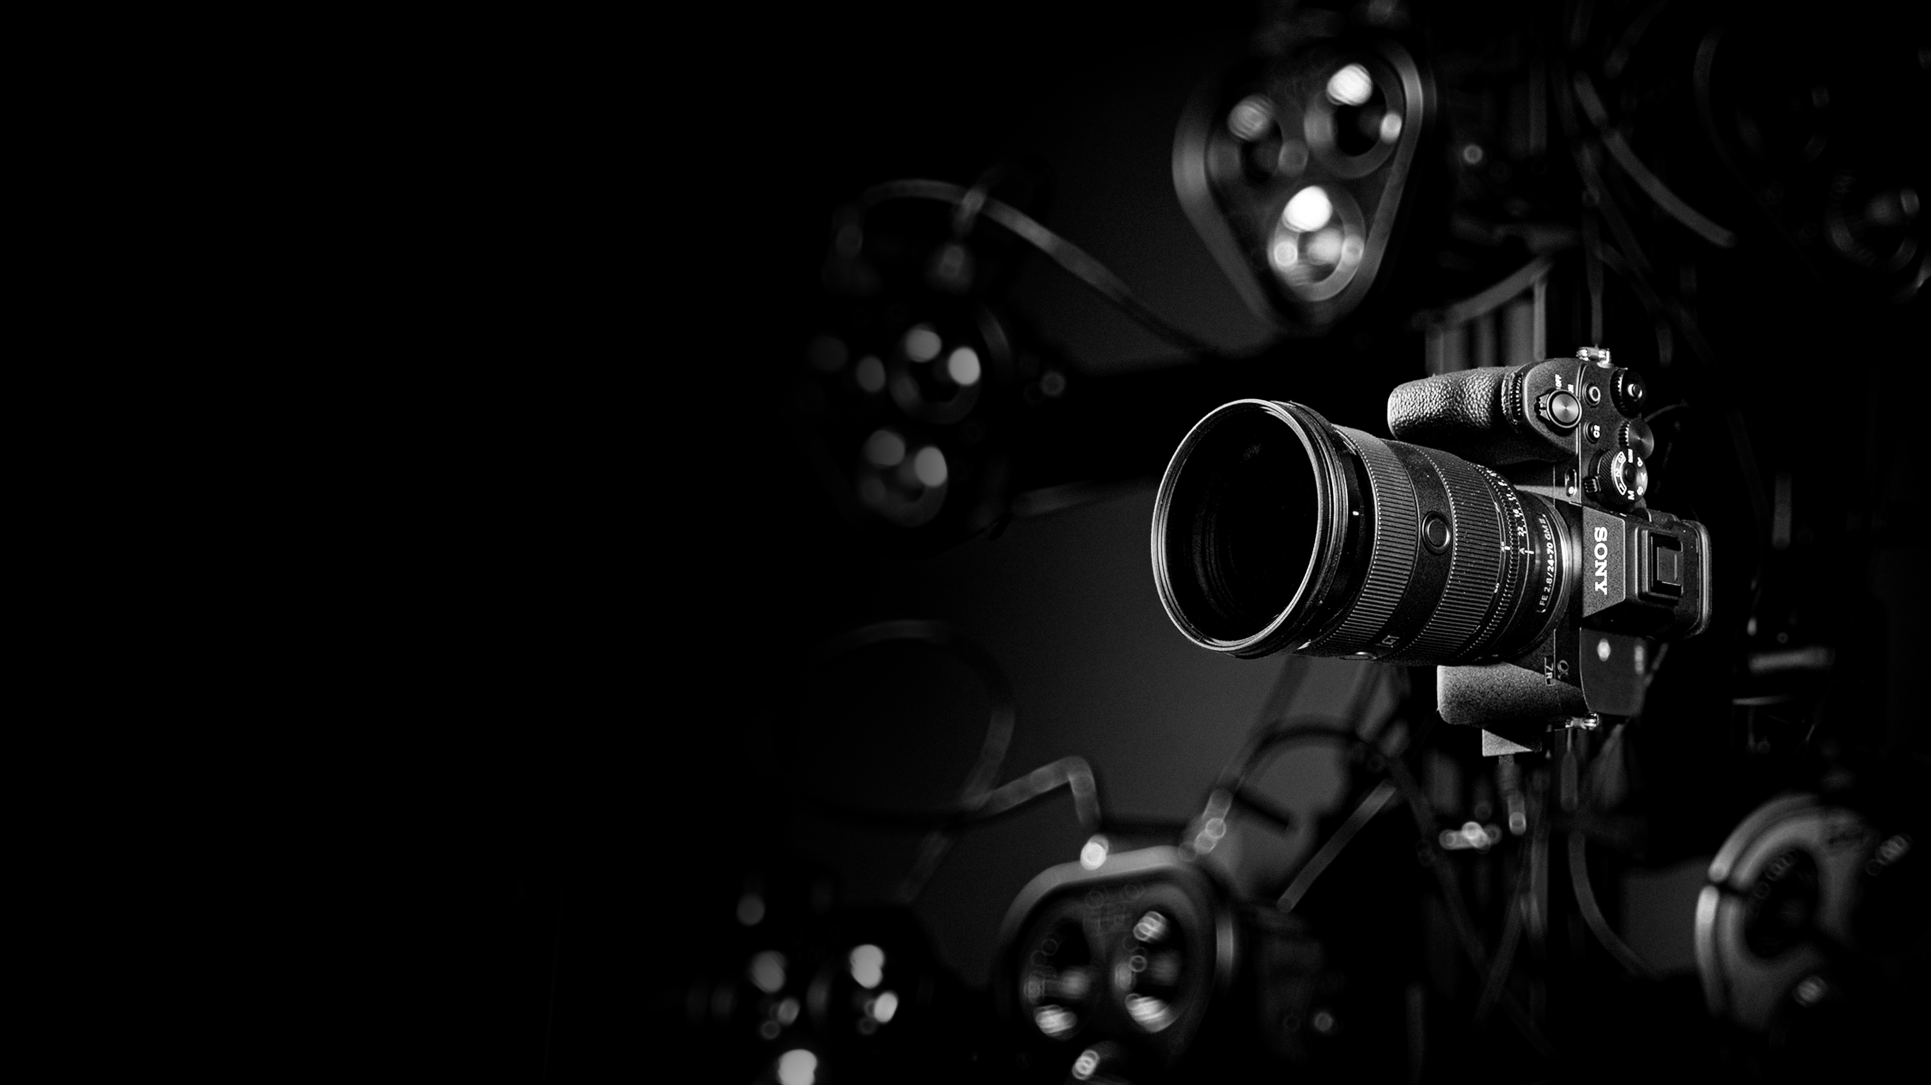
LIDAR&
PPMS?

Slide 4
LIDAR (Light Detection & Range) is a system that gathers the necessary data to generate the accurate geometry of a subject. It works by mapping hundreds of dots onto an object, calculating how much time it takes for those dots to bounce back.

Slide 5
PPMS (Photogrammetry) allows us to get a digital 3D model from multiple photos facing different angles of an object. This method heavily relies on an algorithm to analyze how light disperses across the object in said photos.

Slide 6
LIDAR is typically used as hardware in a bigger system, whilst Photogrammetry is typically software only used for generating 3D models based on photographs.

Slide 7
LIDAR is used in cars such as Tesla for automated driving, it is also used for parking assistance in a wide variety of other cars. Photogrammetry has been used to create props & elements within films & video games.

Slide 8
Using PolyCam, a free app on my phone - I was able to scan a few of my colleagues & even myself!

Slide 9
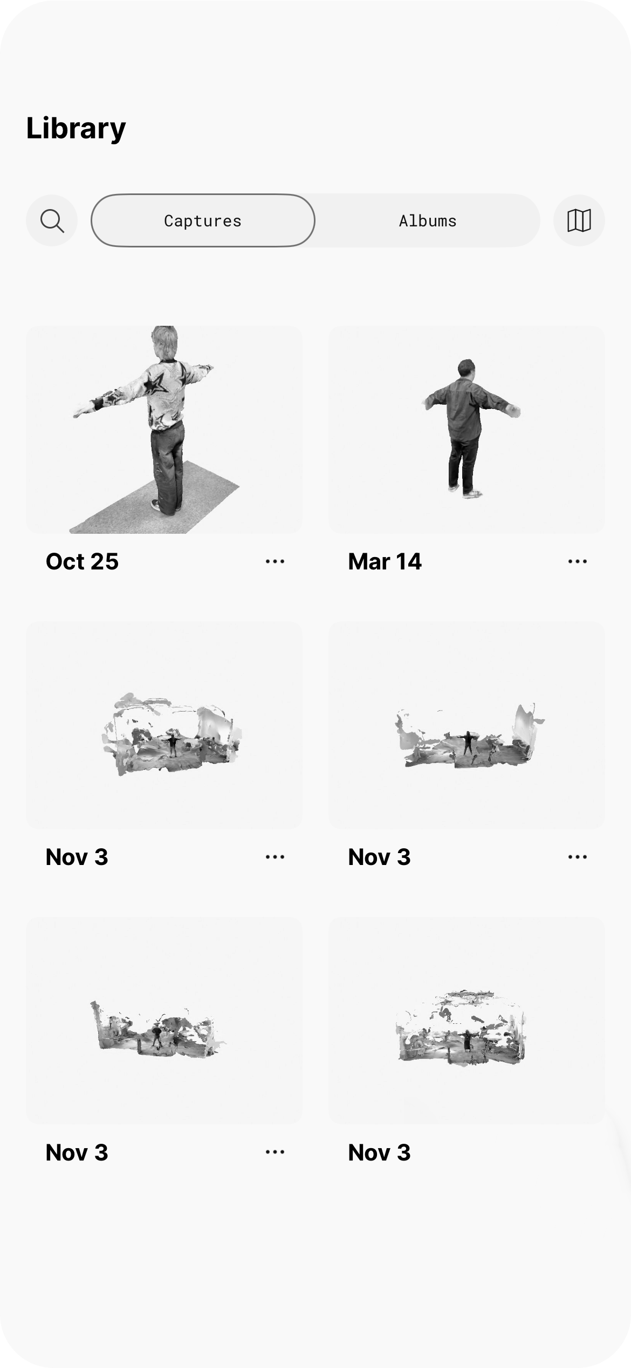
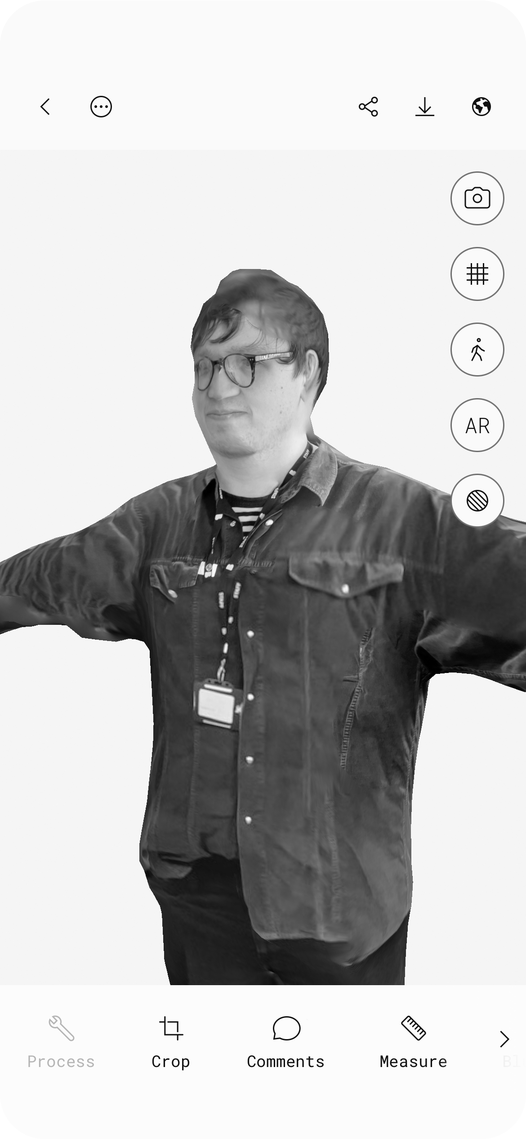

Slide 10
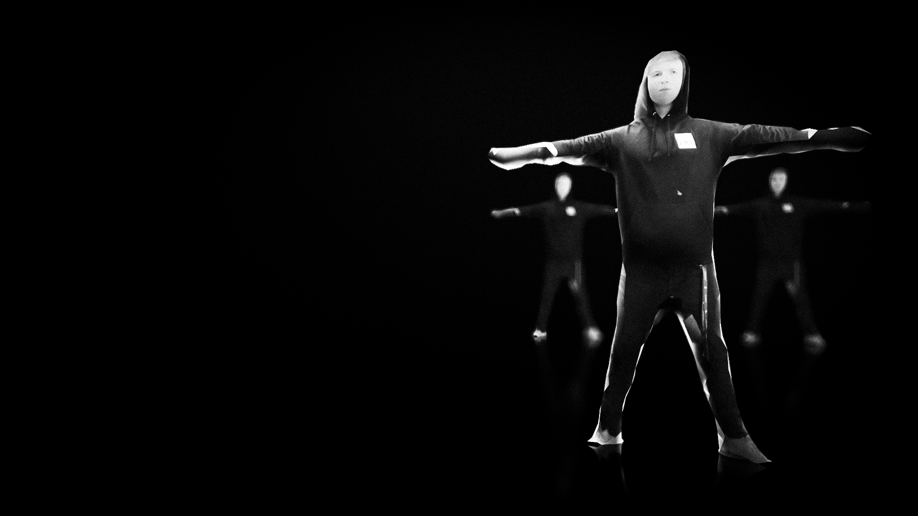
PROPOSAL
MY

Slide 11
Simply, my idea is an exhibition that gives users the opportunity to use Photogrammetry & Possibly LIDAR to create a digital 3D model of themselves.

Slide 12
My proposal is in favor of Trend-Awares, they are active & engaged consumers of culture. They like to discover new & spectacular experiences, often encouraging their friends to join in. Attracted to big ideas that will have an impact on their lives.

Slide 13
Due to how expensive & limited LIDAR & Photogrammetry systems are, they’re not very accessible to the public. With this, filling in the gap by offering these services to the public is destined to attract many visitors.

Slide 14
Not only is it just an experience, the user will also be granted with a choice after the photogrammetry’s succession – they will be able to download a free digital 3D model or purchase a physical 3D model from the giftshop.

Slide 15
Visitors who came unaware of this technology will walk away having learnt the processes of LIDAR & Photogrammetry via the usage of infographics or animated illustrations.

Slide 16
In the future I aim to show how the physical exhibition could look, with any major factors, including ergonomics. In all, attempting to bring an engaging, convenient & functional experience to both user & the museum.

Slide 17
A National Science & Media Museum Marketing Strategy Proposal Presentation Created By Harley Kavailauskas

