Slide 1
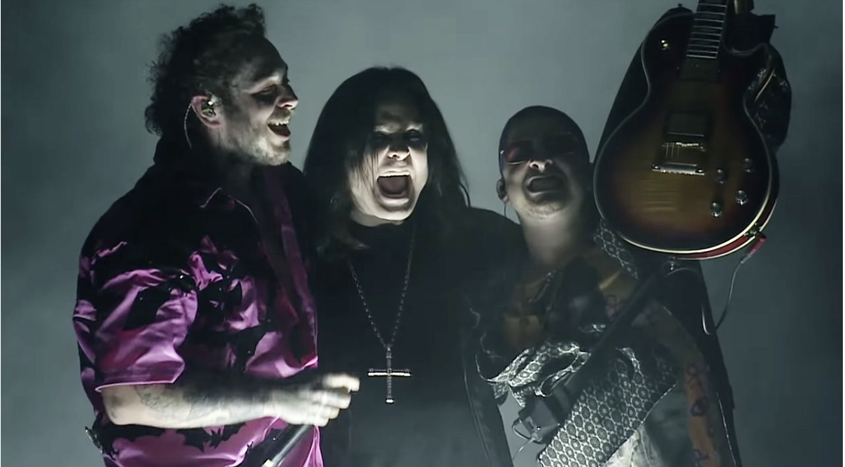
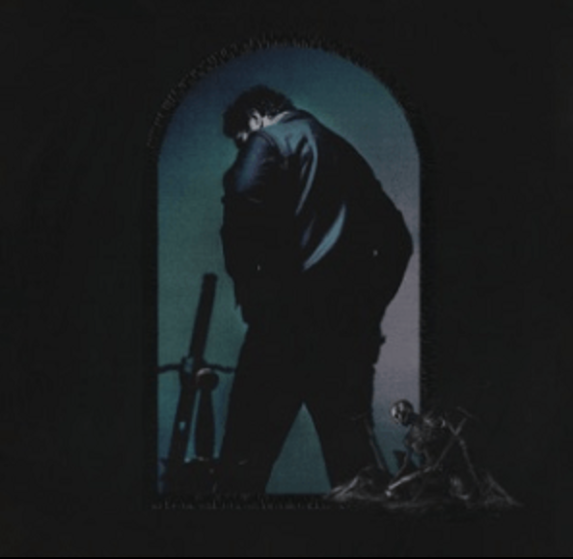
Post Malone and Ozzy Osbourne Live (Take What You Want)
Los Angeles – Late 2019
The Forum

Slide 2
Why I chose this particular performance
I chose this performance because the song is one of my favorites from post Malone and iv been listening to Ozzy Osbourne quite a bit recently.
I love the hybrid of Rap artists and Rock and Roll artists on songs together. The choruses can be amazing if done right.
I especially like the overall vibe of the performance, from the dark colour scheme, to the vocals over the backing track. I think Post Malone and Ozzy Osbourne work really well together especially on a track with the same vibe as this one.

Slide 3
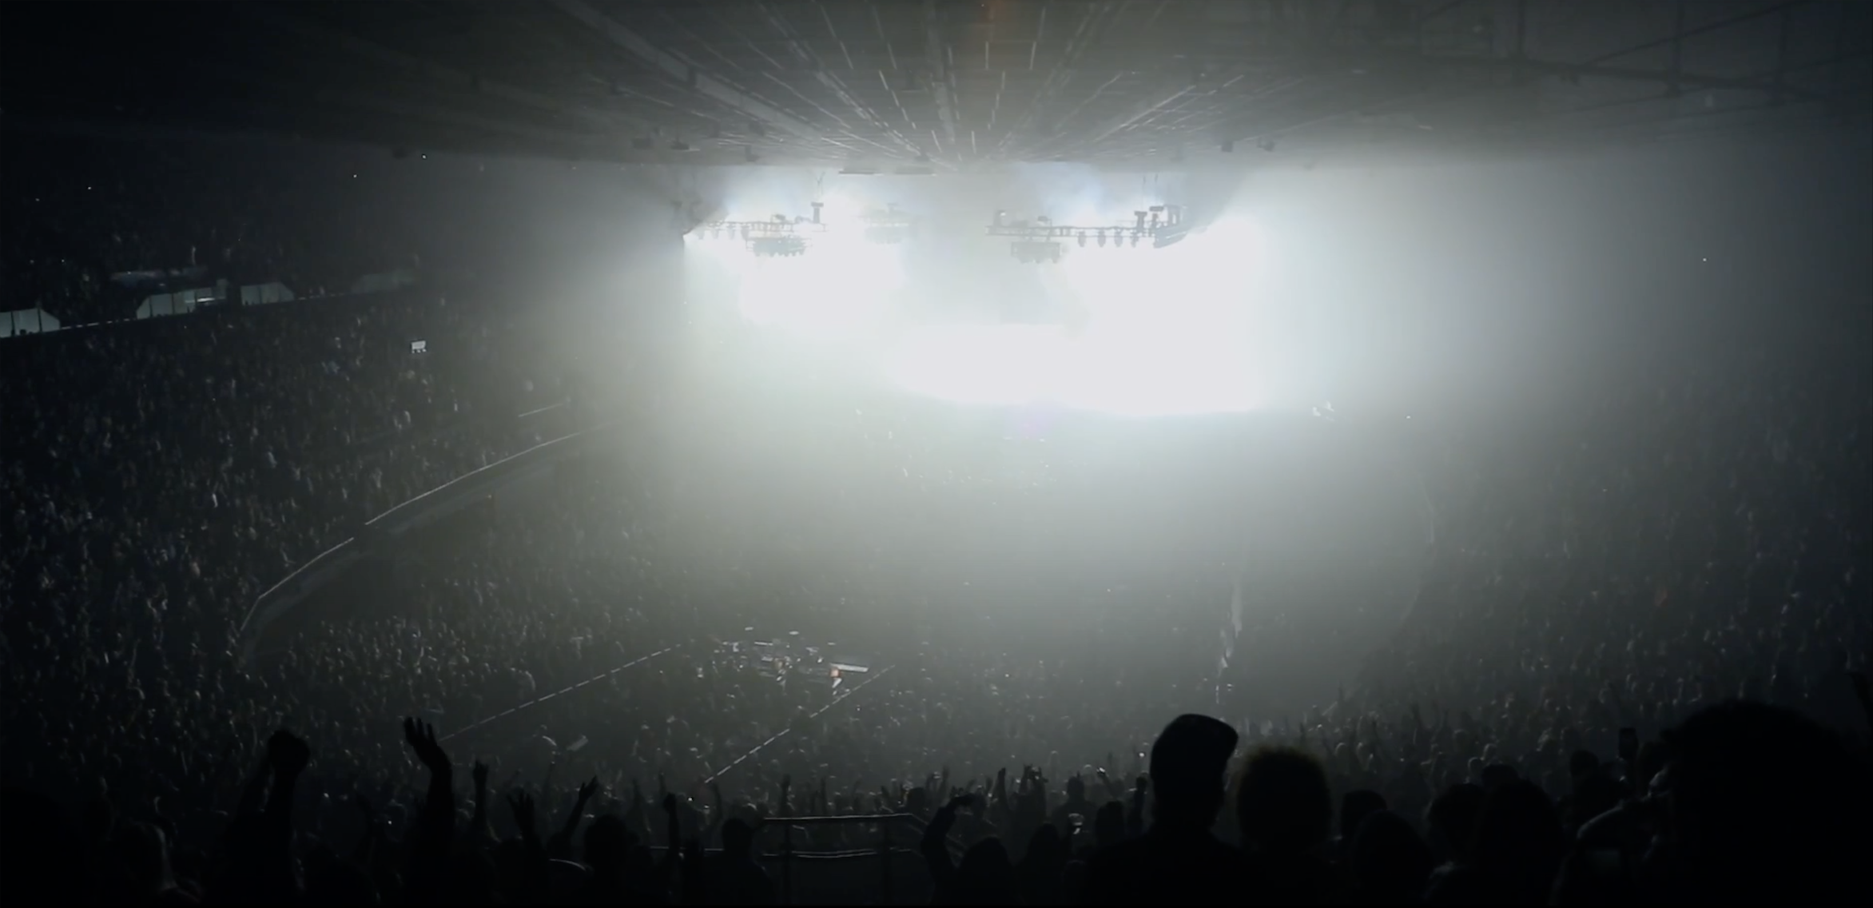
Venue & Audience
The performance is apart of post Malone’s Runaway tour that started on September 14th 2019 and was forced to stop on march 12th due to COVID-19. It takes place at The Forum in LA which has a maximum capacity of 17,505 people. The crowd will be mostly Post Malone fans but you can hear a lot of them chant Ozzy Osbourn’s name at the start of the video and performance.

Slide 4
A Bit About The song
The track its self is rap/rock with the original version including Travis Scott’s verse and breakdown. It features a chorus from Osbourn as well as Post Malone later in the track. A verse from Post Malone and a verse from Travis Scott.
The song is on Post Malone’s 3rd studio album, Hollywood’s Bleeding, which was released in 2019, being number 9 on the track list. The song is produced by Andrew Watt (seen on stage playing the guitar) as well as Luis Bell who is a big producer for Post Malone.

Slide 5
Stage Presence
At the start of the song Osbourne's producer Andrew Watt is shown with a guitar. Osbourne is shown in all black clothes with a Dimond crucifix chain, sitting on a throne referring to his nickname ‘prince of darkness’. This is followed by Post Malone helping him walk to the center stage area. As Osbourne was 71 at the time of the performance he was needing help from others to perform but he was still acting as if he was youthful and on tour.
Post Malone is dressed in one of his usual “stand out” outfits but keeping the dark theme with pink/purple top and bottoms with black bats patterned on them and Osbourne is dressed all in black as he is in most of his appearances.
At the beginning of the performance Osbourne is seen ‘bowing’ to Post Malone. Which is a big sign of respect coming from Osbourne as he has been looked up to and has inspired people like Post Malone.
They were both walking round and being energetic and vibing with each other to match the volume and the songs message.

Slide 6
Stage Presence Pt.2
The lights are quite ‘Dark’ because of Osbourne's persona and to match the song. The lights are a mix of purple and blue with some white heavy spotlights. There is also smoke machines coming up from under the stage to add to the song’s vibe.
There are also other pyrotechnics on stage and off stage such as fire that shoots up and ’explosions’ that go off to match the beat for the last bit of the song.
There was also spotlights to focus more on the artists while performing.
Osbourne is also shown encouraging the crown to clap along to the beat.

Slide 7
Communication
Post Malone shouts Osbourne’s name at the end of the performance and when Andrew Watt does his solo, he does the same to Watt.
On stage Post Malone and Osbourne are clearly communicating with each other by smiling and ‘dancing’ together.
Osbourne and Post malone also embrace in a hug near the end of the performance.
At the end of the song Post Malone outros the song buy shouting Osbournes and Andrews name

Slide 8
Dynamics
Throughout the songs there's buildups and breakdowns. During the chorus it gets significantly louder as the drums, bass and guitar starts to kick in more and louder.
Post Malone also sings with emphasis on some of the lyrics such ‘TAKE what you want from me, TAKE what you need from me’.
Near to the end of the performance Andrew Watt does the guitar solo that’s featured on the song that leads to the end of the track and performance.
The flow throughout the track is not simple but also not a very complex flow. Both Post and Osbourne sing their parts as close to the backing track and in my opinion it makes it sound better.

Slide 9
Instrumentation
In the performance you can clearly hear the electric guitar at the start which is the intro to the track. The drums kick in and the distorted electric guitar come in. More drums are added in the chorus and towards the end of the song.
Near the end of the performance, Andrew Watt does his guitar solo and continues until the track comes to an end.

Slide 10
The Crowd
The crowd during the performance can be heard cheering and chanting, they would have been a bit louder if there was a recording off someone's phone as this particular video is more of a professional one.
You can see that the crownd is putting the torch on on their phones and filming the performance.

