Slide 1
Movie pitch: love and hate
Alex Richardson

Slide 2

Title and logline
The title I have chosen is love and hate. The reason I chose this title is because My short film is about hate crime and homophobia, I am passionate about making this because it affects me personally and it shows awareness of this issue. My logline is love them or hate them but you're not going to stop them. I have chosen this as my logline because its powerful and impactful.

Slide 3

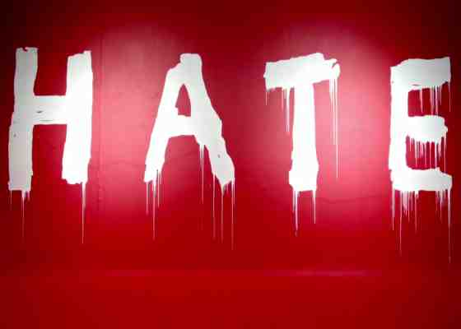
Synopsis and genre of love and hate
Annie is a lesbian woman who struggles with hate crime on the streets and struggles to find her place in the world she has one friend who doesn't know until she is a target of hate crime, and they campaign for hate crime rights. The genre is social realism the reason I’m doing this is because hate crime hasn't had enough support and people need to know about this issue.
My film is social realism/drama which conveys the socio-political ways of the working class. This film will show how the community does against homophobia and bullying.

Slide 4
influences
News given me the inspiration of hate crime
Sex education gave me the idea of homophobia
Real life events my brother

Slide 5

Characters
Annie – the lesbian who is insecure and scared about her sexuality
Mark – her best friend who supports Annie no matter what
Parents – supportive but doesn't know about Annie’s sexuality
Aggressor – homophobic bully very aggressive

Slide 6
Cinematography, styles, lighting: intro
Annie will start by going about her average day to day life waking up see her mum and dad do chores go to her room and game.
Doing this will give an insight to Annies life and the struggle she has fitting into society as well as the abuse she gets from others. This will be filmed on a sunny but cold day so the lighting will be natural and will be shot from a mid-wide angle and close ups.

Slide 7
Cinematography, styles ,lighting: Walk in the park and montage
The walk in the park scene will be shot using wide and mid shots and some close ups. We will use a natural lighting to make it seem authentic. Doing this will create a comfortable scene which will transition to a dark brutal scene is made.
The scene where Annie is beaten will be edited to just be the sound of impact when the aggressor is punching and kicking Annie.

Slide 8
Annies unknown fate and ending
Annie laid in the hospital bed and her parents rushing in will be a one POV shot following the parents running down a corridor into the hospital room. The lighting will be a natural daylight shining in with the use of a fake blood bag and Annie laid unconscious with Mark and her parents crying. The camera will slowly go out of the room and freeze frame will be used with the credits over lapping leaving the viewer unaware of her future.

Slide 9
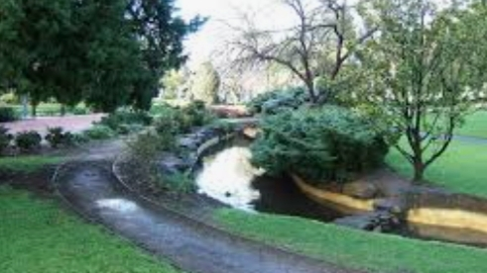
Equipment, locations, and props
Locations will be a fake hospital room and a park.
Props will be fake blood bag filled with fake blood, fake blood, coat rack.
Music will be a happy and sad tune.
Equipment we will need is a camera, microphone

Slide 10
Challenges
Budget will be £35.00 for props excluding the travel costs.
Actors/actresses will be picked by the team to see who fits the roles properly.

