Slide 1
Final Major Project
Marketing-Advertisement

Slide 2

Why am I choosing this project?
I have a huge interest in marketing, I really enjoy advertising
I haven’t done anything like this before, so I want to do it, my last projects were about short films and documentary.
I chose the topic marketing because I want to study marketing next year and so I want to gain some experience
Cars are used by everyone it’s a transport lots of people use everyday

Slide 3
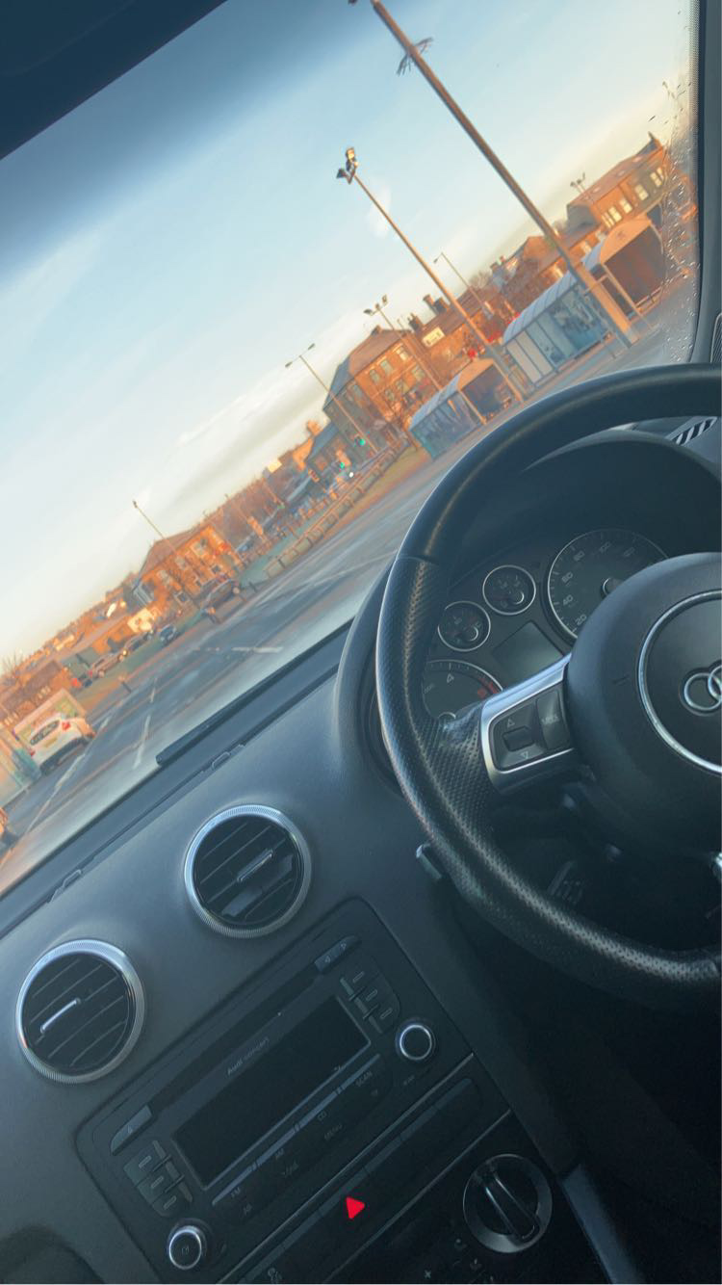
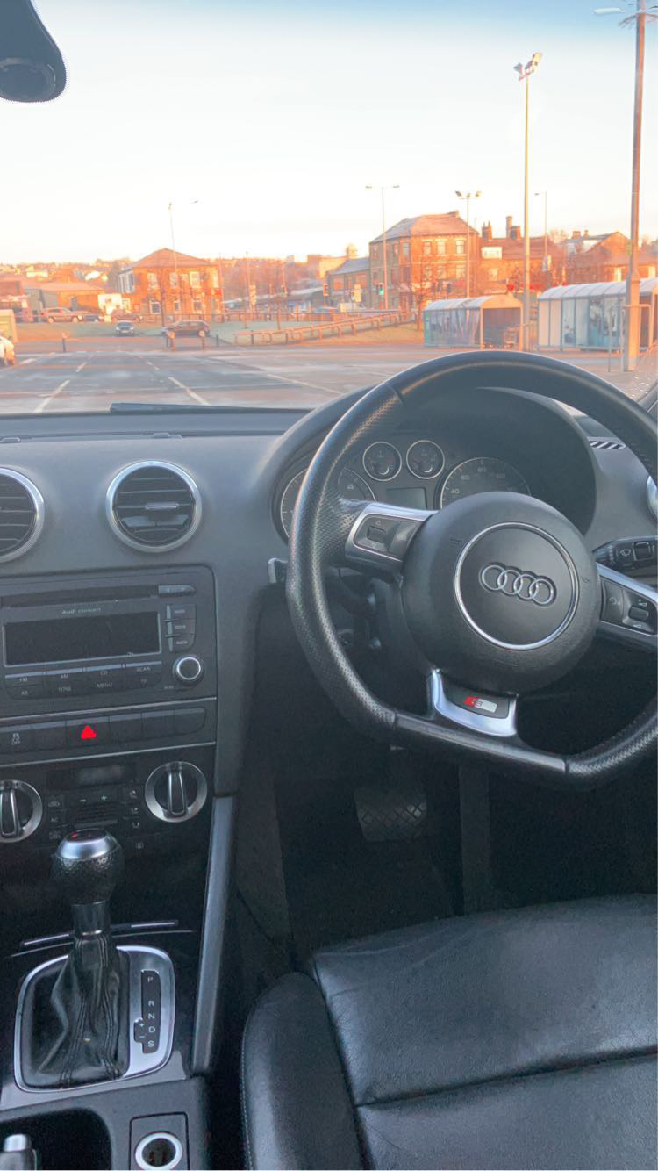
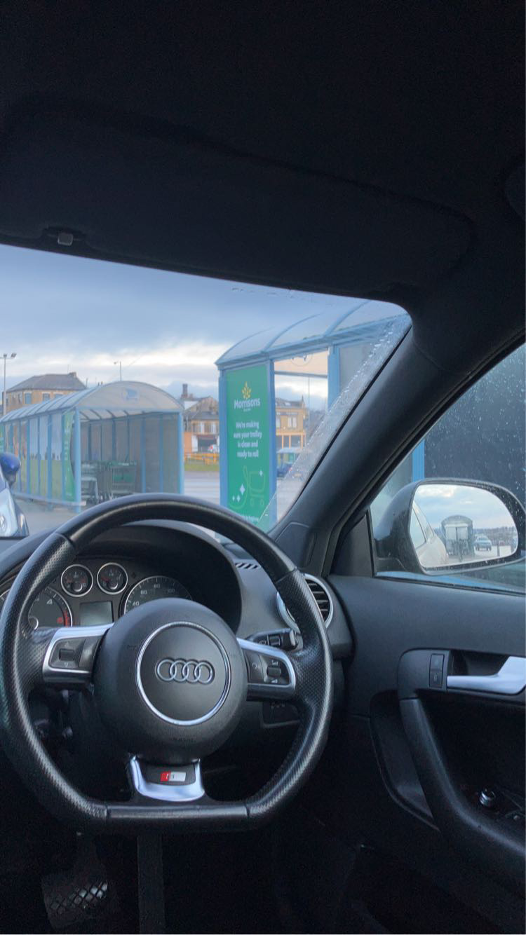
What is my project about?
I have an interest in marketing and advertising and so I chose to advertise cars and brand name. I have always enjoyed photography and filming; these are the pictures I have took myself. I like to mainly focus on the details.
Car interior
Car exterior
Showroom
I am going to encourage people to buy cars and for this I must make the advertisement eye catching and entertaining.

Slide 4
Aims and Objectives
My aim is to persuade and encourage people to buy cars. My objective is to make sure the advertisement is decent and clear for people to watch. This is because I'm trying to sell to people and for this, I’ll need to ensure that the filming and editing is done at a good standard.

Slide 5

Target Audience
https://www.dailymail.co.uk/news/article-5923269/Why-men-cope-seeing-women-wheel-100-000-supercars.html
This is an article about how women are treated when they drive expensive, fast cars. The main point that really stood out to me was, 'They'll make comments such as: 'Your husband is brave to let you drive that!' or 'I bet you can't park it without scratching your alloys.' They wouldn't make those remarks to a man driving the same car.'
Target audience age will be 17+ this is because that’s the age you can drive.
The gender is both female and male, because you can drive any car (if you have a license)
I think that the audience and buyers will mostly be male, because they are always seen buying and driving fast and expensive cars, but for my target audience I chose both female and male, I really want to encourage female to buy because you don’t always see them on the roads in fast and expensive cars.

Slide 6
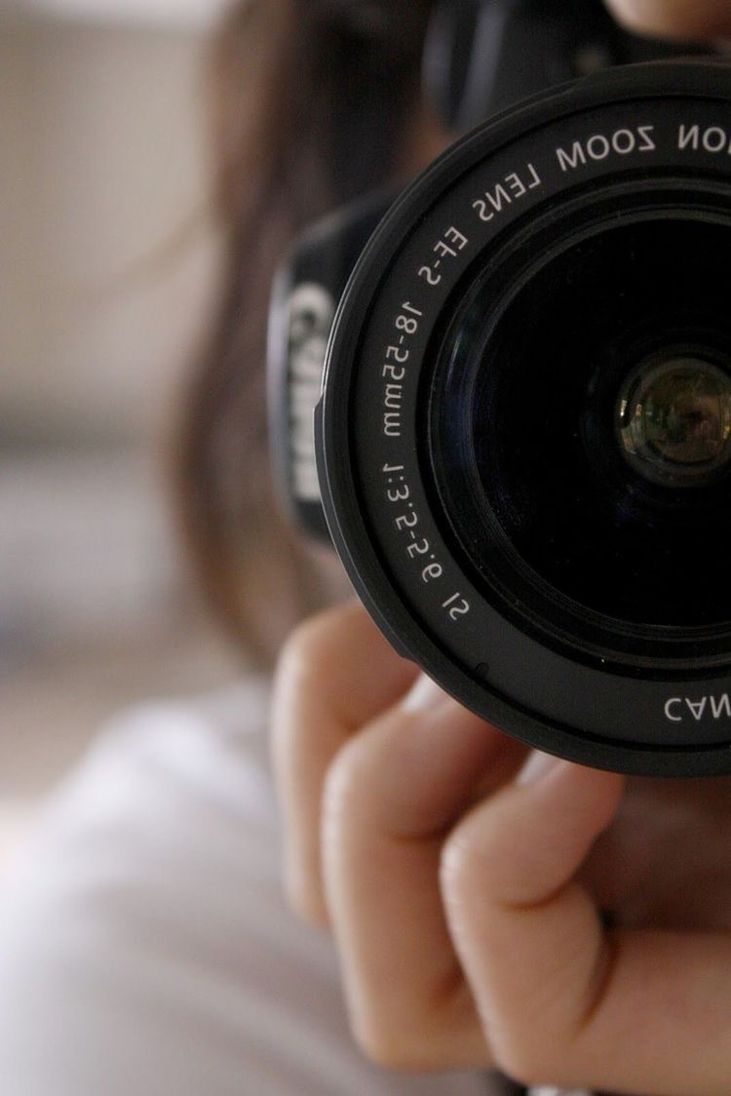

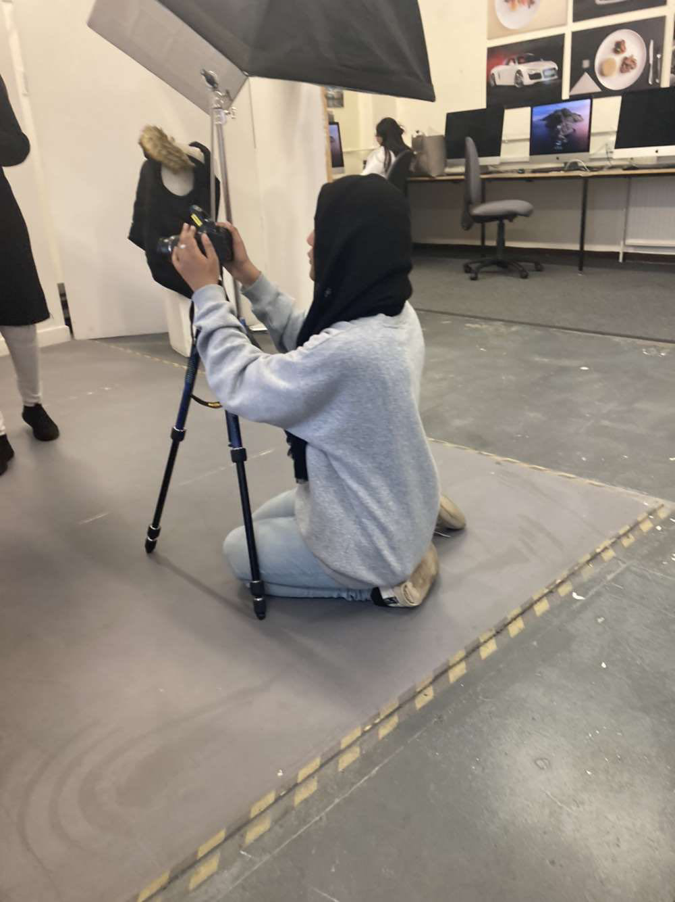
Context/resource/Personnel
My project is related to the media because it includes filming and editing
I will need a camera to film
I am going to work alone and do the filming by myself
For the editing I will use premier pro as I’ve used it before for my other projects, premier pro has lots of useful tools like lots of different transitions.

Slide 7
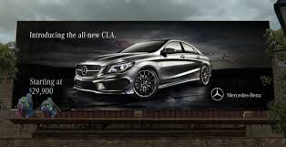
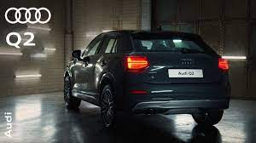
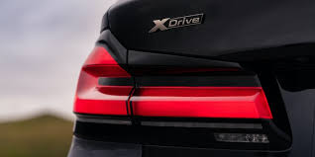

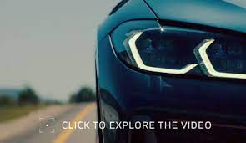

Research(secondary)
I have seen videos on Tik Tok and YouTube of car advertisements that have really inspired and encouraged me
https://youtu.be/B2-D7CbsijM
https://www.youtube.com/watch?v=Evcqg_FNmP0

Slide 8
Health and safety/Backup plan
I will be going out of college and film, so I need to be careful of the roads, traffic, people.
I have asked people beforehand if I could film because some places don’t allow that.
I’ve have contacted a few places not just one because if something doesn't go right, I have other options.
Computers might not always be reliable so I will make sure the footages are all saved on my phone so if I do face any problems on the computers, I have it saved with me.

Slide 9
Planning/practical skills
For the planning I will start of by doing lots of research and getting more ideas and then plan for my filming like camera angles, shots and location.
After I plan everything, I will start filming that could take up to a week because I don’t want to rush.
I have done 3 projects before, and so I have already used cameras, computers, photoshop and premier pro.

Slide 10



Presentation/promotion
My final product will be an advertising video about a car brand, encouraging people to buy. I will be doing a YouTube video advertising; the advertisement will be filmed landscape.
I have chosen YouTube because its more likely to get lots of views, anyone can access YouTube even without a tv. https://www.auraads.co.uk/post/how-effective-are-youtube-ads
I will also make a poster about the car brand, for this I’ll use Photoshop, I will take pictures of the cars and use it for the poster.

Slide 11



Evaluation and reflection
Whenever I film, I will look over at all the footages before editing just to make sure the footage is recorded clearly.
I will always check my work and get feedback from my classmates and family

