Slide 1
FINAL MAJOR PROJECT
Title-Florida's book

Slide 2
Genre/Target audience
Genre is fantasy, the main character uses her imagination to fight her fear.
The age group is aimed at school children aged 6-13 years old's
The gender is for girls and boys

Slide 3
Setting
For my short film I have decided the main settings will be Florida’s school, her bedroom and the place where her imagination takes us.

Slide 4
Characters
Florida (main character)
Prince
Florida’s Classmates
Florida’s parents

Slide 5
Plot
A girl gets bullied by her classmates at school. She then comes home and reads her most favorite books and imagines herself into a magical world. She then has a dispute with an ogre. She uses her imagination and fights her way out.
Ogre (represents the bully)

Slide 6
Ideas/why I chose this
I have chosen this idea because I want to catch hold of children's attention through the idea imagination. I reflect on this idea that this will clearly show my understanding and skills I have learnt in college. I learnt a lot about filming in my previous project and I’m confident using photoshop and adobe illustrator as I use it a lot for graphic design.

Slide 7
Job roles
I will be working in a team with my classmates for the final major project. The idea is that I will be the director, I will also be filming, Malaika will be doing the graphics for the animations, Hirah will be editing and helping with filming. We’ll all be ensuring that the work should be finished in good standard.

Slide 8
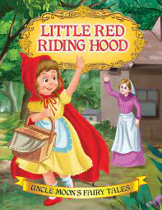
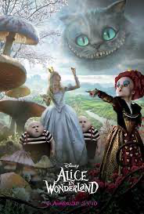
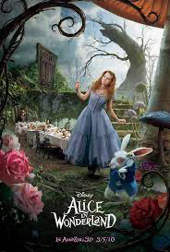
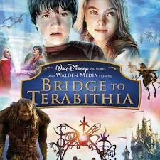
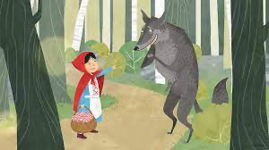
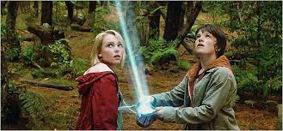
Inspirations
Alice in the wonderland
Bridge to Terabithia
Little red riding hood

