Slide 1
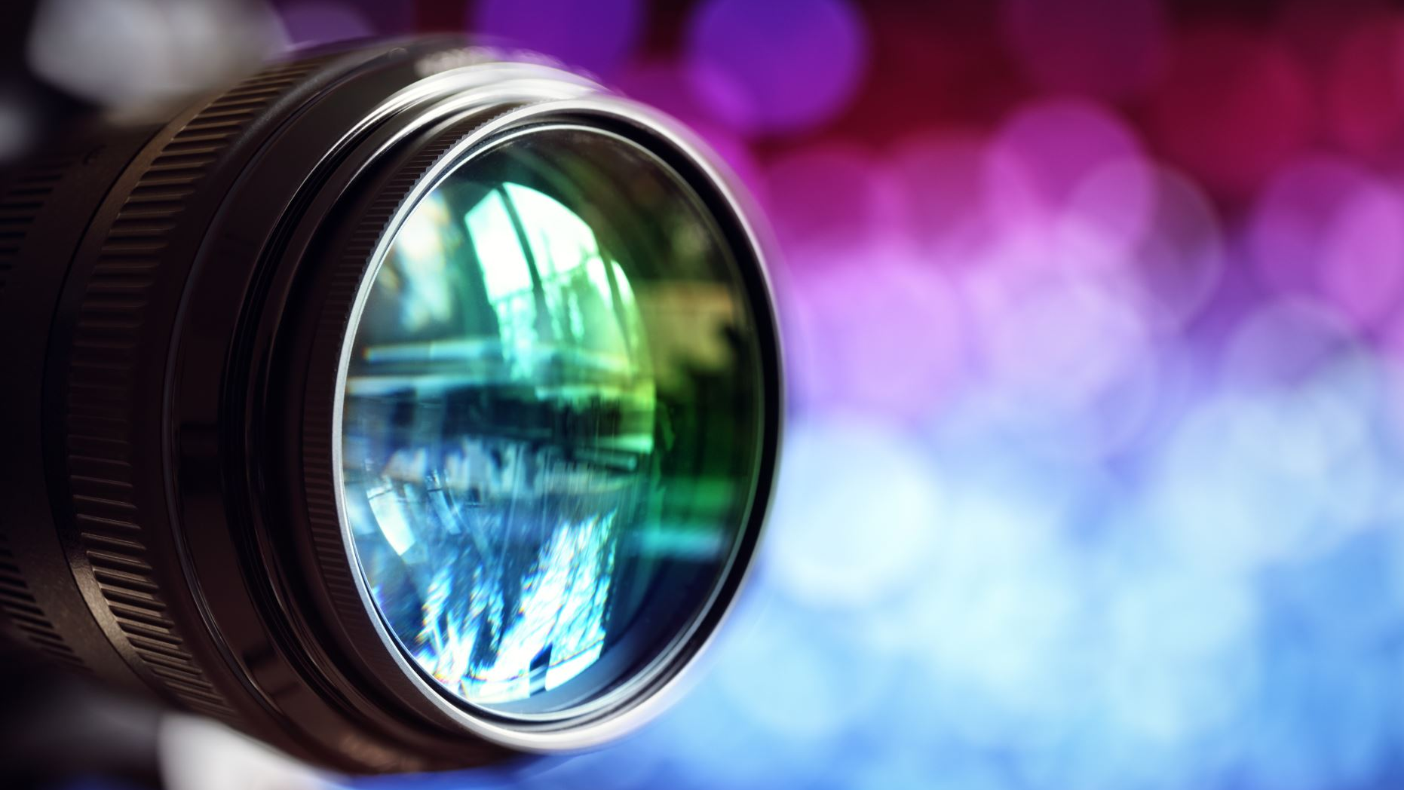
My Short Film
Haafsah Khan

Slide 2
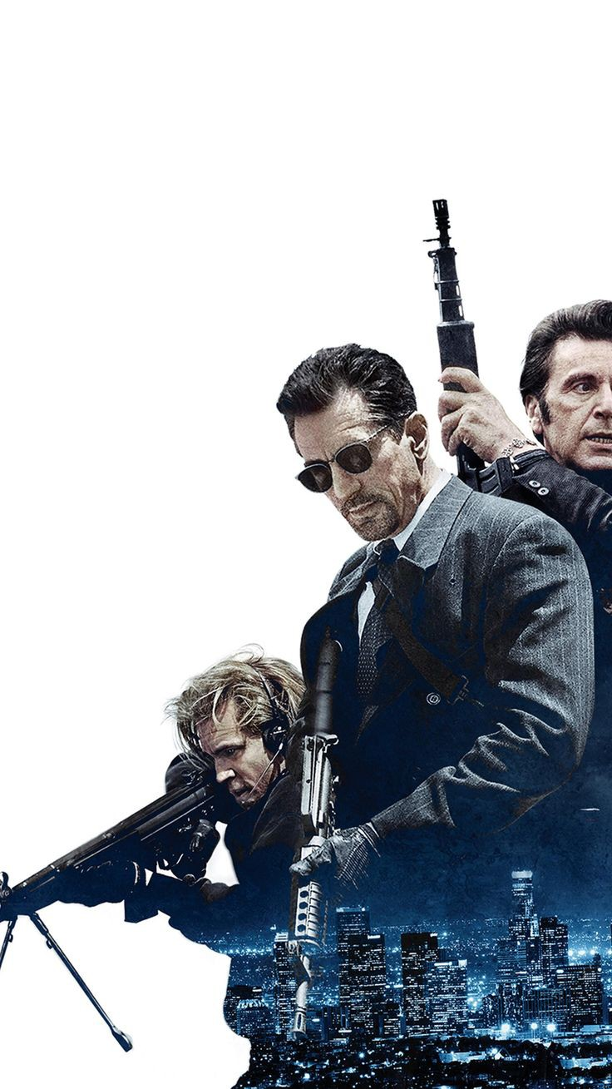
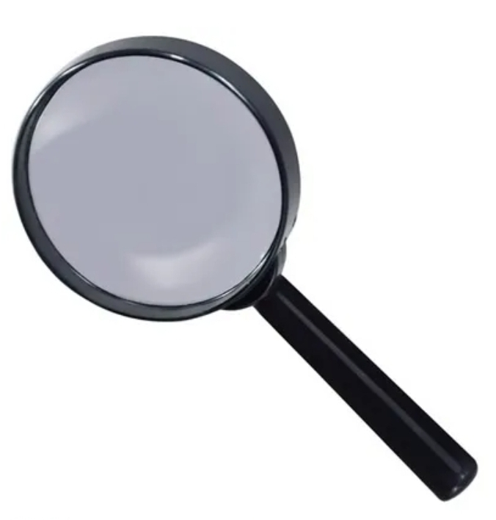
Genre
Action
An action movie clearly defines hero, victim and villain. The hero's desire is always to stop the villain and save the victim. The power divide between the hero and villain is large.
Mystery
Mystery follows a crime to the moment it is committed to the moment it is solved.

Slide 3
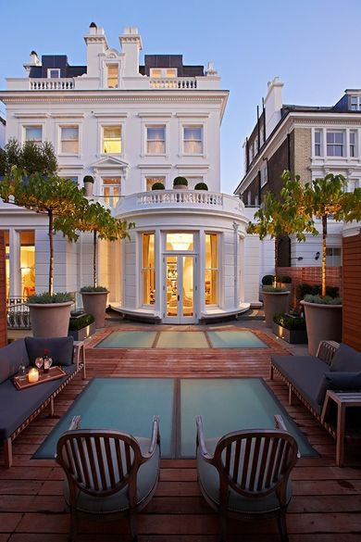
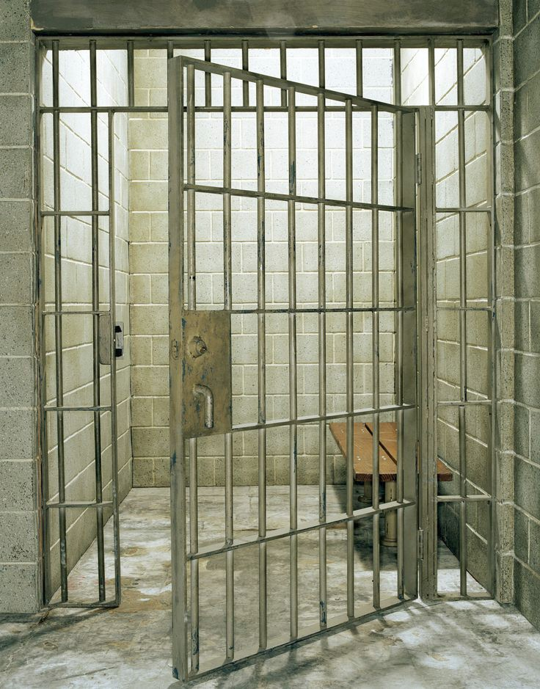
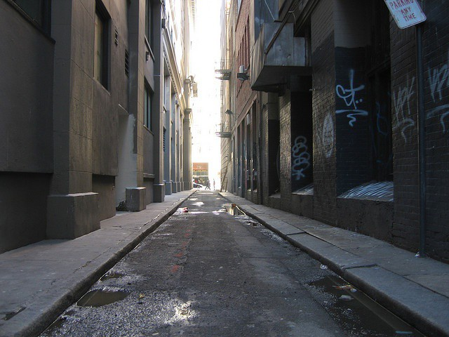
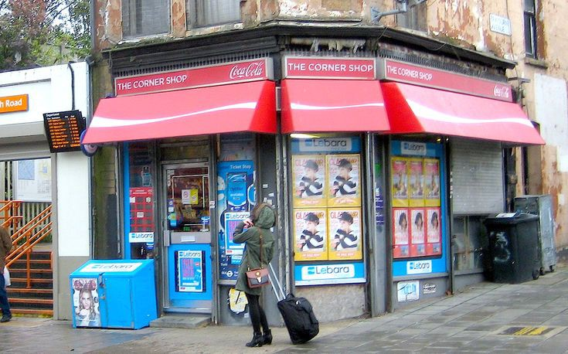
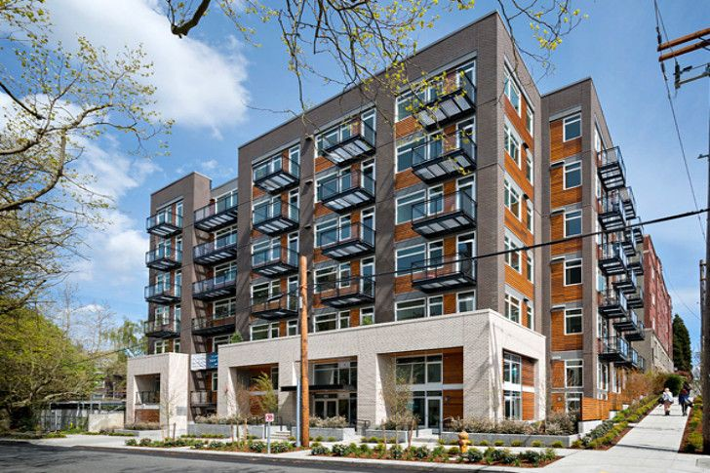
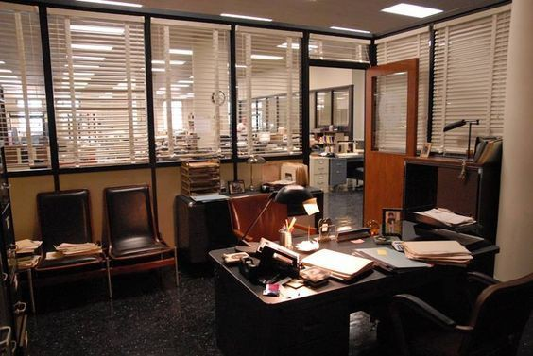
setting
Prison
Alleyway
Corner shop
Villain's house
Friend's apartment
Police headquarter

Slide 4
characters
Hero 49
Victim 18
Villain 40
Victim's Best friend 21
Victim's dad 55

Slide 5
plot
Villain's brother is rich and so all his inherited money goes to his son. The villains kidnaps his brother and turns his son into a drug dealer and he gets put in to jail. He is betrayed by his best friend and uncle. The hero is his dad's best friend. Hero is also an ex-police he breaks his son out of jail and they both go on a mission to find his dad.

Slide 6
Camera shots/ Camera angles
Close up shot to show the characters features and expressions
Extreme close-up shot to show the characters true feelings
Long shot, to show the background, this would also help the audience get a sense of the place
Low angle is used for setting the mood and feeling of the scene
High angle shot looks down at the villain and hero from a higher perspective.
Over the shoulder focuses on the main characters action and emotions
Dutch angle gives an uncomfortable feeling around the room and creates tension between the characters.

Slide 7
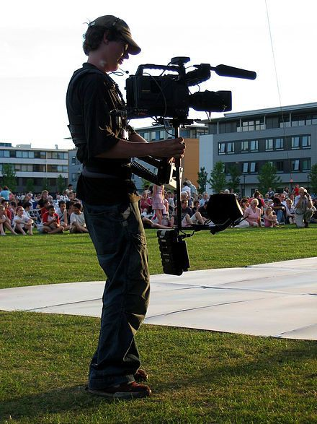
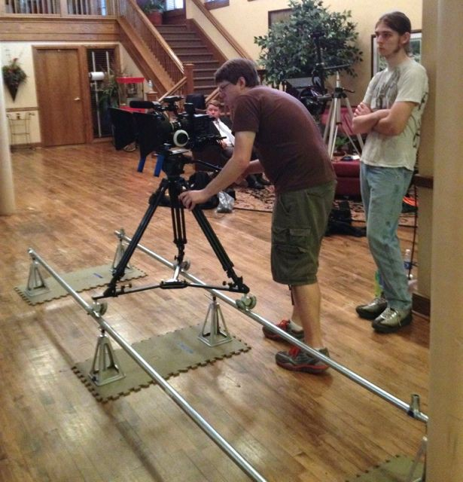
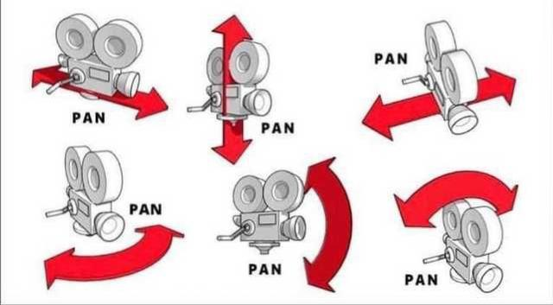
Camera movements
Pan is used to show the surroundings
Dolly is used to follow the character
Hand-held is used to show the action closely and build tensions

Slide 8
Title/Logline
Lies
Disloyalty and intrigue

Slide 9

conclusion
Both villain's end up in jail, and the victim's dad is found, but unfortunately he dies from cancer. Victim gets all his dad's money. Hero and Victim then live their life in a different country.

Slide 10
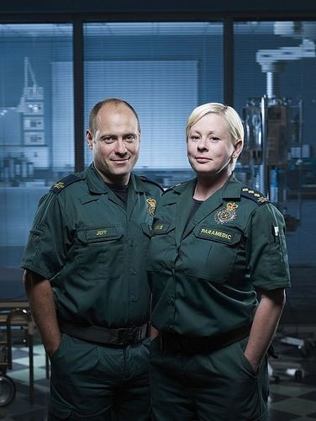
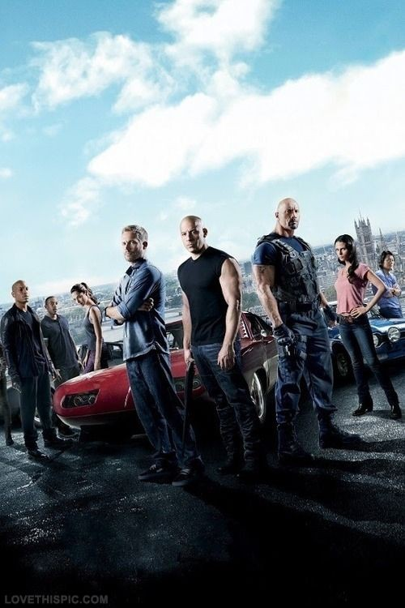
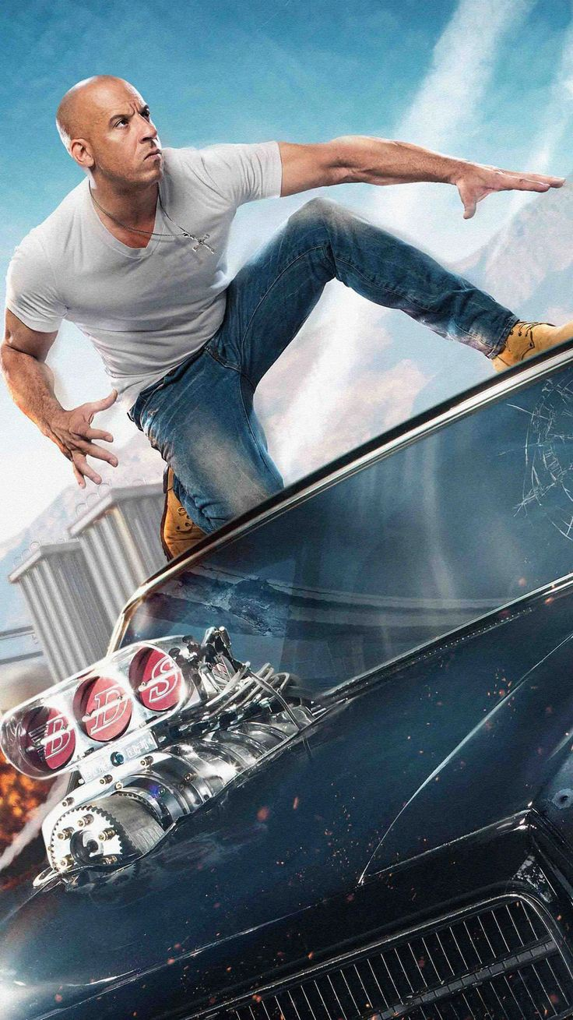
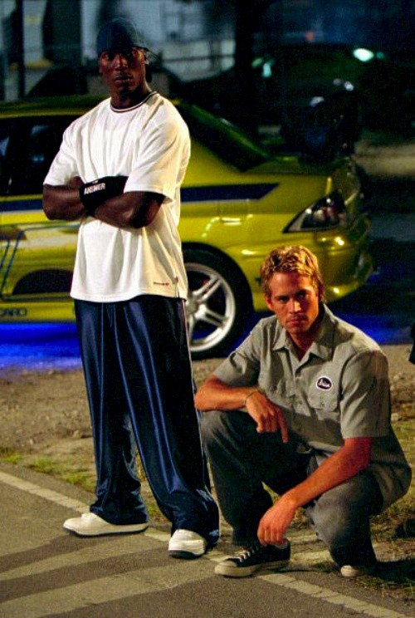
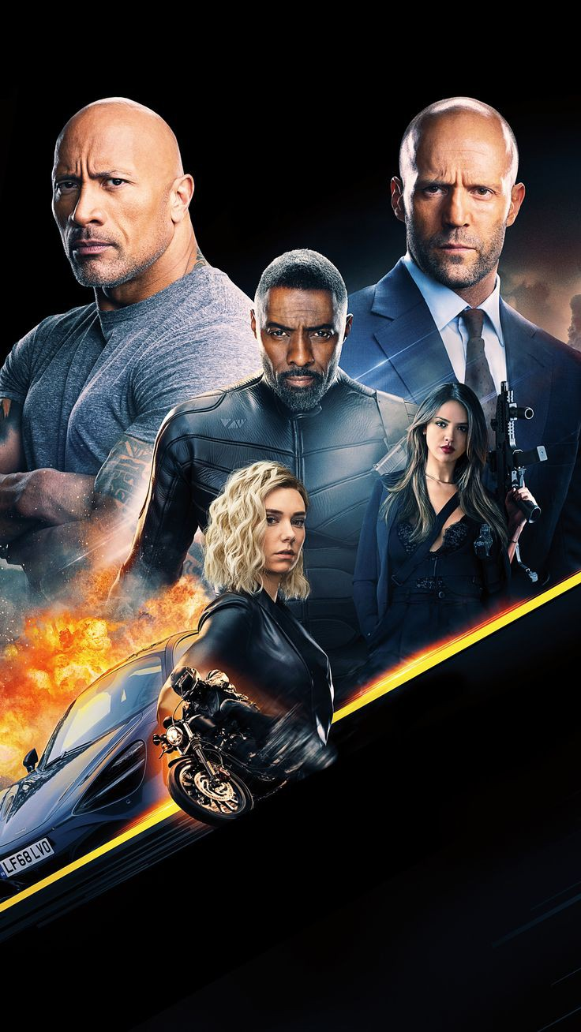
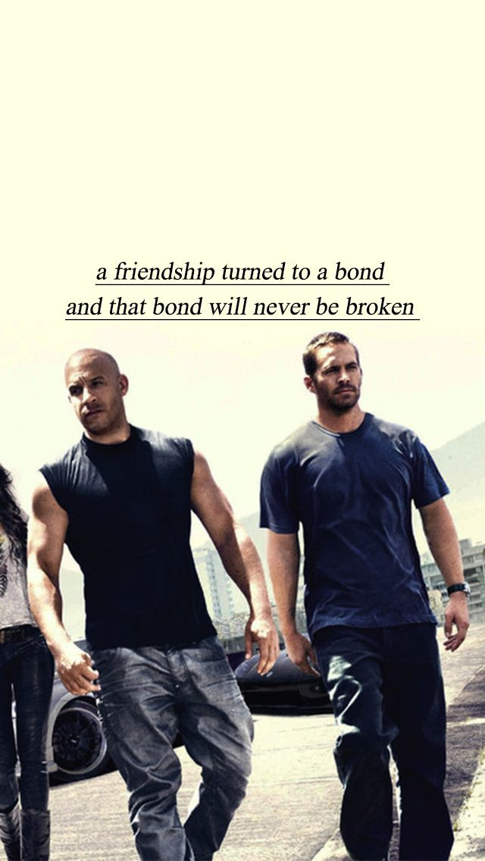
What inspires me?
Fast and furious
Casualty

