Slide 1
Final Project Presentation

Slide 2
What is my final project?
For my final project I want to record (on logic) a 3 track alternative rock EP of covers by bands and artists I like. After deciding what 3 songs I am going to choose, I will record everything myself such as drums, bass, guitar, piano, vocals and keyboard as well as setting and micing it all up. I will also mix the finish product and produce it all myself. I will be covering the 3 songs the way they were made as they’re already perfect the way they are. I will also create some artwork for the EP with the assistance of Paul.

Slide 3
Why am I doing this for my final project?
I am choosing to do this because I really enjoy doing full band covers by bands and artists I like and also because I want to have even more experience and knowledge about recording, sound engineering and mixing.

Slide 4
My aim for this project?
The aim of my project is to learn, engineer, record, produce and realise a 3 track EP of cover songs using Logic Pro X and release it on YouTube with accompanying artwork. I aim to complete all aspects of the project by myself, including the performance and recording of all parts.

Slide 5
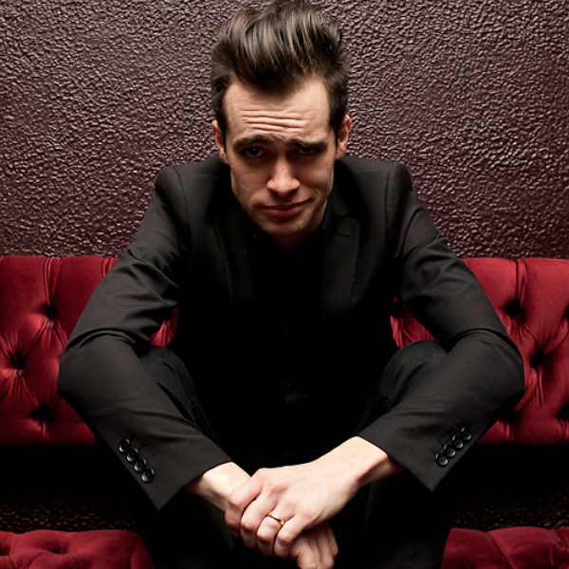
Inspiration
My inspirations and influences for this project are Fightstar, Don Broco and Panic at the Disco since I am covering these 3 band’s songs. I chose songs by these bands because they’re all a bit different and the songs I'm covering are all a bit different too which gives it a bit of variety as each song I'm covering has its own sound and atmosphere.

Slide 6
Research
Using articles and YouTube videos, I will be researching how to improve my recording engineering and mixing skills so I can use them to enhance the quality of my covers.
Using YouTube videos, tabs, lyrics and my ears, I will be researching the 3 songs to learn the songs as well as learning any unique recording or producing techniques that will help recreate these songs as best as possible.

Slide 7
Planning
Week 1 - 20/2/23 – Start research, Start artwork ideas, Start weekly evaluation
Week 2 - 27/2/23 – Start recording and mixing
Week 3 - 6/3/23 -
Week 4 - 13/3/23 – Start and finish context
(15/3/23 to 30/3/23 away for Italy project)
(3/4/23 to 16/4/23 away for easter)
Week 5 - 17/4/23 -
Week 6 - 24/4/23 -
Week 7 - 1/5/23 –
Week 8 - 8/5/23 - Finish recording, Finish artwork, Finish mixing and mastering
Weeks 9 and 10 - 15/5/23 to 26/5/23 FINAL DEADLINE – Start and finish final evaluation, Finish weekly evaluation

Slide 8
Resource List
I will need myself, a studio, a drum kit, a guitar, a bass, a MIDI keyboard, Mics (which include an AKG d112, Shure SM57, 3 AKG d440s, 2 AT4041SPs and a s’Es Titan) and Cables (such as jack leads and XLRs).

Slide 9
Practical Skills
I will need drumming skills, guitar skills, keyboard skills, vocal skills and recording skills so I can record the instruments for the songs.
I will also need mixing and mastering skills so I can enhance the sound of the song to make it closer to the original songs as possible.

Slide 10
Problem Solving
A problem I may encounter is not having enough time in the studio. A solution for that is too practice and learn the songs at home so when I'm in the studio I can do it in one take.
Another problem I may encounter is having too much of a workload. A solution for this may be to work out what I should prioritize to prevent any stress. I could also reduce my workload if I feel like it is necessary.

Slide 11
Presentation
I will present my project with artwork to accompany my covers and put them on to YouTube.

Slide 12
Evaluation and Reflection
I will do the main evaluation and reflection at the end of the project so I can evaluate and reflect on everything I have done for this project.
I can also use a target sheet to evaluate and reflect on my progress every week.

