Slide 1
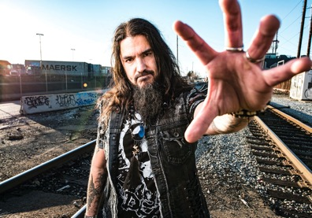
Trivium - Creeping Death - feat. Corey Taylor and Robb Flynn

Slide 2
Venue and Type of Audience
The Venue is at the 2012 Revolver Golden Gods Awards and it fits this genre of music because it provided metal fans with some serious thrills, as their favourite artists winning awards, presenting and collaborating for once-in-a-lifetime performances and it makes it that extra special as the audience is physically there to feel the power of the music.

Slide 3
Communication
They use a lot of verbal and physical communication throughout the whole performance to make the audience make as much noise as possible during the song especially Corey Taylor who shouts at them a lot so they make as much noise as possible.

Slide 4
Stage Presentation
The band members have a small stage and they use all their stage very well so they can constantly move around each other. They use flashing red and blue neon lights to make them stand out to the audience and it puts the spotlight on them.

Slide 5
Musical Competency
They perform the song very tightly which is good to say it’s a one of thing and they don’t consistently rehearse it together since there are featured musicians and as well as it being a cover so they are not as familiar with it compared to Metallica who wrote the song and they consistently play it together and know the song of the back of their hand. It also has the same dynamic and volume the whole way through which is perfect for this song.

