Slide 1
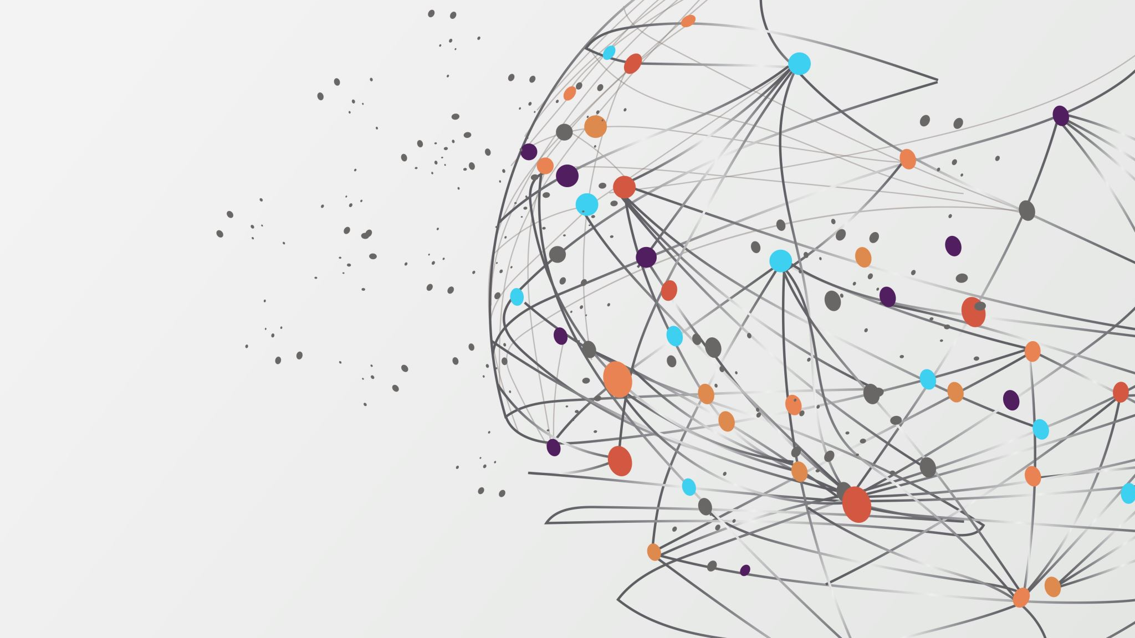
Final project by Azan Iqbal
How Music Affects To Your Mental Health
1 idea Podcast (TRP)
2 idea TV show
3 idea You Tube Podcast video

Slide 2
You tube Podcast (TRP)
Mentioning different type of classics songs
Using facts and figures
Therapist/Physiologist recommend to listen to more happy music
Mood Booster songs
Pakistani/Indian music
Videoclips and Acting Style
LGBTQ+ Songs
Negative bits are that it requires a lot of script and time and organization

Slide 3
What it means to me?
And it has be something that everyone should be aware of
This is very personal to me and helped me a lot
And I hope is something that helps a lot more people

Slide 4
Target audience
My target audience is Pakistani\Indian youth audience
LGBTQ+ music and what it means for people that go through LGBTQ-Phobia
There is no official data on the LGBT+ population in India, the world’s largest democracy, but the government estimates there are 2.5 million gay people.
LGBT+ rights activists say the true figure could be far higher and want authorities to spread awareness about gay rights to prevent last year’s verdict from fading into irrelevance.

Slide 5
Happy songs(Mood Boosters)
Research
Music can be distracting and lower your stress
https://namica.org/blog/music-that-makes-us-feel-good-playlist/ - :~:text=Our favorite melodies release dopamine,energize us for the day. In fact, research has shown that it can lessen the impact of depression and anxiety. A study done in 2019 found that college students who listened to classical music every day for two months lowered their levels of anxiety significantly.
https://www.northshore.org/healthy-you/9-health-benefits-of-music/#:~:text=It%20can%20also%20reduce%20heart,feelings%20of%20anxiety%20and%20depression.
It can also reduce heart rate, lower blood pressure, decrease cortisol (stress hormone) levels and increase serotonin and endorphin levels in the blood. It elevates mood. Music can boost the brain's production of the hormone dopamine. This increased dopamine production helps relieve feelings of anxiety and depression
https://www.northshore.org/healthy-you/9-health-benefits-of-music/ - :~:text=It can also reduce heart,feelings of anxiety and depression.
Our favorite melodies release dopamine, known as the feel-good hormone, which activates our brain's pleasure and reward system. Music can have a positive, immediate impact on our mental state; fast tempos can psychologically and physiologically arouse us, helping energize us for the day.

Slide 6
Context
I think the topic I’m talking about is very important and is very relevant for today’s generation a YouTube podcast is a great way to deliver a message, because YouTube is very used and also is very popular by youth, and the topic I chose is something that affects millions of people, and makes their day to day every difficult, so a great way to help them is talking about this topic, and giving some tips and help about it.
I think is very suitable the topic because it affects to more people day by day

Slide 7
Style I wanna make (Reference)

