Slide 1
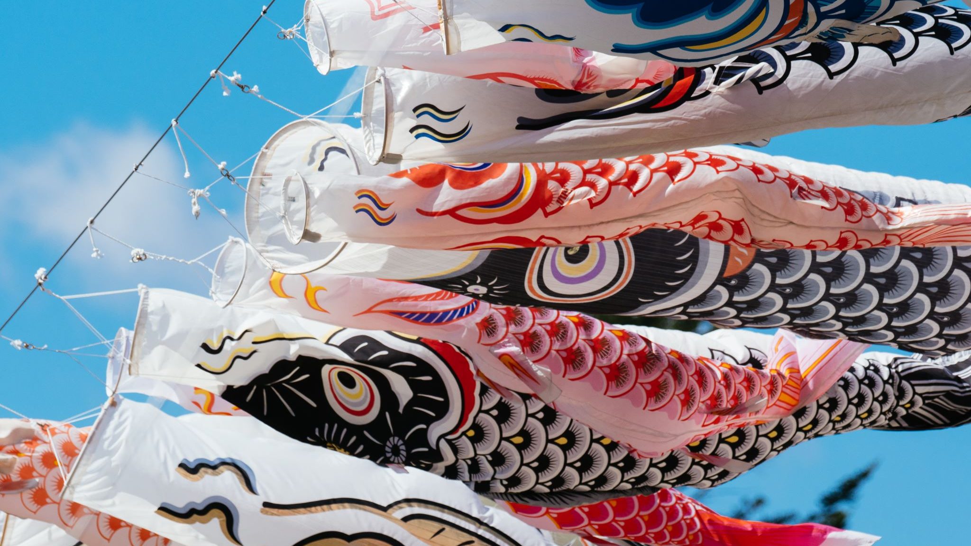
Japanese mythological creatures

Slide 2
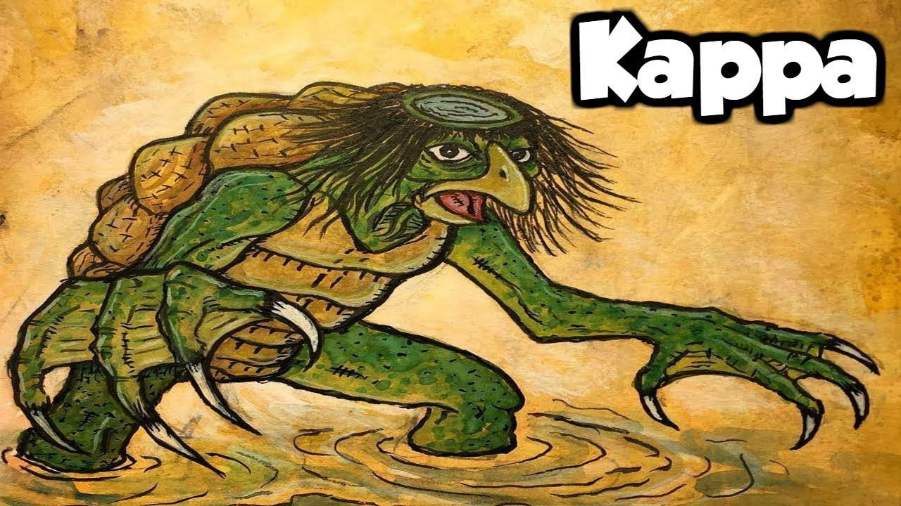
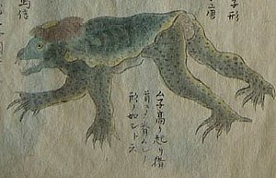
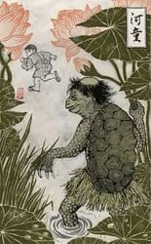
kappa
The kappa is a water dwelling creature that lives in e.g. lakes, rivers and ponds of Japan.
The word ‘Kappa’ is another word for ‘river child’
The kappa is a humanoid swamp Japanese mythical creature

Slide 3
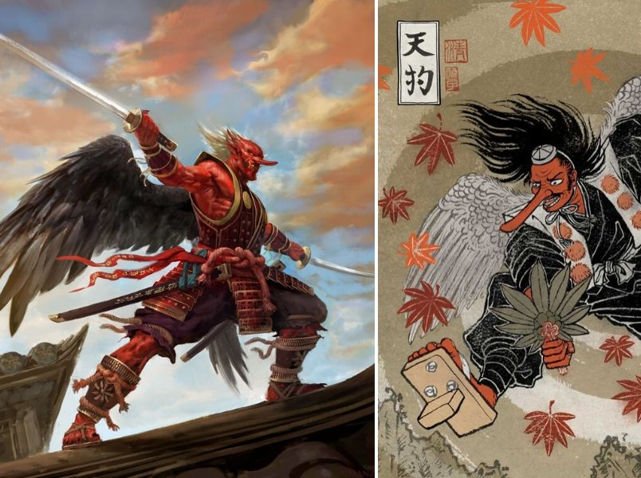
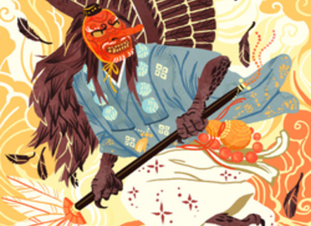
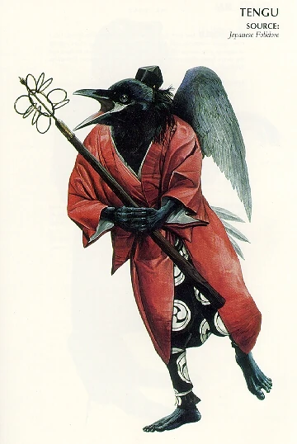
tengu
Tengu is a supernatural being that can appear into different forms
The first tengu is depicted as having crow like features for an example black wings, bird head and ect.

