Slide 1
Project 3 scrapbook creative task due date: 03/02/2023 Alexander Hammond level 3 year 2

Slide 2
Table of contents
Slides 3-9 Briefing & intro
Slides 10-18 problems & solutions
Slides 19-44 brainstorming & idea pitches & locations

Slide 3
BRIEFING
&
INTRODUCTION

Slide 4
WHAT IS THE PROJECT
This project is a free range no restrictions placed, creative process where we are given 4 weeks to have a short film/show which includes a fully custom script to front of house hospitality. The project is very varied in what we are allowed to come up with, however we have to consider many things such as age groups and what is appropriate to who we would be presenting to.
This project also includes complete independency which gives us a challenge and prepares us to lead the younger year into this years FMP which can improve our problem solving and leave us better suited to the incoming stress of the FMP that looms upon us.

Slide 5
MY GROUP
My group is:
Me- script, camera crew, light crew, sound crew
Olivia- camera crew, light crew, sound crew, Director
Tyler- script, camera crew, editor, light crew, sound crew
Oliver: script, camera crew, light crew, sound crew

Slide 6
WHAT IS THE AIM OF THIS PROJECT
The aim of this project is realistically a last chance to have the creative and stress free freedom before our last major project (FMP) with despite the small turn around of under a month as the official starting date was 05/02/2023 which means we have just under a month to have everything done.
The aim is also to make it so we have a rough idea of what to do for the FMP so we know what we are doing and are prepared to lead so we wont be left behind and we can start to plan straight away as early as day 0

Slide 7
What am I excited about?
I think the possibilities are almost endless and that intrigues me to the highest level. I know the entire process with be a laugh with my friends and no matter the end result I should be able to enjoy it to its fullest as last year was very enjoyable when we partnered with the creative media team.
I am sincerely hoping that I enjoy this process as well, it has been a while since the last thing I have done during my time here that I liked doing from start to finish so my hope this time is high

Slide 8
Am I nervous..
Yes and no, about the project as a whole I know I have a reliable team that can we can push through and put on a good show so I am not concerned about that aspect. However, due to the current situation of writing this at 14:46pm on the 05/02/2023 the on going rail strikes across the UK are really limiting our ability to meet up and get scenes recorded/rehearsed in real time which can lead to some quite interesting and potentially critical problems in the later run as for example the performance day something could cause Tyler and Oliver not to show and we would be in a very serious predicament

Slide 9
WHAT SKILLS WILL WE GAIN
Independence
Leadership
Coordination skills
Stage-management
Time management
Much needed lighting experience
Directing skills
Set/ sound/ costume making experience

Slide 10
PROBLEMS & SOLUTIONS
(p&s)

Slide 11
INITIAL PROBLEMS (solutions on some slides listed)
Train strikes info slides 12-15
Limited ideas
Indecisiveness
Cast members not showing up (mostly due to the strikes)
Evade-ability
Starting the script
Brainstorming
Planning issues

Slide 12
Current train strike info. (Dec to may 11th)

Slide 13
What the last couple of days have been looking like.

Slide 14
What do I know this causes?
Unfortunately, there isn’t many ways to deal with strikes and there isn’t anything we can do about them as they aren’t going to stop until the government folds and eventually compromises and they agree to terms.
I am aware that this can destroy the rail line industry as a whole for the UK if they continue much longer
This is going to make our life's very inconvenient since our members Tyler and Oliver now have very limited travel almost every day causing them to also leave college early which isn’t great.

Slide 15
What can we do?
The only logical thing we can do at this point in time is to just to hope that the very crucial days run smooth for them so they can get here without issue
If this isn’t possible however and fortune isn’t in our favour, we will have to make do with what resources we have for that specific inconvenience as we cant let it get in our way of the process so compromises like teams calls and (if we decide on the film) to record scenes within Skipton and have them edited in with a scene in both Bradford and Skipton look incredibly similar which isn’t an easy task
We will have to see what the future holds (update on slide * as this was written on 5th of January)

Slide 16
Our current position 05/01/2023
Ideas and conversations
planning
Train strikes and script
Key:
Green: good
Amber- all right
Red- problematic

Slide 17
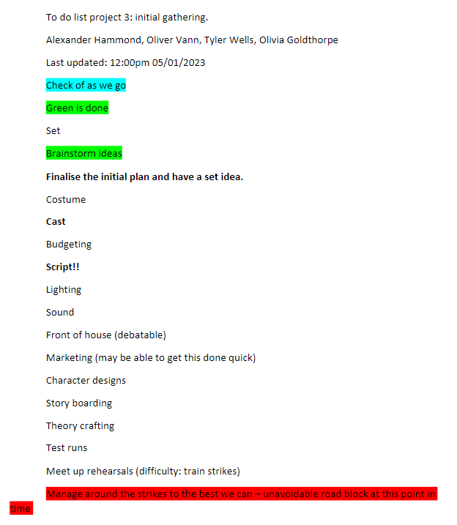
To do list 05/01/2023

Slide 18
The train strike aftermath
Luckily, the trains were on our side most days. We were fortunate enough that the train drivers were reluctant to keep their strikes to a minimum during the filming days. However, this did not mean they were reliable as many late shows from our crew which was out of our control but now it is over it wasn't bad at all and was very easy to manage

Slide 19
Bibliography (p&s)
Rail Strike Travel Information 2023 | Disruptions & Refunds | Trainline (thetrainline.com)- last accessed 05/01/2023 15:04pm
Train strike | Everything you need to know | Northern (northernrailway.co.uk) – last accessed 05/01/2023 15:05pm
2022-12-11-to-2023-05-20-1668082567.pdf- rail strike information table last accessed 05/01/2023 15:05pm

Slide 20
INITIAL BRAINSTORMING & SHOW/ FILM PITCHES

Slide 21
INITIAL IDEAS PUT THROUGH
A spinoff episode of the popular UK tv show the inbetweeners
Splicer 2 a sequel to the first splicer from the Collab with creative media last year
Inspector wells a prequel to the events of splicer
A film about the main character suffering who is believed to be scitsophrenic but the person she speaks to throughout is actually a spirit and is dead (plot twist)
An adapted version of a musical of some sorts
A fully choreographed dance piece

Slide 22
FINAL CONCEPT
The final agreed terms with my team is inspector wells a splicer story™ was the final confirmed idea. The story of an inspector who is corrupted by the killer that he hunted for almost 8 straight years and due to the many events that occur he his driven to murder and it’s the origin story of the original splicer!

Slide 23
THE SCRIPT BREAKDOWN
SCENE 1:
we meet our protagonists inspector and detective wells and con who are sharing a pint within the bar Sunbridgewells™ where the conversation heats up as con who has been a Pushover starts complaining how he had the chance to catch the killer and solve the mysteries but wells stepped in because of his higher rank from a characters direct orders that we meet shortly after. The scene fades out after the shocking discovery that con finds out that night..

Slide 24
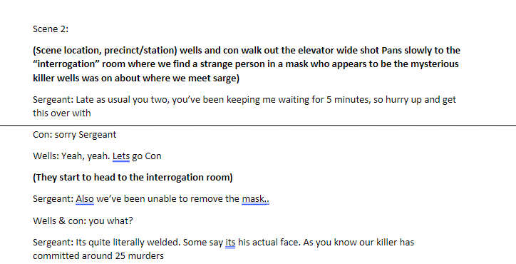
Scene 2

Slide 25
Scene 2:
In this scene we meet sarge. Sarge is a veteran female officer who demands respect from everyone and shudders con for being inexperienced and pushes him about for it. We are lead to a room where a mysterious man is seated with a mask that cannot be removed who seems very pleased with himself where an interrogation takes place with this masked unnamed killer.

Slide 26
Scene 3
This is the killers monologue where wells begins to realise the dark truth behind “famous” detectives. The scene is a mo0nolouge wide panned out with a close shot from behind the inspector until the sergeant abruptly interrupts as he did find out what he needed and proceeds to name every name despite being annoyed from the interruption

Slide 27
Scene 4:
The sergeant calls con after the last scene where days have passed and wells is no where to be found and con gets into a very heated argument with her and is eventually told to “piss off” after talking down to such a high ranking officer.

Slide 28
Scene 5 (finale)
The final plot twist where wells turns evil and becomes the infamous splicer which is what leads to the original ever filming of this small franchise splicer! Where con is unfortunately brutally slain and the ending is going to be very similar to the first to keep the theme.

Slide 29
The characters.
Splicer- Alex (slide 29-30)
Inspector wells- Tyler (slide 31)
Detective constance (con)- Oliver (32)
Sergeant- Olivia (33)

Slide 30
The original splicer.
The original splicer played by Alex (me) is a mass murderer who had been on the run from the well renown inspector wells. During his 8 year get away he had performed and hid away 26 bodies which is accountable for a mass genocide. He is a cocky, smug, cold-hearted killer who, when captured. Didn’t really seem to mind and his fate isn't his number one concern, and he enjoys correcting people on his tally of murders.

Slide 31
My personal Inspiration for the splicer.
https://youtu.be/9lsSXUupB4w - Scream: Wrong answer (HD CLIP)
Channel: Binge Society
As inspiration to create my splicer. I took inspiration from the scream franchise. I love how cocky the Ghostface is and their gender fluidity to keep them shrouded in mystery until the big reveal when they are taken down. As to why I chose this infamous killer, the way he toys with his victims with gameshows for example or driving them insane with his phone calls and persistency as shown in the clip above . I know I can use the techniques during my monologues that are shown in this example clip to instill fear into our audience watching

Slide 32
Inspector wells
The main character of this short film. He is a veteran inspector with many years of investigating experience like the deduction skills of Sherlock Holmes with how quickly he can deduct a case and hunt his target down and get them into the station and locked behind bars with not a single detail missed. He is tall and dresses smartly and has a charming but stern personality about him. His best friend and partner in arms is detective constants who he shields from Sarge when he is being pushed around

Slide 33
Detective Constance
Inspector wells closest partner and friend who works in the force on the desks and barley gets put in the fields and when he does wells takes over due to experience and rank issues. He is a confident lad but has issues due to being intimidated by his highest-ranking commander Sarge who pushes him around but when she wants him to be better and stand up for himself, but he always takes it the wrong way

Slide 34
Seargent (sarge)
The Seargent is the head female chief of the force and commands and gives the go ahead to all the ongoing investigations and hunt downs. If anything will happen, she will need to know asap. Nothing gets past her; she commands respect around the station and instils fear to every criminal that stands before her, and they wouldn’t in their right mind try anything. She isn't close with our other detectives and sees them as desk monkeys working their life's away to please and capture the murders of the world.

Slide 35
Set props:
Orange purge glowing mask
Plastic bloody knife
Old computer
Old keyboard
Old printer
Fake blood

Slide 36
Filming techniques
THE TILT AND PAN:
The most basic filmmaking technique for aspiring filmmakers is tilt and pan. two terms represent a simple camera movement on a tripod, but they are slightly different:
Tilt: A camera movement that tilts the tripod head up or down.
Pan: A camera movement that pans the camera head from left or right

Slide 37
panning
Panning and tilting the camera during the creative process was our most basic technique we used to get our shots. Using; wide short slow and fast pans. Up, down tilts to get different angles of our shots. Using different angles allowed us be more varied which can add more complexity to a shot instead of the camera just zooming in and out giving the scenery more depth and more focus. Despite being such a basic and obvious tech, it can really give more emphasis on a scene and create very minimalistic tension which can be very effective which is eveident with the inspector wells bathroom scene as a prime example of this.

Slide 38
Dolly & Trucking Shots
Dolly Shots and Trucking Shots. Like tilts and pans, Dolly Shots and Trucking Shots are slightly different filmmaking techniques:
Dolly Shot: A movement where the entire camera moves forward or away from the subject.
Trucking Shot: A camera movement where the entire camera system moves parallel to the subject.

Slide 39
Dolly and trucking.
Dolly and trucking we made use of to change the subject of the characters during shots which allowed us to make the shots more diverse and complex. What I mean by this is during the film as you can see in the final slide which is the link to the video you can see we used trucking a lot when we work with the characters to follow them up the stairs for example with con. Which is shown in the final product and allowed us to play with different angles from the front back and side shots.

Slide 40
DUTCH ANGLE A dutch angle is a filmmaking technique where the scene is shot at a dramatic angle. A dutch angle is used to disorient the audience, giving them a general feeling of uneasiness, towards whatever is portrayed on screen. Like zooms, dutch angles should be used sparingly. But when used correctly, a dutch angle can be a great tool for disarming your audience.

Slide 41
Dutch angle
We had played around with the idea of the Dutch angle but due to lost footage we cannot show this. However, we had recovered the footage towards the end where we recorded the final scene where the splicer disappears and reappears that didn't make the final cut where we used different angles in silence where we had him face differently to make it unpredictable where had next show up.

Slide 42
LOW KEY LIGHTING
In contrast, low-key lighting is a film lighting style that extensively uses shadow to increase dramatic effect. You’ll often find low-key lighting in films that require a sense of suspense or drama. For example, horror, drama, romance, and action movies.

Slide 43
Key low lighting
We used low lighting in multiple shots that never made the cut or that was unfortunately lost due to an editing mistake on the final recording day, but we had experimented with low lighting to no lighting at all which allowed us to get creative with the experience to make the shot as tense as we could whilst not making it horror focused

Slide 44
SLIDES 36-39 SOURCED FROM
15 Essential Filmmaking Techniques Every Filmmaker Should Know | ActionVFX

Slide 45
LOCATIONS AND ASSESSMENTS

Slide 46
Locations outside of college
Sun bridge wells we have been given permission by their manger and we have prepared a risk assessment that I will provide on the next slide which entails the full details of what we will be doing. Sunbridge wells is a local pub located near the other pub Weatherspoon's in Bradford city centre with a very rich history that you can ask about to learn more of how it got to be where it is today. This location is perfect has we have had close connections before with the staff within so getting permission is not going to be an issue.

Slide 47
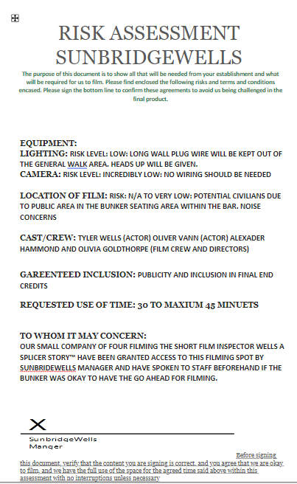
RISK ASSESSMENT

Slide 48
Why are risk assessments important
Risk assessments are a vital part of health and safety and ensuring the employer and or establishment/company you are professional, and you know what you are doing. If we did not have beforehand the likelihood of us being able to film would have been extremely low.
Without a risk assessment you are shown as your first impression as weak and incompetent as a company who will just wing it and hope for the best but with proper preparation you can avoid tragedies such as:
Injury/death
Lawsuits
Liability deductions.
Confusion

Slide 49
With a proper risk assessment, you can..
Avoid being sued
Avoid injury and death
Not be made liable
Have more control over the situation
Have agreed terms to work privately
Assure the employer/ lower worries
No interruptions
Clear an area for filming
Rent the location.

Slide 50
Location 2: The hallway
The hallway located outside b25 was a place we had previously used for the original splicer that we had never planned to use as our editor accidently deleted the footage which we had to rush to use and get the scene re recorded for when con and wells walk intot the station.

Slide 51
Location 3: A33 music room
This room was perfect for Olivia (sarge) to look through and then leave the interrogation room as the killer asks her to leave if wells wants anything out of him at all. Recording and getting permission was super easy with getting asked permission from Michael our tutor when he asked for us

Slide 52
Location 4: mezz floor
The mezz floor is meant to be a staff only room within the college. However, with trust granted for our team we were allowed to record. We used a desks chairs and an old laptop found as the set, and we got everything done with minimal interruption and we politley sent everyone on their way when needed.

Slide 53
Location 5: C21C bathrooms
The scream scene. Where inspector wells loses his mind. This was by far the hardest place to record smoothly as we had multipul retakes as we were disturbing the class next door by mistake but we got it done. We needed this space as it is the only one we could find that wasn’t commonly used

Slide 54
Location 6: Outside the cafeteria
The place old splicer is killed and where wells becomes splicer and finds the mask. This was a very high-risk place to film as a lot of civilians were around. The floor was horrible and very unpleasant to sit upon when filming and was not comfortable at all and required sanitizing fo me after as the smell on my hands was awful. There was lots of sharp objects around Aswell which was very bad

Slide 55
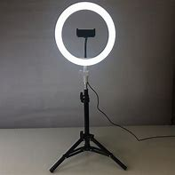
Equipment used
A basic ring light that we utilized in sunbridgewells to get the right lighting

Slide 56
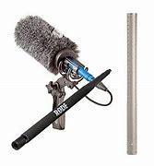
Sound mic

Slide 57
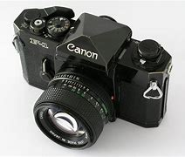
Camera to film.

Slide 58
Rehershal photos

Slide 59
Sunbridge wells behind the scenes 56-58

Slide 62
What is going on in these photos 59-61
In these photos Tyler and ollie are discussing shots with the bartender Alex and going through potential shots on how they walk in and receive their drinks, many theory shots were taken (unfortunately lost) of them walking in as seen in photo 61 if they should walk in together or simultaneously but it was eventually agreed on them walking in together.

Slide 63
Behind the college 59-63

Slide 68
What is happening 63-67
We went over many crafting sessions to get these shots right. Experimenting with me being dragged in pic 66, and Tyler lifting the mask after killing me in 64-65. It wasn’t easy to know what we wanted and there was a lot of deleted footage and retakes which helped us decide what we wanted as its such a vital part of the film. Discussions carried on for a very long while to get what we wanted and we took many different set re designs to get the shot we needed

Slide 69
Mezz floor 64-69

Slide 75
What is happening 69-74
These are some examples of us deciding on shots for the interrogation and setting up the office scene and going through our plentiful options to make this look as good as possible as shown in pic 72,74 and 71 with close ups and wide shots. In pic 70 setting up the Sarge and con scene was easy to do a dolly pan over to get into the shot we got.

Slide 76
THE FINISHED PRODUCT!
https://www.youtube.com/watch?v=oYvpeXtCdy8
Duration: 11mins and 29 seconds.
Inspector wells: a splicer story

