Slide 1
Alexander Hammond’s FMP PITCH

Slide 2
Hammonds 4 Step Agenda:
Step 1: WHAT ROLE I WOULD LIKE AND WHY (PRODUCTION/ACTING)
Step 2: WHY I SHOULD BE CONSIDERED FOR PRODUCTION ROLE
Step 3: MY IDEAS AND SCHEDUELES
And finally step 4: A CERTIFED PLAN FOR SUCCESS
With this agenda that I am presenting to you today you will be enlightened to my vision of what I see for the potential of Bradford colleges FMP Grimm Life By David ayers.

Slide 3
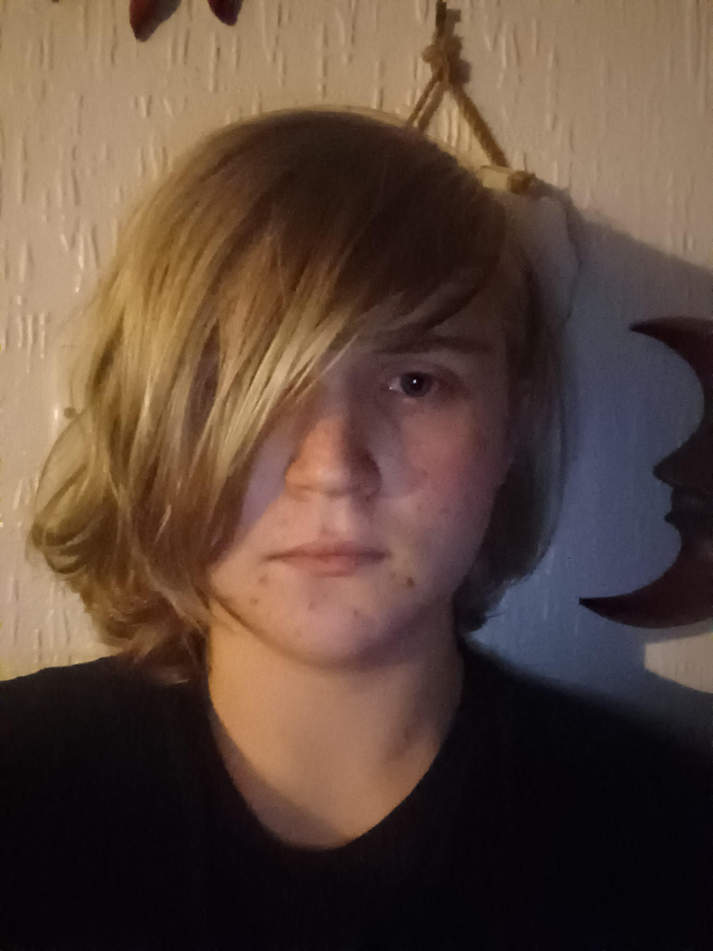
STEP 1: Item 1
A basic introduction, who am I? name: alexander Hammond age:18 profession: triple threat. Experience: RSC Deer shed 2022 screen Yorkshire Dance united Yorkshire saint gorges hall 2021 musicals: ELF- lead Marry Poppins- ensemble les Misérables- ensemble Grease- Lead

Slide 4
Step 1: Item 2
What roles am I interested in?
Production: Warmup leader Acting role: Lord bosemann/Thothh
Why?
As for the production role I have always enjoyed during my almost 7 years experience in the industry the warmup aspects of the production elements. It is a well known fact that warmups prevent injury and provide proper preparation but can also be great for mental preparation for the sessions which is vital for productivity and I believe I can provide that energy for the company and bring the heat every single day and get the team motivated.
As for the acting part, during the initial read throughs two characters really stuck out to me giving this plays very pantomime nature which is bosemann and the Thothh. Both are very important to the story as bosemann is the main villain and the thothh is a big part of the characters development during the play due to being the lackey of bosemann and they both provide comic relief and are very high energy characters that would be a ton of fun to play around with and develop with during the process

Slide 5
Step 2: Item 1
Why me for warmups?
As shown in step 3 very shortly I will present to you my routines and preparation for the warm ups which will include my unbreakable solution of the what I like to call “sweat not brek initiative” which is comprised of many easy warmup techniques that will gradually increase as I further advance the difficulty as everyone's stamina improves which will be flexible to everyone's needs as seen fit. From day one to the very end I intend to build up our actors to get them to the standard and have the stamina evadable to sing and dance at the same time. The same goes for the vocals as well, without proper cord warm up you can seriously strain my voice and damage your vocals regardless of being a singer or some one who is doing 5 monologue's its all essential for our day to day practices.

Slide 6
Step 3:The “sweat not brek” initiative: the first nine weeks.
Goals: final push. | Week1 | week2 | week3 | week4 | week5 | week6 | week7 | week8 | week9
Monday | 10 sit ups | 5 press ups | Sit ups and press ups(20/15) | Plank 30 secs | 5 press ups 7 burpees | 30 sit ups. | Breaks. Stretches | 10 burpees | 2 min plank.
Tuesday | 15 sit ups | 10 press ups | squats 12 | Plank 45secs | Arm extensions 2mins | Breaks. stretches | Breaks. stretches | Breaks. stretches | 30 squats.
Wednesday | 20 sit ups | 15 press ups | 5 burpees | Plank 1 min | Breaks. stretches | 5 press ups. | Breaks. stretches | 1min 30 plank. | Break. stretches
Friday | Rest. | Rest. | Rest. | Rest. | Rest. | Rest. | Rest. | Rest. | Rest.
Saturday | Rest. | Rest. | Rest. | Rest. | Rest. | Rest. | Rest. | Rest. | Rest.
Sunday | Rest. | Rest. | Rest. | Rest. | Rest. | Rest. | Rest. | Rest. | Rest.

Slide 7
Step 3: part 2
I am well aware that not everyone can adapt to such an extreme schedule so alternatives will be put in place and everyone ability will be accounted for no matter what week we are in and medical conditions physical wellbeing etc.

Slide 8
And finally step 4.
My plan will ensure the most efficient development of stamina possible, by the end of the initiative the company should be able to hold there own in the rehearsal process and should be properly ready to ensure a solid and productive day as they will be ready to work hard to get this how properly on its feet. Thank you for your time!

Slide 9
Fundraising ideas
Raffle prize: Easter eggs
Pj/non uniform day
Name the teddy
Bake sale
Duration: 27th Feb- 2nd March

Slide 10
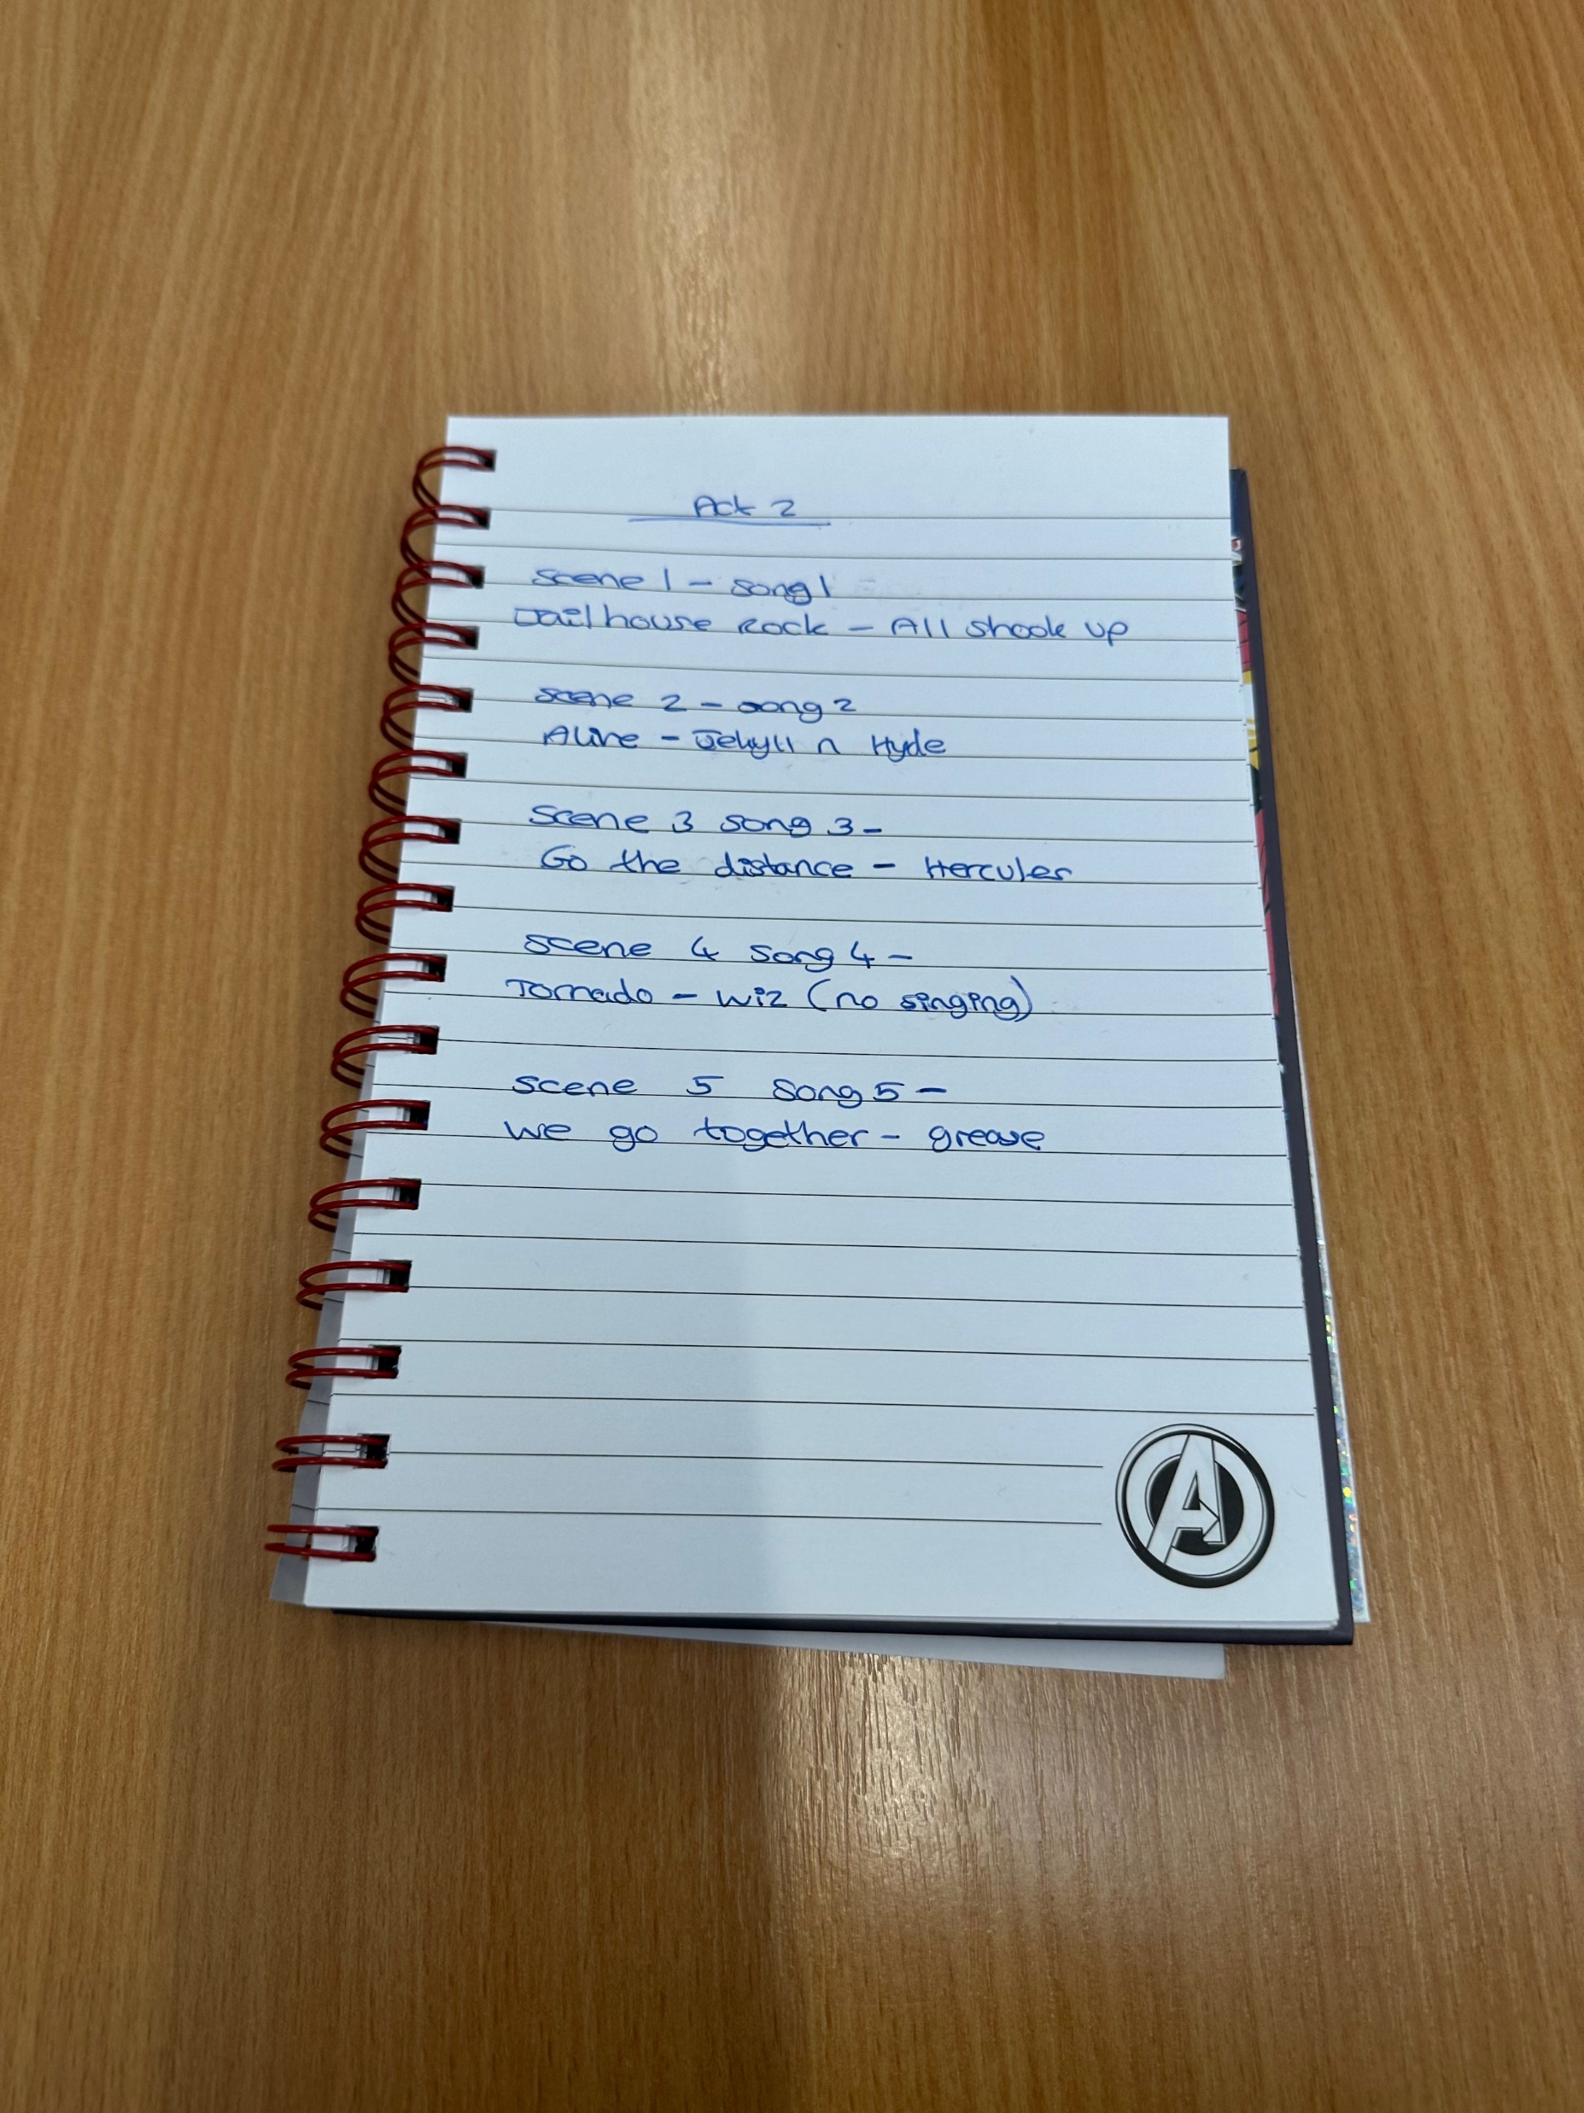

Slide 11
THANK YOU!

