Slide 1
Pitch
Hope Maiden

Slide 2
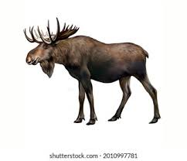
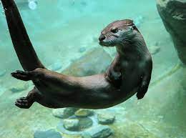
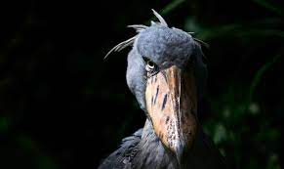
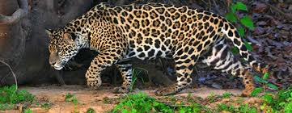
Idea
The idea for my Final Project is to have drawings and a few animations of animals from around the world. I will be including small amounts of information on each animal that are both interesting and fun for people of multiple ages. I will have aquatic, land and aerial based animals for each location. The animals will be from Australia, America, Amazon and Africa.

Slide 3
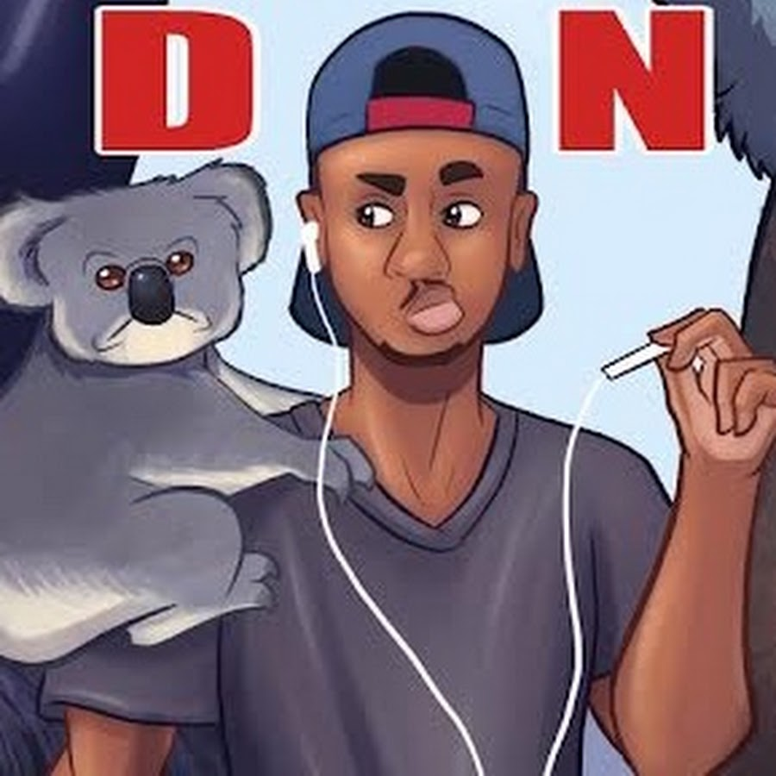
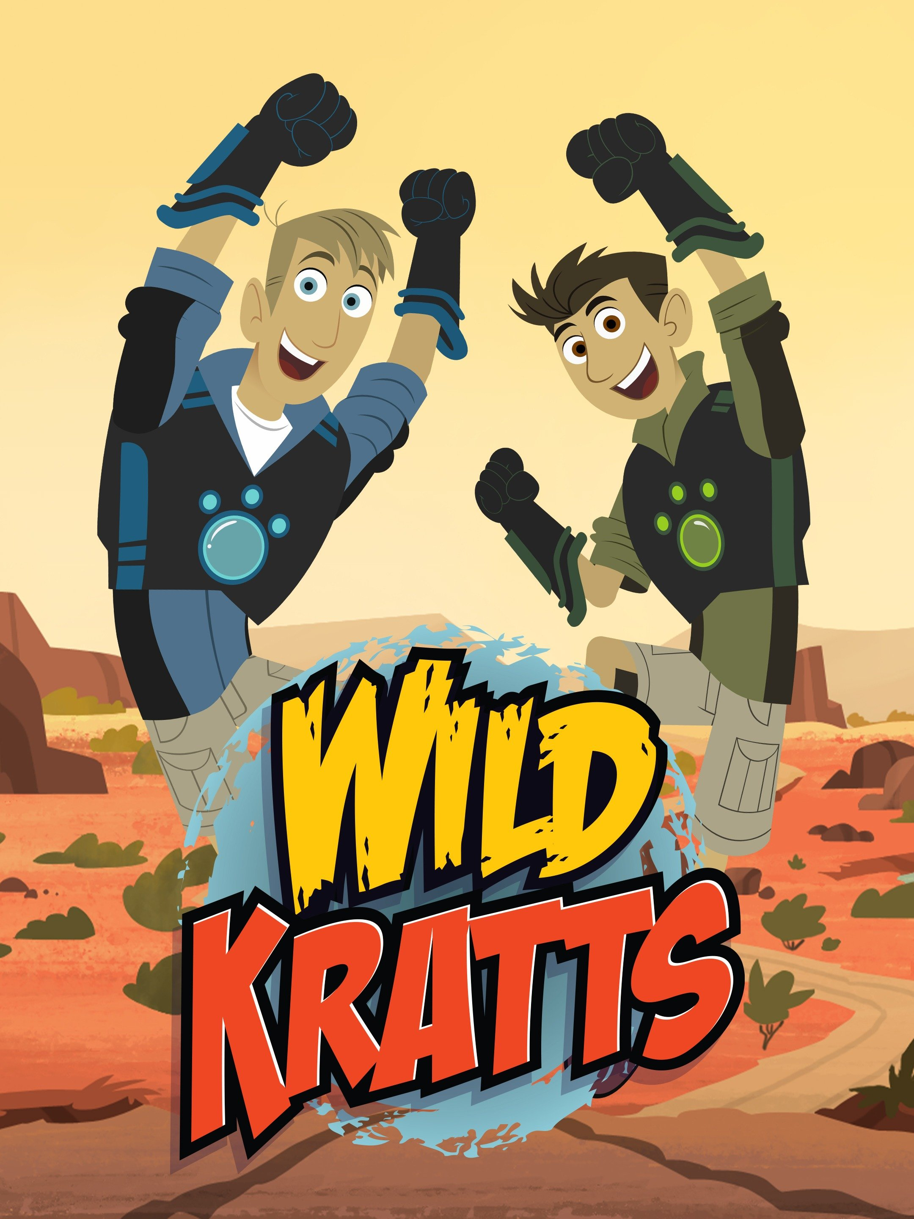
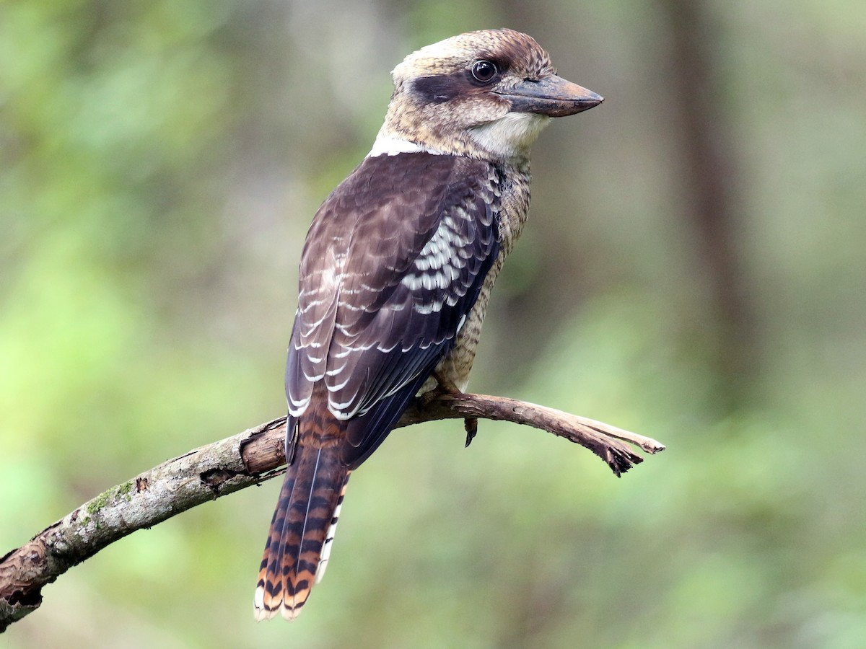
My Inspiration
My inspirations for this project comes from shows I watched a a child such as wild Kratts and youtubers such as casual geographic. This has also been influenced by my ability to draw and animate animals easily.

Slide 4
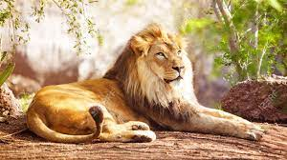
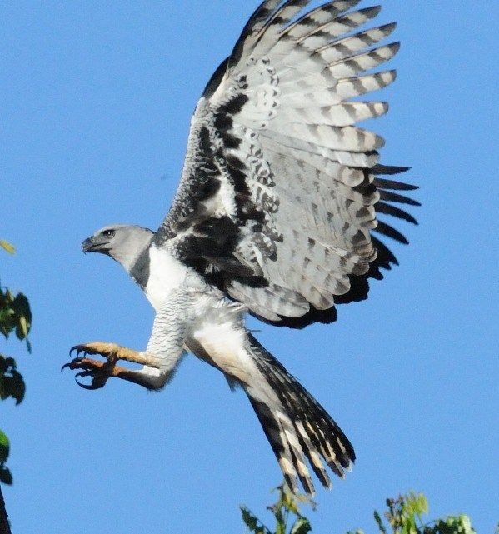
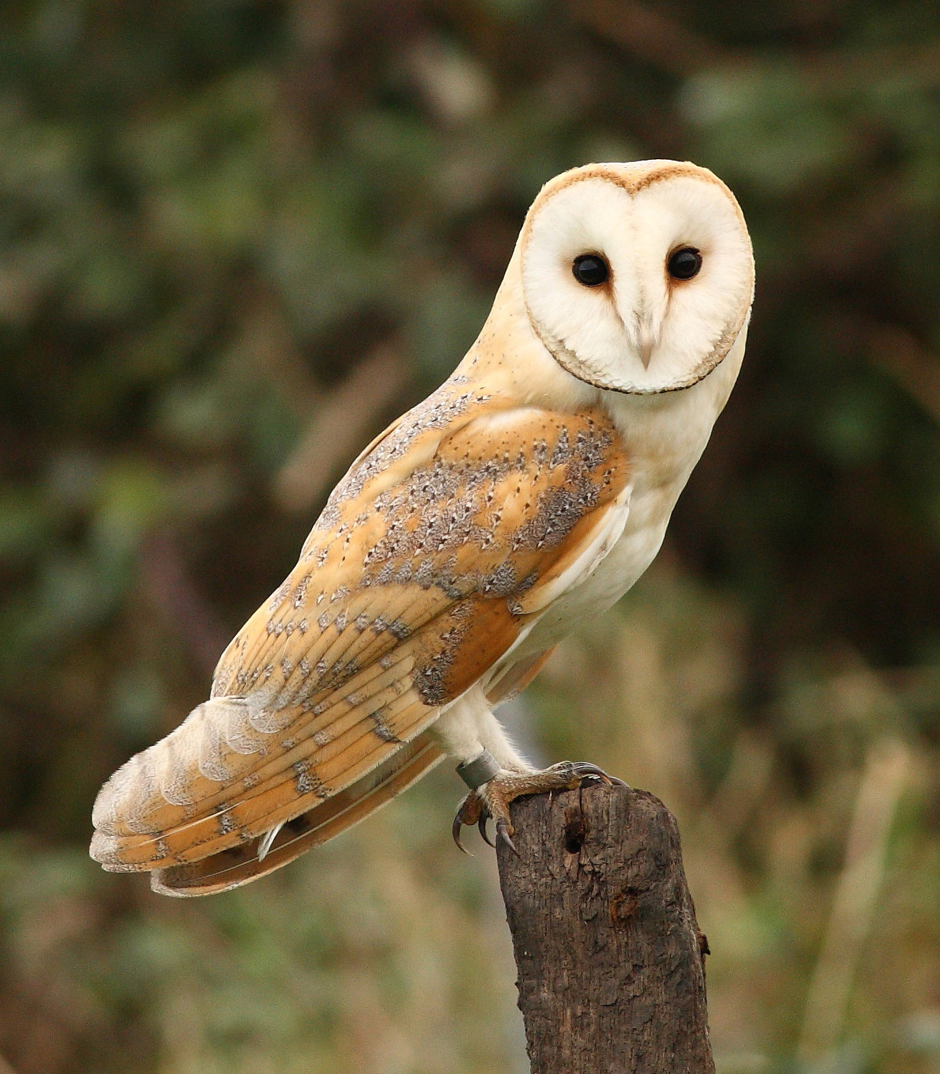
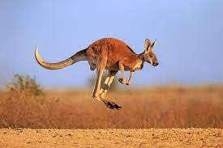
My Role
My role is to draw and animate animals around the world that fit the pocket planet theme in the dear-shed festival. I also need to provide information that is both interesting and fun for people of all ages. The information also need to be understandable by everyone including people with disabilities.

Slide 5
Theme
The theme for this project is called pocket planet. The reason for this theme is to include a more diverse knowledge of different cultures, religions, species and history of places around the world.

Slide 6
research
My research for this project involves finding information about multiple different animals from around the world, such as habitats, socialization and how they live in the wild. The research also included the history of multiple different animals and how they evolved to be what the are today and what there closest living relative would be. I also looked into how humanity has either helped or hindered the survival of many species.

