Slide 1
Pitch
Hope Maiden

Slide 2
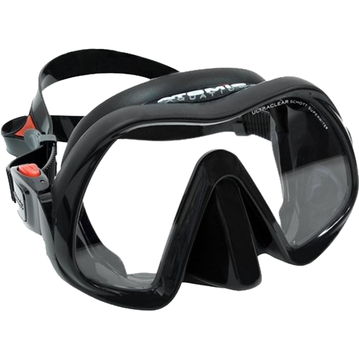
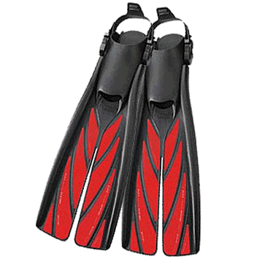
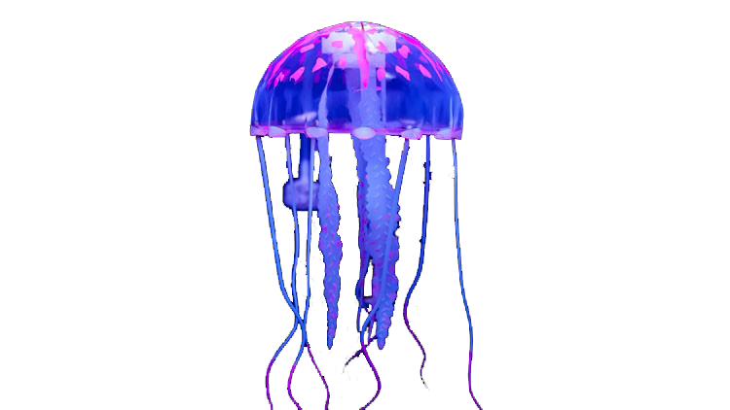
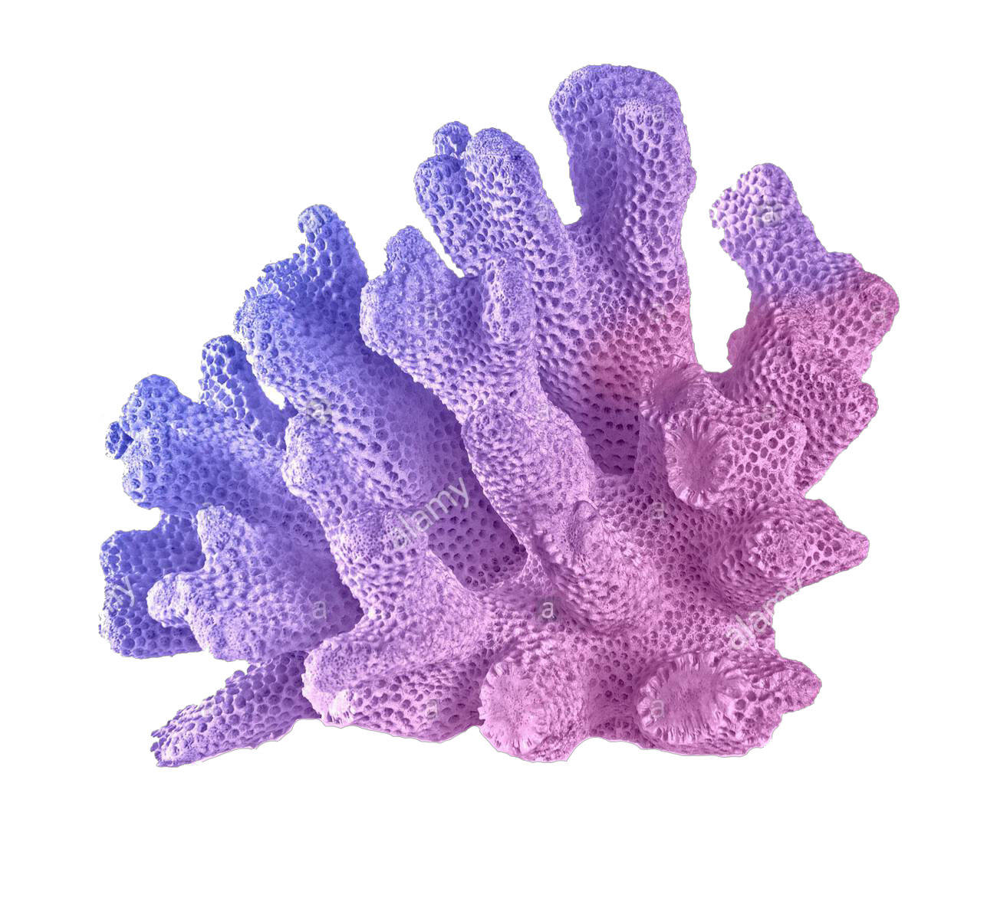
Title
Genre
The title of my movie will be The Silent Cry. This is to show the silent pain a victim of bullies can be in.
The genre of this movie will be fantasy and slice of life. One convention of fantasy movies is supernatural creatures such as merfolk, elves, fae and pixies.
Another convention is special abilitys in humans such as pyrokinesis, cryokinesis, hydrokinesis, chlorokinesis and telekinesis.
Logline
The Silence Is Here.

Slide 3
Synopsis
Why
When someone is bullied it can be hard to tell anyone, especially if nothing is done when they do tell. Bullying can and will get worse as time goes on, even faster if nothing is done about it at the start.
This is to show the extent of how far bullying can go when nothing is done about it.
Characters
I will have multiple characters most of which will be roughly 15-17 years old. The main character will be 16 years old while the three bullies are in the 15 and 17 range. The strangers age however will be unknown to the audience while clear that they are ancient.

Slide 4
Conclusion
This film is supposed to end with the meaning of not being hurtful or rude to others for any reason. To improve on this in the future I am hoping to have access to quality filming locations and editing resources.

