Slide 1
Live performance presentation
AJR
Wow, I’m not crazy live
NYC
10/10/19

Slide 2
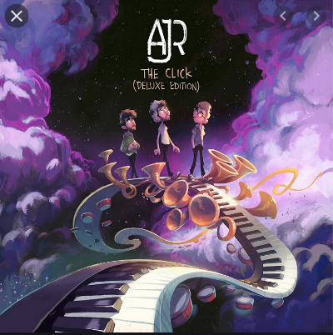
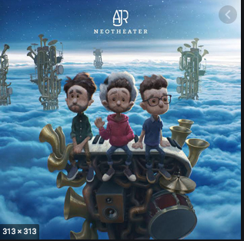
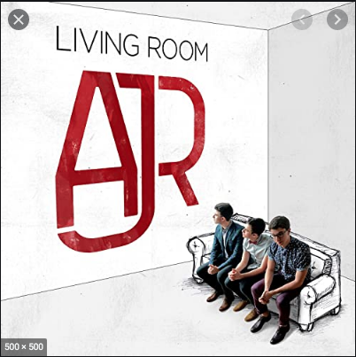
AJR the band
AJR are a trio band they are brothers Adam Jack and Ryan Metzger
AJR have 3 albums to there name Neotheater being there highest-charting album
AJR have said that for there live performances they wanted to bring a theatrical experience to the stage and in my opinion I believe that there live performances are the best I’ve seen.

Slide 3
Audience
The lead singer (Jack Metzger) before he starts the song he worms up the audience with call and response while the band and the technicians prepare for the song
The band changed there way of performing live from there last tour there new album tour brought a whole new live experience for the audience to enjoy
AJR wanted the audience to feel like the were watching a Broadway and to know that everything's there for a reason

Slide 4
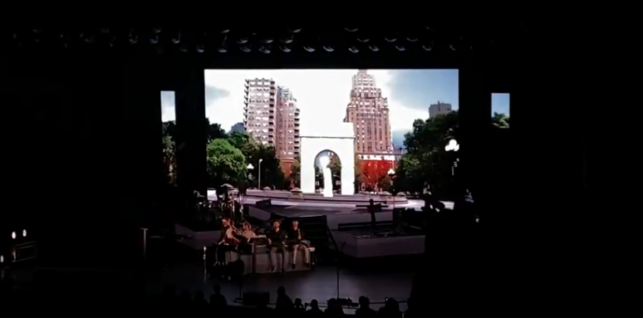
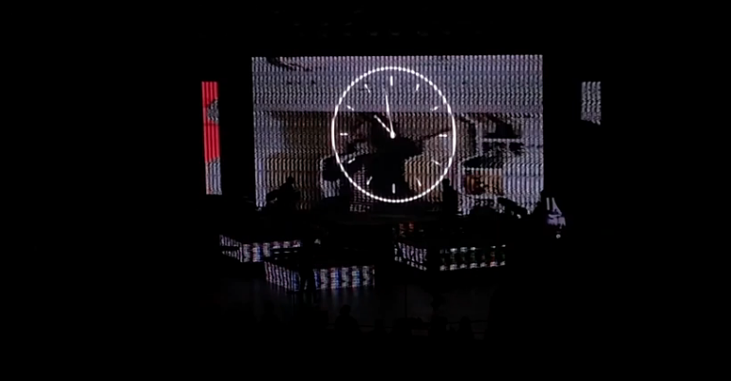
Visuals and sound
While on stage AJR use a sound board to use prerecorded vocals to help carry the song forward
The band used a time travel gimmick to show there busking days this was shown when the lights went out and the big screen in the back had a clock going back with recorded voices
Once the went back the lights were switched back on and the screen show a park in New York were they used to busk

