Slide 1
My FMP idea
Hirah Aurangzeb

Slide 2
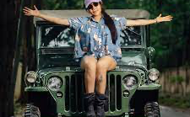
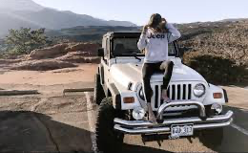
What Is my Project
This Project is based on branding the company Jeep.
This is by making a social media post on the interior and exterior look of the Jeep Rubicon Wrangler.
My log line is going to be: ‘Beep beep I'm a Jeep.’

Slide 3
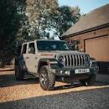
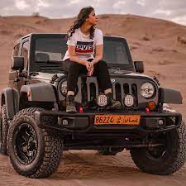
Why am I doing this project?
I'm doing this project as I am trying to be able to climb the ladder to fit in the Marketing Career, so in order to do that I am wanting to begin small. My Main Project idea is to be able to make a social media post or small reel on the interior and exterior of the Car ‘Jeep’ and showcase this brand.
My strengths that are motivating me is Loyalty I have to my dream car, and I have good communication skills with people, I want others to realize that you can never judge a book by its cover. There has been many people that when they hear about my passion of cruising in a Jeep, they are shocked thinking of a young female off-roading in a Jeep, it blows their mind.
One thing that influenced me about marketing is that I have a big interest and passion for Jeeps, and this is golden chance for me to believe in myself.

Slide 4
Aims, Objectives And target audience
Aim:
I am aiming to be able to gather experience with this project in going into my dream field (marketing). I hoping to be able to expand the demographics for the Jeep industry in rebranding them in a female limelight rather than the normal masculine perspective.
Share my Passion:
My aim is sharing my passion about Jeeps, cruising in one 4x4 cars with massive tires. Jeeps have a great design with an outstanding interior and exterior.
Target Audience:
My target audience is young females into thinking that it’s normal to be able to look cool in Jeep and it’s a stereotype thought of society that they can’t cruise in big cars or 4x4’s.
Many people come back with unnecessary comments towards women behind wheels.

Slide 5
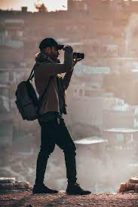
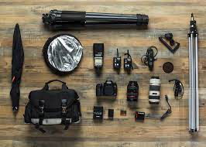
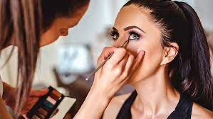
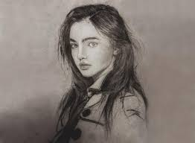
Personnel/Resource List
Makeup Artist
Model
Camera kit
Photographer

Slide 6
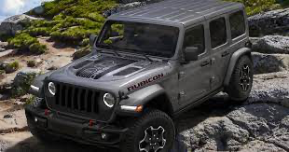
Collaborations
My only collaboration will be with the Jeep Company.

Slide 7
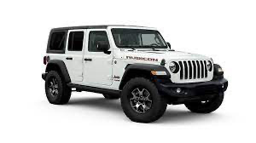
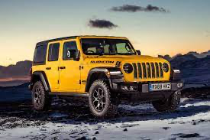
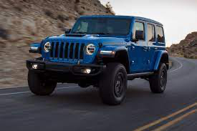
Research and Context
The primary research will be a focus group of 3 females and 3 males, questioning them about the desired dream car and whether they ever come across a female young driver in a Jeep or any big car.
I’m going to take on my secondary research by researching through online research and videos on YouTube. As well as this I am going to do some research by look through some marketing books. Which help me understand how to project my idea and I can help this field.
My project is relevant to the media industry as once again we are going rebrand to be projected to both genders and not only to one gender.
Mine is related to media industry as it will help in promoting the marketing of the Jeep company.

Slide 8
Resources and Problem Solving
Resources:
I will be using Adobe Premier Pro and After effects. Primer Pro will help me in editing the reel I am going to make an interior and exterior of the car. Then I will be polishing the reel up in After effects to make it look more enhanced erasing all the dull lighting and making up to industry standards.
Problems: - Rejections
To overcome rejections, I'm going to try to ask in advance, so they have an enough time to say yes or no. If no Jeep showroom gives me permission to be able to record in one of new cars, then might to a showroom or business where they have used Jeeps even if it is not the Jeep Rubicon Wrangler.
-Crashing
If the systems end up crashing, then I will use another editing app to finish off editing the room. Moreover, I am going to try to get 3-4 different reels to be able to chose the best one.
-No social media
Set up a temporary work account

Slide 9
Planning and Practical Skills
I am going to use organize my planning by using checklists where I can see where I am up and what I have got left. For each day I'm going to give myself an outcome of what should of be done for this week for example ‘WEEK 4 - Initial idea completed’
With this outcomes planned it will give me a chance to check off and reschedule resources and plans to be able to get the project done before the deadline.
The practical skills that I will need whilst making a reel for my dream car is:
Knowing know what I want to say
Communication
Organizing
Patient
Understanding
Observant
Most of the skills I have already built during my two years of this course.

Slide 10
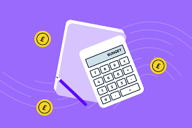
Budgets/Finances
I have no funds to take on this project.
Will be using many resources of Bradford college with permission. Will be using money to for travel expenses.

Slide 11
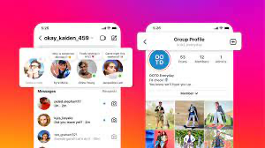
Presentation-Promotion
Presentation:
In my presenting my final product it will be a video format such as a mini advertisement. It will be linked on social media and sent to the Jeep company asking if they like it and want to be on the website. Will be sharing with family and friends to carry on sharing.
Promotion:
To promote my project, I will use a few social media platforms to share it, for example – Instagram, TikTok, Maybe Facebook, but YouTube shorts.

Slide 12
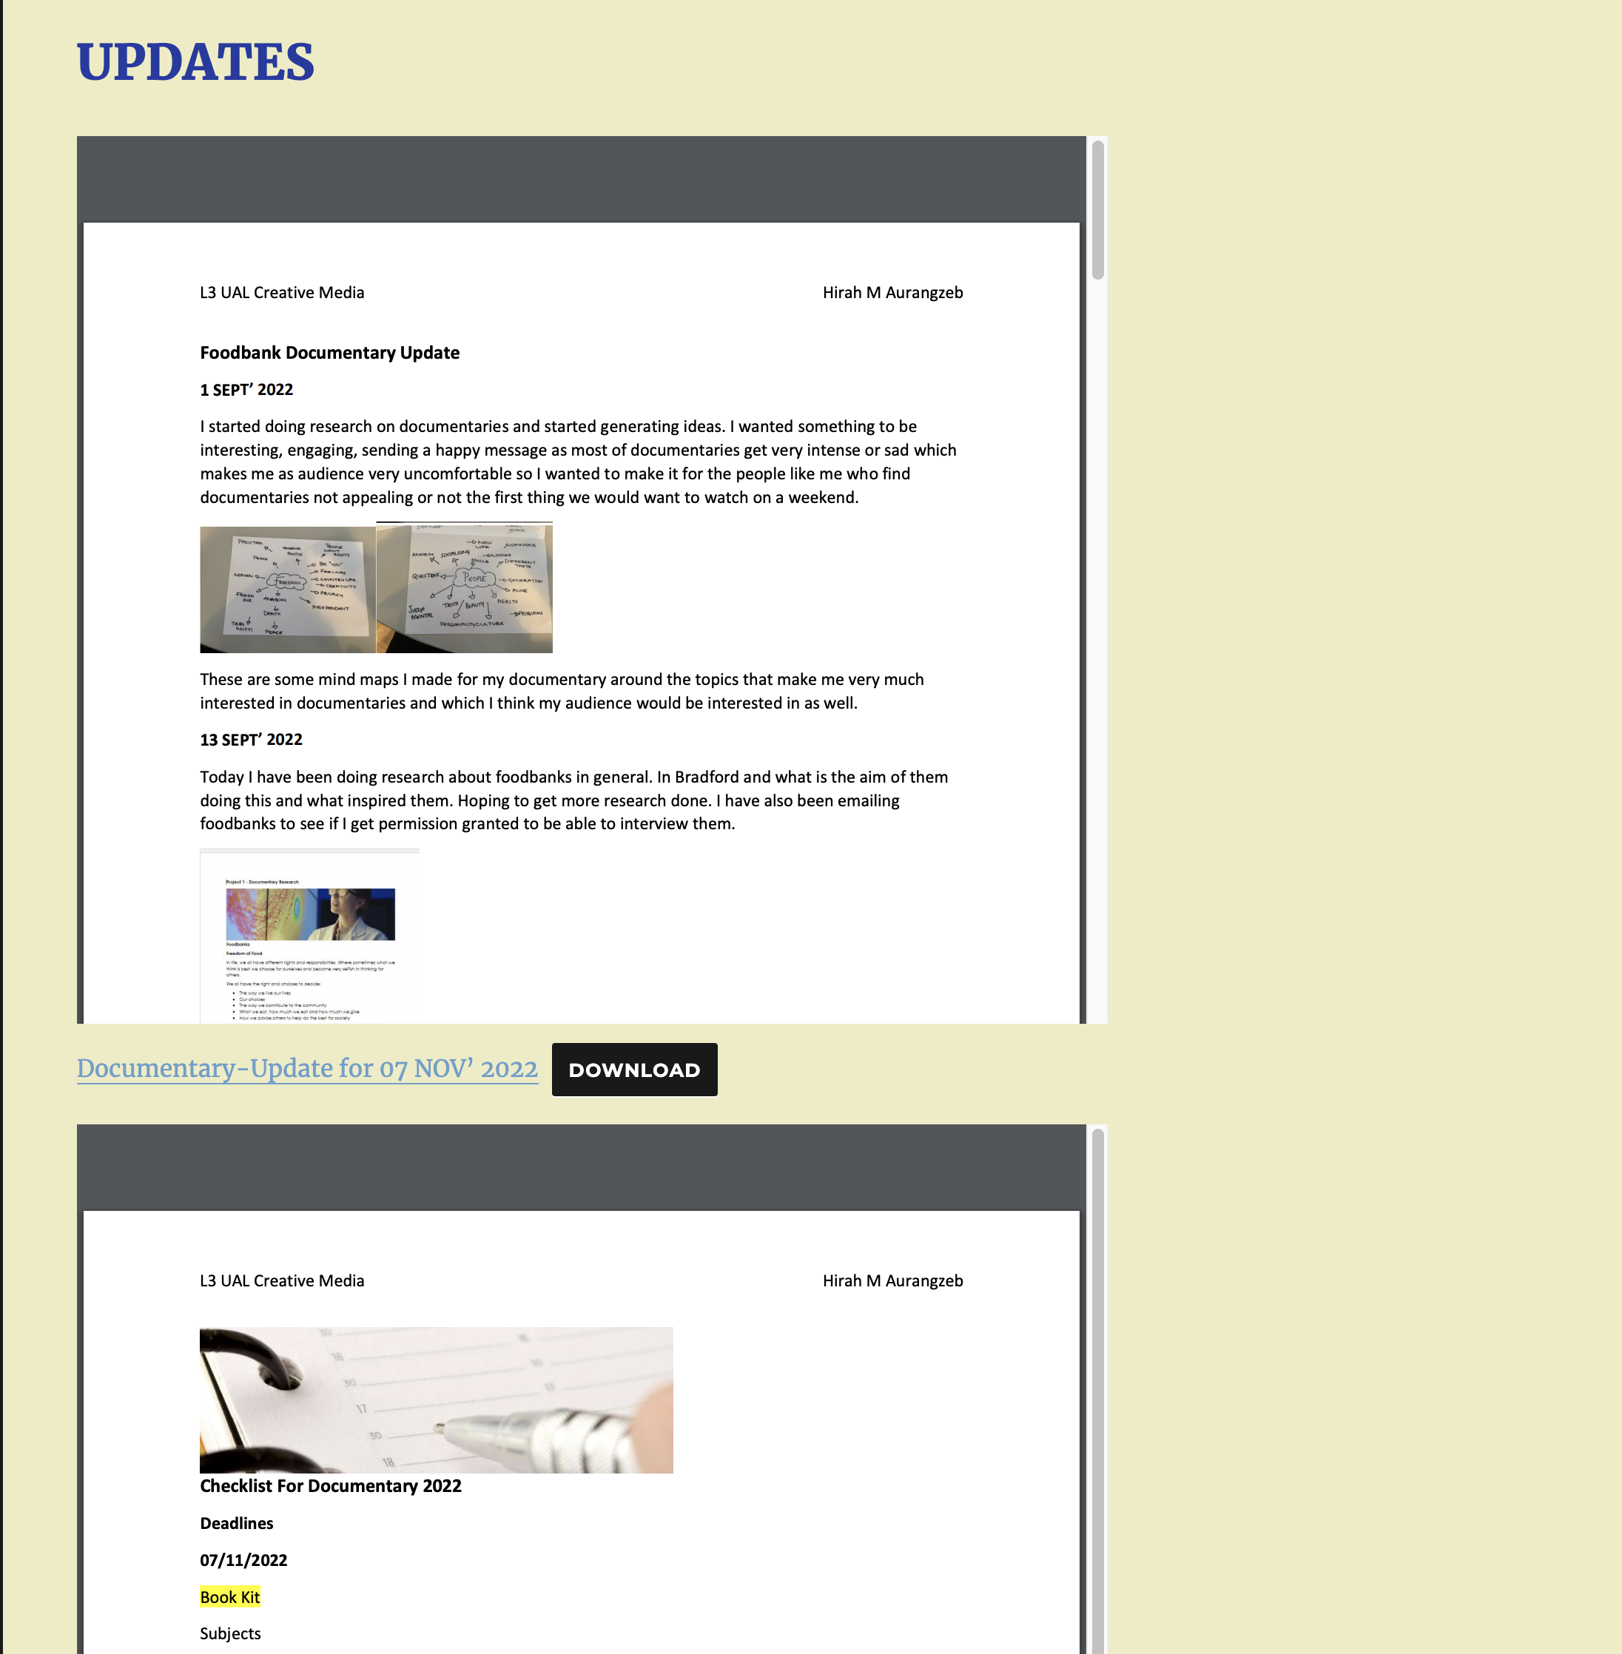
Evaluation and Reflection
Evaluation
For my evaluation I will be writing up many weekly updates, I will have a journal I will be editing alongside this project, for example any problems I face I will write them down and how I came over each problem. Many times, if I am busy trying to get editing done or other plans, I will be recording my thought, feelings, challenges and the positives of my project at the minute. Then may write it up later then post it on Digital space.
Reflection
For my reflection I will writing up what went well, what could have gone better, what can I do next time to prevent it.
Many times, I will be getting others to look at my work and either giving me feedback in what they can see is going well and one thing I should change.

