Slide 1
MY FMP IDEA
Meher ali shah

Slide 2
What is my idea?

Slide 3
Nasheed video
My idea is to do a Nasheed video (Music video).So I will be recording this video by the middle of April. I want to get it recorded by then. My idea will be something I am very comfortable and confident with.
This idea will bring my skills out in many ways. I will be directing the video , producing it.
This idea will improve my directing skills.
THIS idea will be planned and coordinated with my team.

Slide 4
What is A NASHEED ?
he Nasheed (plural, a {nasheed) is a song without musical instruments with lyrics that resemble hymns that praise God (Allah). The person who sings a Nasheed is called a munshid.
Nasheeds are popular throughout the Islamic world. The material and lyrics of a nasheed usually make reference to Islamic beliefs, history, and religion, as well as current events.

Slide 5
How popular are nasheeds?
Nasheeds are sang all over the Islamic world.
Nasheeds promote the love of the prophet Muhammad (p.b.u.h) and allah (god).
It is the praises of allah and the prophet Muhammad (p.b.u.h)
Nasheeds are most popular in the eastern arabian areas, turkey , Syria , Saudi arabia , Iraq , iran , Afghanistan , Pakistan and many more countries.

Slide 6
TARGET AUDIENCE.
WHO IS MY TARGERT AUDIENCE?

Slide 7
Target audience
Ages :
6-11 – children
13- 19 – teenagers
20-26+
Countries:
Syria
Arabia
Turkey
UK
pakistan
MY TARGET AUDIENCE ARE MAINLY THE YOUTH .NASHEEDS ARE LISTENED TO PEOPLE WHO ARE CLOSE TO THEIR RELIGION. IN RAMADAN ESPECIALLY NASHEED'S BECOME VERY POPULAR. INSTEAD OF LISTENING TO MUSIC THEY LISTEN TO THE PRAISES OF GOD AND THE PROPHET MUHAMMAD (P.B.U.H).THIS BRINGS A PEACE OF MIND AND BRINGS YOU CLOSER TO ALLAH (GOD).NASHEEDS ARE LISTENED BY THOSE PEOPLE WHO LOVE THE PLEASURE OF ALLAH. PEOPLE OF THE EASTERN ARABIAN LANDS LOVE NASHEED'S , ITS THEIR WAY OF EXPRESSING LOVE AND FEELING LOVE.

Slide 8
What will i be researching?

Slide 9
research
I WILL BE RESEARCHING DIFFERENT EXAMPLES OF NASHEED VIDEOS.
VARIETY OF SHOTS I WILL BE USING.AND HOW YOU CAN USE THESE SHOTS.
I WILL BE RESEARCHING THE TARGET AUDIENCE
MY LOCATIONS , WHERE I WILL BE WANTING ACTUALLY SHOOT THE VIDEO.
THE DIRECTING ROLE OF PRODUCING A MUSIC VIDEO.

Slide 10
WHERE WILL I BE SHOOTING MY VIDEO/LOCATION?

Slide 11
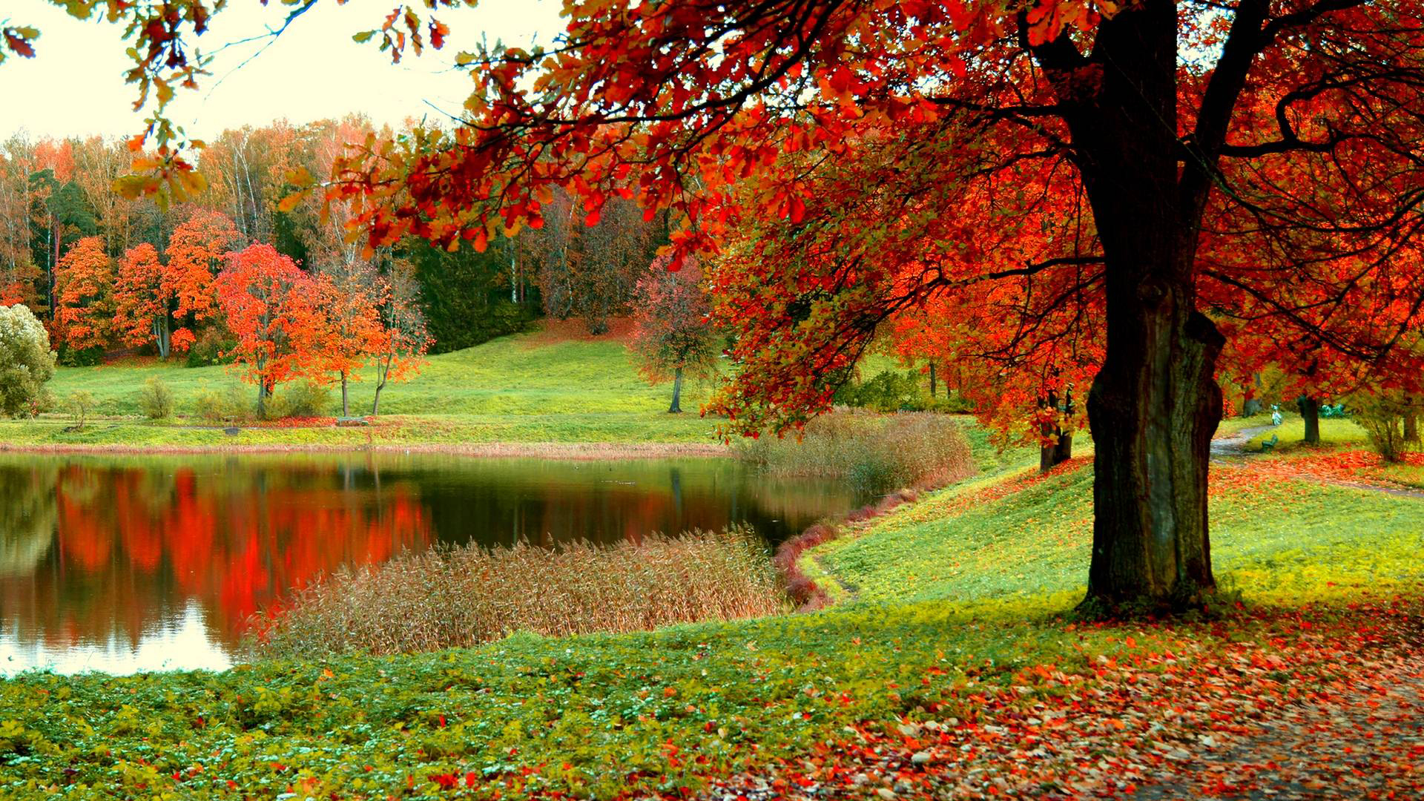
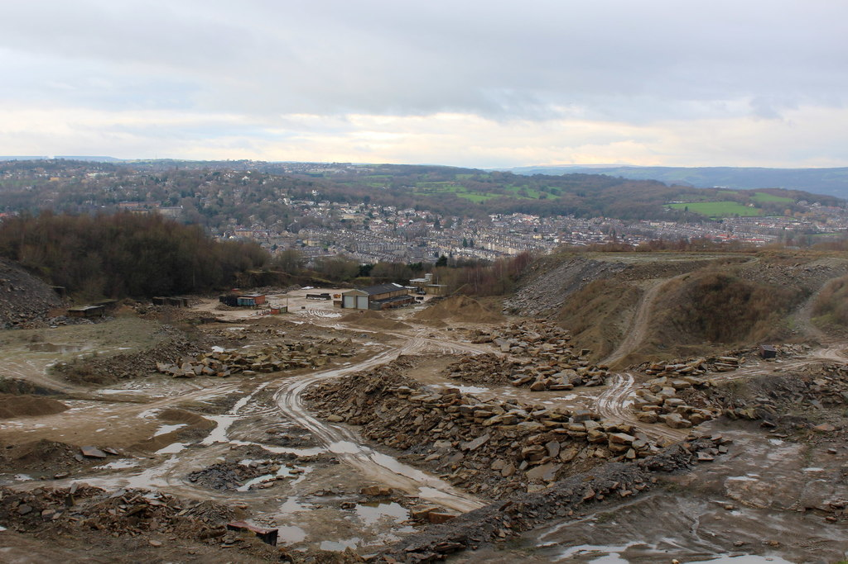
LOCATION

Slide 12
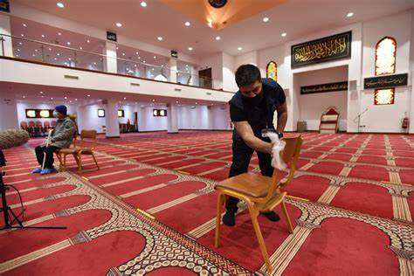
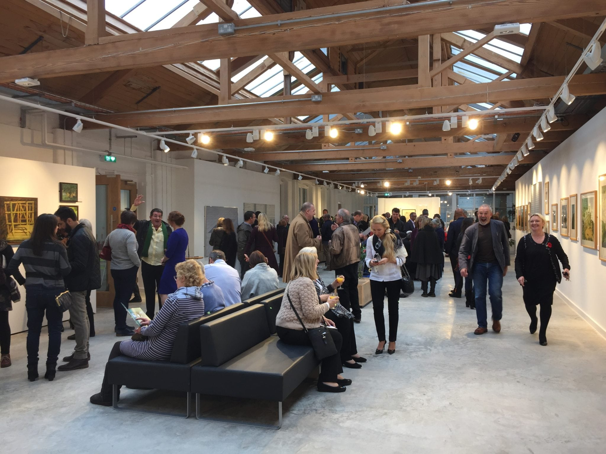
location

Slide 13
collaborations
I will be collaborating with my course friends in making this work.they are experienced in filming short films and recording music videos. They have done so in the past many times.so I will be collabarting with joel and the team on this project.

Slide 14
Problem solving, how will I solve my problems?
I will solve my problems by talking with the team , working as a team.if there is a problem, we work around it not with it.always have a plab b in the back of your mind.we will break down the problem and find different solutions to it.

Slide 15
promotion
After I have done this video , I will be promoting it creating reels on instagram and short promo videos of my nasheed to post on TikTok using different hashtags to interact and get to my audience.i will share my promo video on all social media platorms , to my contacts.
I will get other nasheed artits and influences to share my promo video aswell.
I will mainly be using digital marketing to promote my video.

Slide 16
How will I be presenting my final product?
I will be presenting my final product on youtube. On a digital format.
I will be holding meetings every other week with the team to dsicuss what needs to be done next and what improvements I have made during te time.
I will do a self-reflection short video aswell to show my progress.
I will be presenting my work on digitial space.

Slide 17
What shots will I be using?

Slide 18
Shots and angles
WIDE SHOTS
CLOSE UP SHOTS
PERFORMANCE SHOTS
CUT AWAY/B ROLL SHOTS
SPECIAL VISUAL SHOTS
OVER THE SHOULDER SHOTS
Pov shots
Drone shots
I WILL BE USING THE GIMBLE TO RECORD THE MOVING SHOTS.

Slide 19
What equipment will I use?

Slide 20
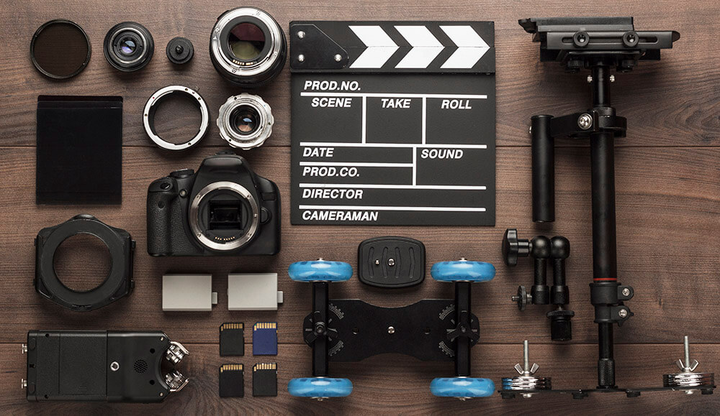
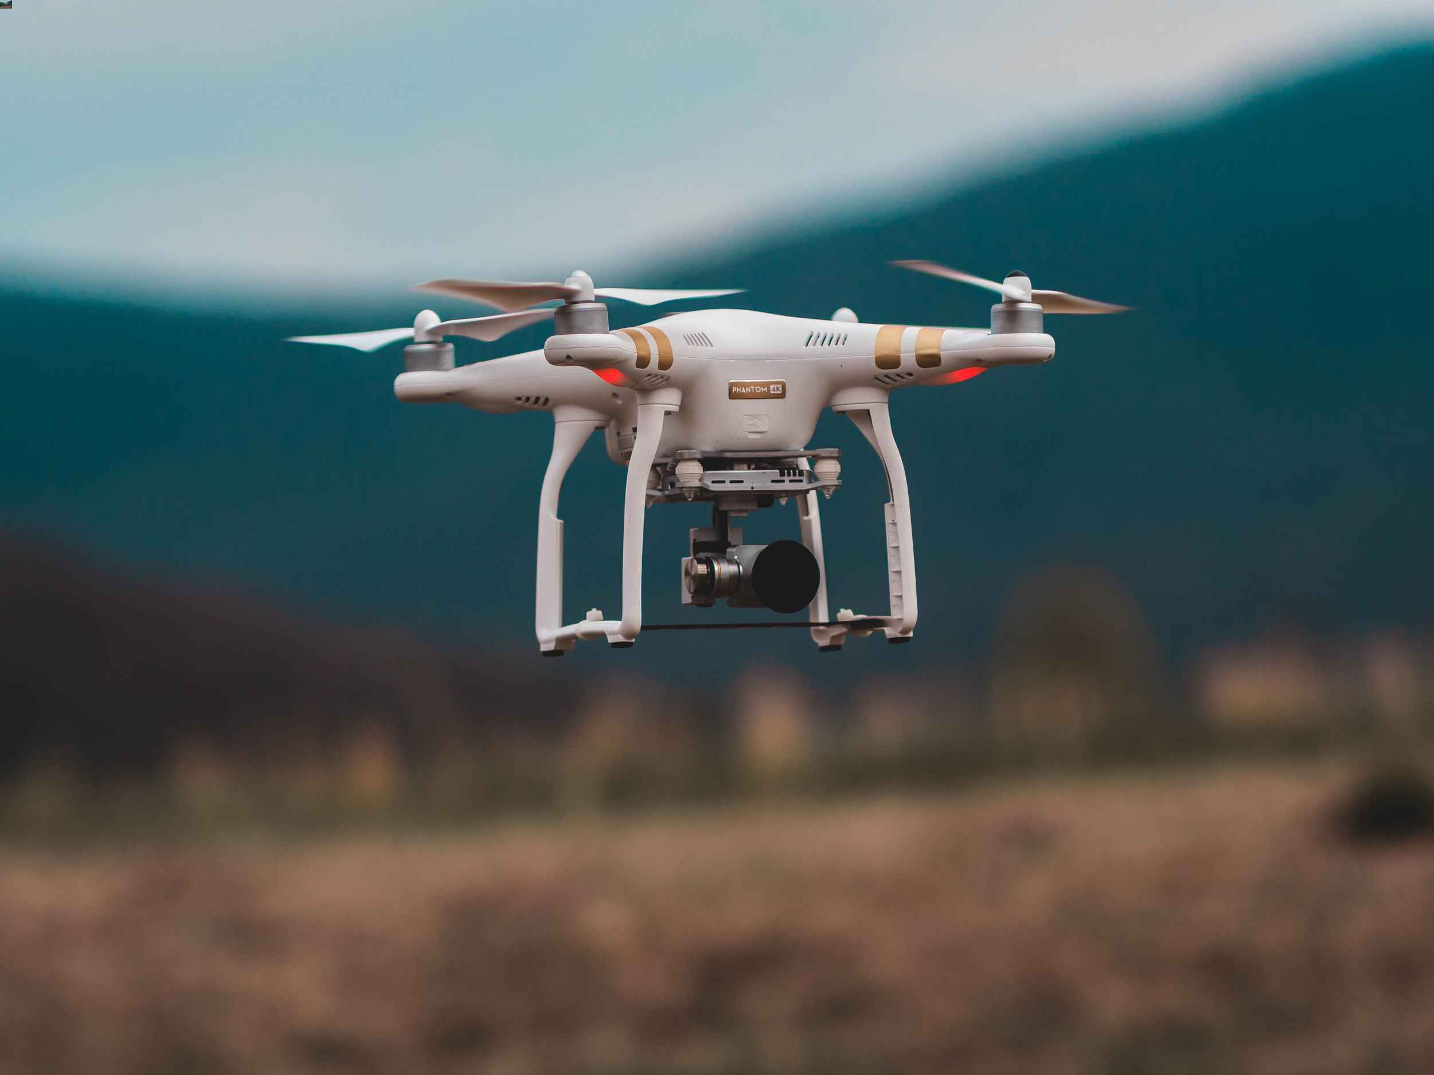
equipment
Camera
Tripod or Gimbal Stabilizer
Video Lighting Kit
Interchangeable Lenses
Headphones.
Speaker

Slide 21
DEADLINES FOR MY TASKS.
Task 1 to be completed by the 10th march
Task 2 to be completed 20th march
Task 3 to be completed by the beginning of april
Task 4 to be completed by the end of april
Shoot to be at the end of april.
Evaluation to be completed by the end of the may.

Slide 22
Conclusion
IN CONCLUSION I PERSONALLY BELIEVE THIS PROJECT WILL BE VERY FUN TO DO , I WILL BE IN MY COMFORT ZONE. THIS IS MY STRENGTH ; I AM VERY CONFIDENT GOING INTO THIS FMP PROJECT.I HAVE LOADS OF SKILLS TO SHOW AND IMPROVE ON. THIS PROJECT WILL HELP ME DEVELOP MY SKILLS FOR THE NEAR FUTURE PROJECTS.i cant wait to show my final piece and work with my team to finish this final year with a successful end result.

Slide 23
Thank you for listening!!!!
Any questions please feel free to ask?

