Slide 1
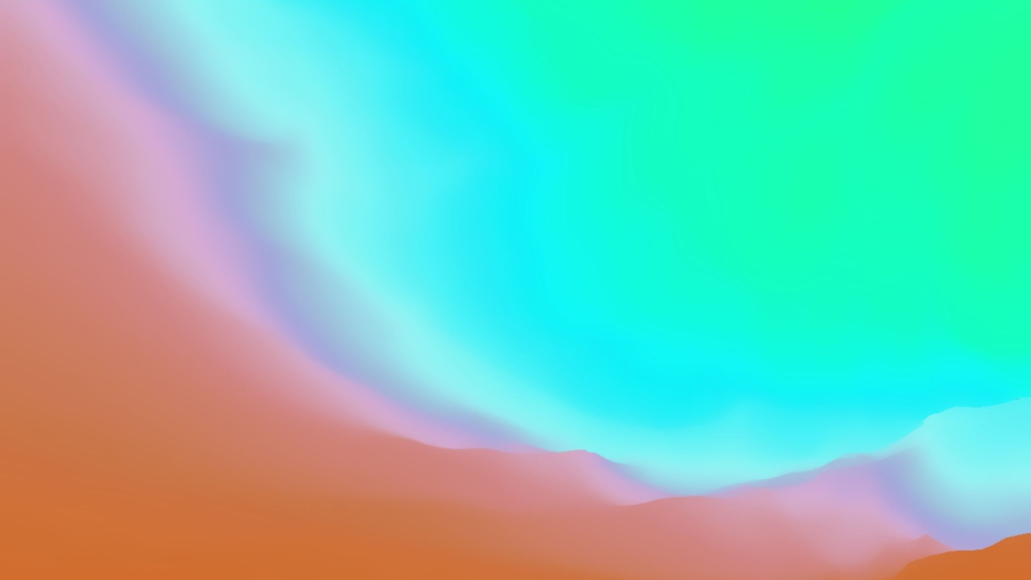
Final Presentation
Tia Trueman

Slide 2
Initial Idea
EP: 3 piano compositions accompanied with strings and percussion. Live recording if I can find a string quartet but if not then I’ll use software to record the strings. Recording using Logic.
Live performance of 1 of the compositions from the EP, with light projections to create the scenes of the ocean/nature.
Upload the 3 compositions to Spotify with canvas’ of my poetry. Using Kapwing to create the canvas’.

Slide 3
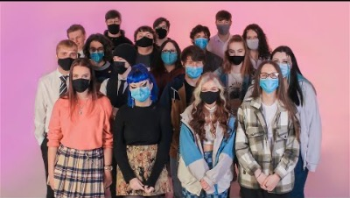
why
In previous projects, I’ve created solo piano compositions.
I wanted to use my strengths but challenge them and develop them further, which is why I’m incorporating different instruments, creating artwork for them, doing an immersive performance and uploading them to a place where more people will be able to reach.
(38:38-39-10)

Slide 4
Process Plan
Week 1-2: Research – What specific software could I use for realistic string sounds, incase I can’t get a string quartet? How to record for a string quartet (mics/positionings)? Common percussive beats? How have older and more modern composers incorporated strings/percussion in their compositions? How to upload to Spotify? What is the best app to design canvas’?
Week 3-6: Composing the piano for all 3 tracks. Alongside writing, I’ll be recording around the sound time so it doesn’t slow the process down.
Weeks 7-8: Piano compositions complete, scoring for strings and adding in the percussion on the tracks.
Weeks 9-10: All about designing and promotion. Designing the light projection for the performance and the Spotify canvas’ for each track.
Weeks 11-12: Promotion and finalizing any last details. Checking all my documentation is up to date and that I’m happy with all the final tracks.

Slide 5
Target Audience
People who like piano compositions.
To reach my target audience, I will use social media (Facebook/Instagram/Twitter/Snapchat/TikTok/Youtube Shorts) and hashtags. Mostly 7 seconds of the tracks or the process of making them. Using linktree to link people straight to my Spotify and other social medias.

Slide 6
Resources Needed
I’ll need a piano, percussion and hopefully a string quartet, if not then at least a realistic software to imitate the sound. I’ll need a pen and notebook as well as a scoring app (possibly Sibelius) to actually work with my ideas.
Depending on which track I perform live, I could need someone to play percussion with me.
Logic to record and master the tracks. An app to create the Spotify canvas’ on. MadMapper app to design the light projection.
Social media to promote myself.
Condenser microphones to record the acoustic piano.
Youtube, google scholar, online library, online journals – research.

Slide 7
Collaborations
I wanted to do most of the work on my own to get some experience in all the different jobs. However, I can ask my friends to help with promotions, by sharing my link on their social medias. I can ask people with experience in light to help with designing the light projection. I could ask someone with experience in percussion to help me with the recording of percussions. If I can find a string quartet, I’ll need to work out the payments.
No set collaborations yet.

Slide 8
Context
My project is very relevant to the industry in many different ways. I’m using the role of promotion to reach my listeners. I’m using the recording engineer's role to record and master my tracks. I’m using the graphic design role by creating canvas’ for Spotify. I’m using the composer’s role by writing for all the instruments.

Slide 9
Problem Solving
Main problems that could arise:
Can’t find a string quartet – I can find a software that could imitate as closely as possible.
I over run on some of the plan – I gave myself extra time that what I’d probably need to so it unlikely to happen. Disciplined enough to stay on track and reach the deadlines. Planning out my time to balance each aspect.
Budget- If I can find a string quartet, how much would it be?

Slide 10
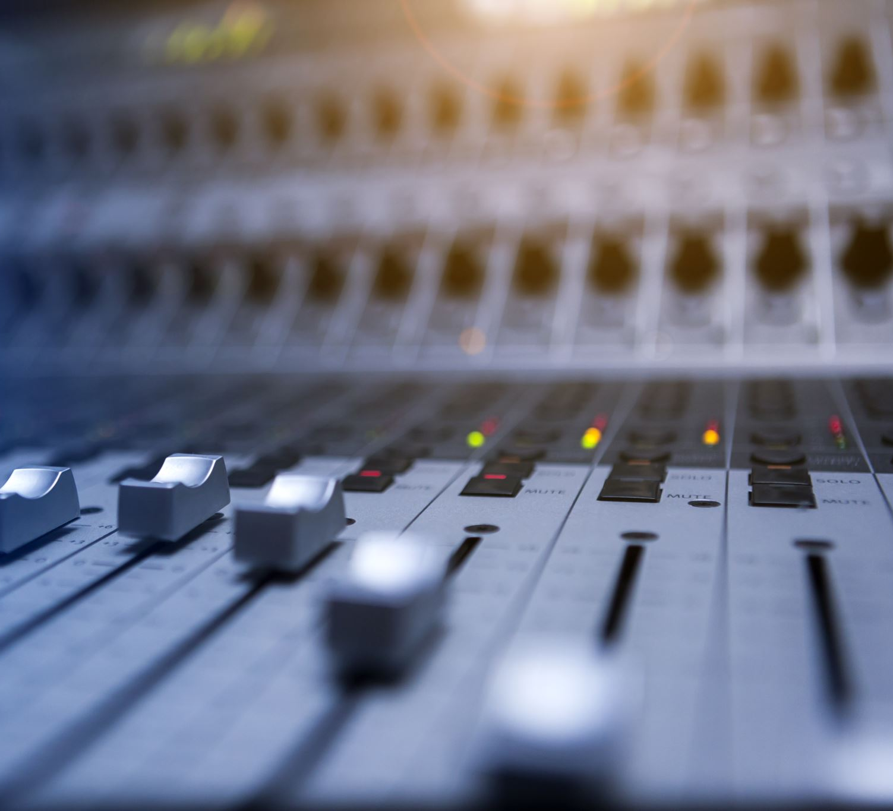
Health and Safety
Sound levels when recording and mixing – have it low as I can then turn up the master at the end to check the takes.
During the performance, we’ll need to still light up the exits, piano and stairs.
No food or drink near the mics and studio equipment.
Taking breaks and good posture.

Slide 11
Documentation
Ill be writing most of my progress in my notebook so I’ll take photos of them to upload and analyze in my weekly write ups.
01
My weekly write ups will be documented on my digital space.
02
Alongside write ups and photos, I want to get as many videos of the process as I can to also upload. Then, I’ll evaluate the videos.
03

Slide 12
Stage Design/ sound set up
Sound:
2 condenser microphones into an audio interface and into Logic to record the acoustic piano. 1 dynamic microphone to record percussion, into audio interface and into Logic. Condenser microphones into an audio interface and into Logic to record the orchestral instruments, or midi keys with the app if I can’t find a live orchestral to play. For the live performance, I’ll be using the pre-recorded orchestral track and play to that on an electrical keyboard that sounds like a piano.
Stage:
Using MadMapper to imitate nature.
Collect videos of the ocean and nature to imitate the story of my playing and create an immersive atmosphere.
Dimmer lights for stairs, exits and the instruments playing.

Slide 13
Presenting final product
Three track EP with canvas’.
Perform one of my compositions at the showcase with light projection.
Documentary style compilation of footage that works up to my final takes, for my Digital Space, along with weekly write ups.

Slide 14
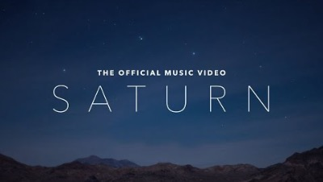

Inspirations
Saturn – Sleeping At Last
Experience – Ludovico Einaudi
(1:25-2:25)
(1:50-2:35)

