Slide 1
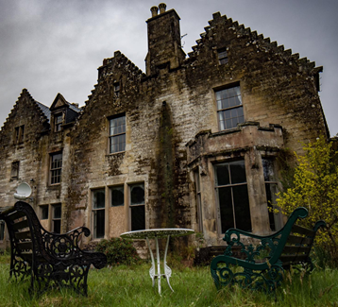
Mystery mansion 2d platformer game

Slide 2
My pitch
My pitch is of a mystery game with 2 levels with 2 characters who are trapped in a mansion and are trying to escape but to escape they must complete puzzles and then they can escape there is also 2 puzzle so far. but will slowly get harder as you go through them. The theme of the game is mystery as you must find the way out of the target audience for this is 7+ so the puzzles are difficult but not too difficult.
Game plan
The plan is to use a gaming development website to make the game and make the coding for it as well as the characters and what they can do and make the coding for each puzzle and make them different from each other and to slowly make them harder to complete.
The plan is to also have an ending scene to show you that you did it and to also maybe have a timer so you can try to beat your time each game. So I will need to use the feedback from my friends or other people I let try my game to improve.

Slide 3
Target audience
The theme of the game is mystery as you have to find the way out of the target audience for this is 7+ so the puzzles are difficult but not too difficult an mansion that you have no idea how you got there. I will use the internet to find out what the 7+ like in puzzle games and will also ask people what they think they like in puzzle games

Slide 4
theme
The theme of the game is mystery mansion game where you have to solve puzzles to be able to escape and there is only 2 characters you play has as you go through 2 levels each with only 4 puzzles. It fits with incognito because you have to try to escape and it also makes you wonder how you got there in the first place and why are you there it also adds to the mystery with theses questions.

Slide 5
Primary research and secondary research.
For my primary research I will do a questionnaire to see what the target audience like as puzzles and add them to the game and ask for ideas for what the characters can do and what I can do to improve the idea for the abilities and choosing the best ones for the characters. I could also have a group of friends to look at the design of the game and give me there opinion of what they think I could add. For my secondary research I will use videos to look at how you make a 2d puzzles game and how to make a platformer. I will also look at different gaming software to be able to make the game to able to make it the best I can. I will also look at different websites to have look at how to make platformers with puzzles and how to make the puzzles.
An example of this is: https://www.gamasutra.com/blogs/DamienAllan/20170501/297179/Designing_Video_Game_Puzzles.php
And
https://en.wikipedia.org/wiki/Platform_game

Slide 6
My inspiration
My inspiration for this game is batman games where you have to do puzzles to get further into the game and among us to get an idea of what the puzzles could be and how to put them into the game. The idea of it being a mystery comes from the puzzle game professor Layton what was a puzzle game where you had to complete puzzles to solve the mystery. Another inspiration is Damian Allan who give information on how to make a puzzle and how to make them harder and to use a variety of skills and ideas of what they could be.

