Slide 1
Mythological creatures quiz pitch by Morgan Campbell

Slide 2
The theme
The theme is pocket planet where we have to do a game video or documentary about a planet or somewhere on the planet. I have made my idea with the theme by using mythological creatures from different cultures and areas in the world.

Slide 3
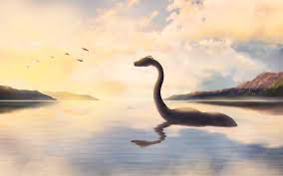
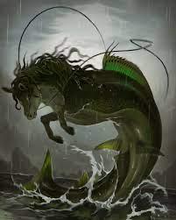
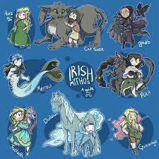
My idea
My idea is a mythological quiz that has different question and you get three chances to answer each question and if you get it right a animation of the creature that comes across the screen. The audience is teenagers and people with disabilities as they need to kept amused to play so the animation will keep them amused and they will also get to keep playing as they can keep retrying and their will be a lot of easy and hard question it will be mixture of how difficult it is.
This will showcase my skills as I have worked on making a game before and have made animations and know how to make them do different things like dance.

Slide 4
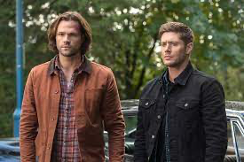
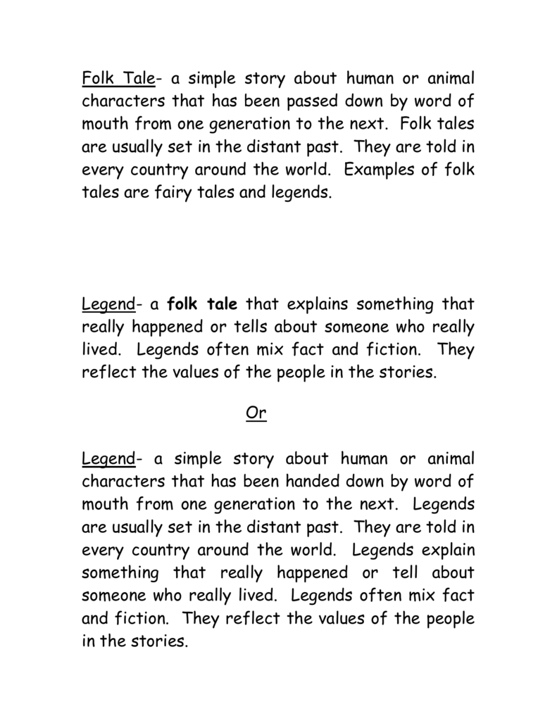
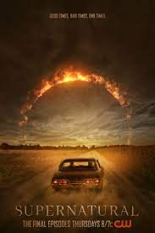
My influence
My influence for the project is folklore of different religions and the idea of the creatures and the show supernatural gave me the idea as there is a lot of mythological creatures in that show and their different questions about the creatures and different lore.

Slide 5
My role
my role for this is the producer as I must make the game and make sure there is nothing wrong with it and I must promote the game and make sure that it has a great impact on the target audience. I also have the role of researcher as I must make sure all the research is done and make sure that all the research is from a reliable source and not a fake source that I don’t get the wrong information for the quiz. I will also do focus groups if necessary and make different categories for each mythology I will do.

Slide 6
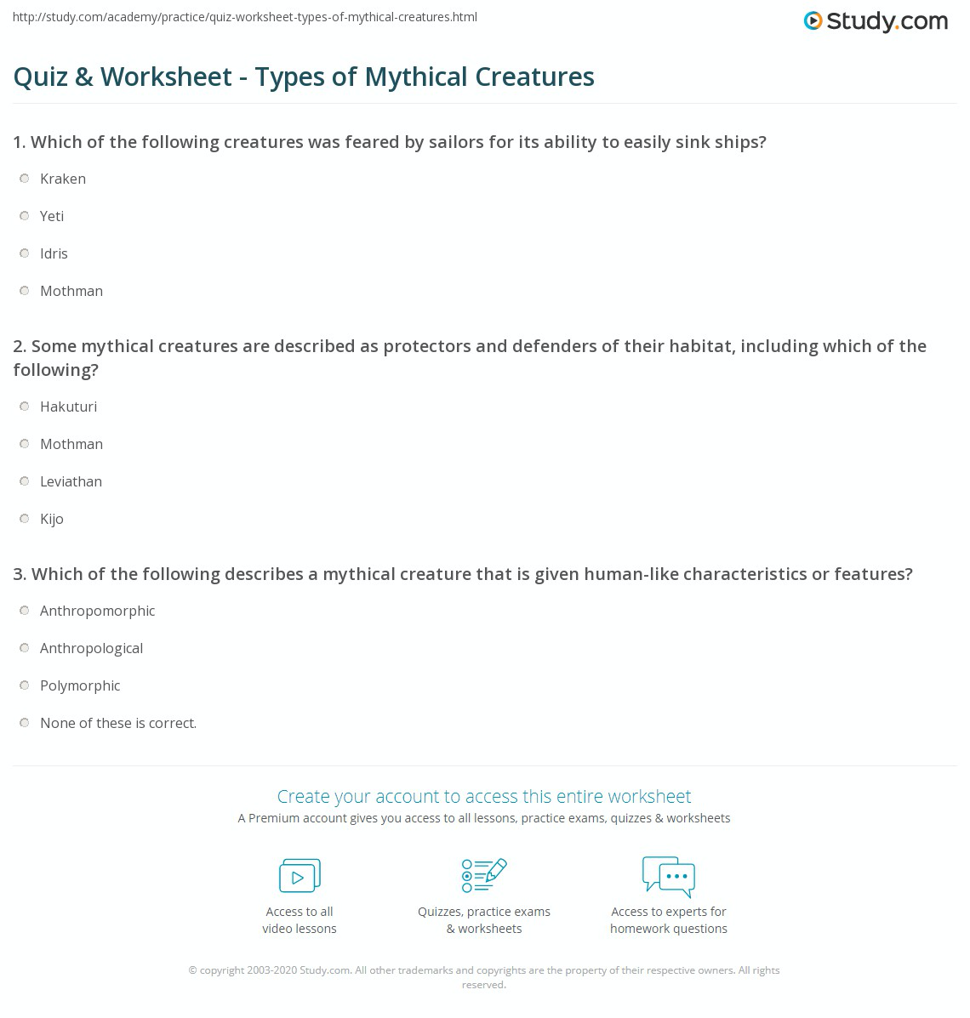
Primary and secondary research
For my research I will use different websites as well as my own information on some of the creatures and use the information from the tv show supernatural as they had lots of information on different mythological creatures. I will also ask my family and other people about some creatures to make sure I have all the info I need for the quiz game
https://www.twinkl.co.uk/teaching-wiki/scottish-mythical-creatures

Slide 7
Planning and production
For my planning I am going through all different types of mythologies and taking information on the mythical creatures and making a question based on the creature and I am going to make different categories for each mythology and allow the players to choose which category the want to do.
For the production I am going to make a bunch of questions and find a application or website that will allow me to make the quiz and add the categories for the players to choose from

