Slide 1
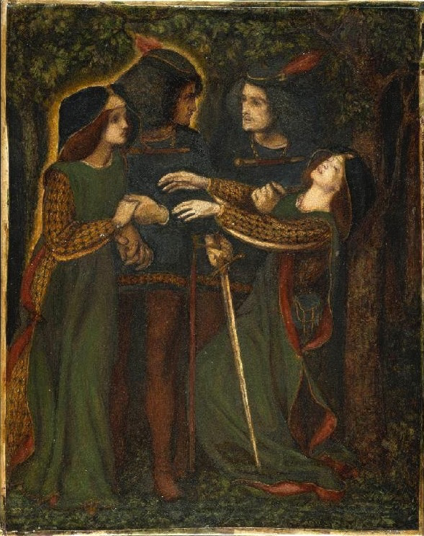
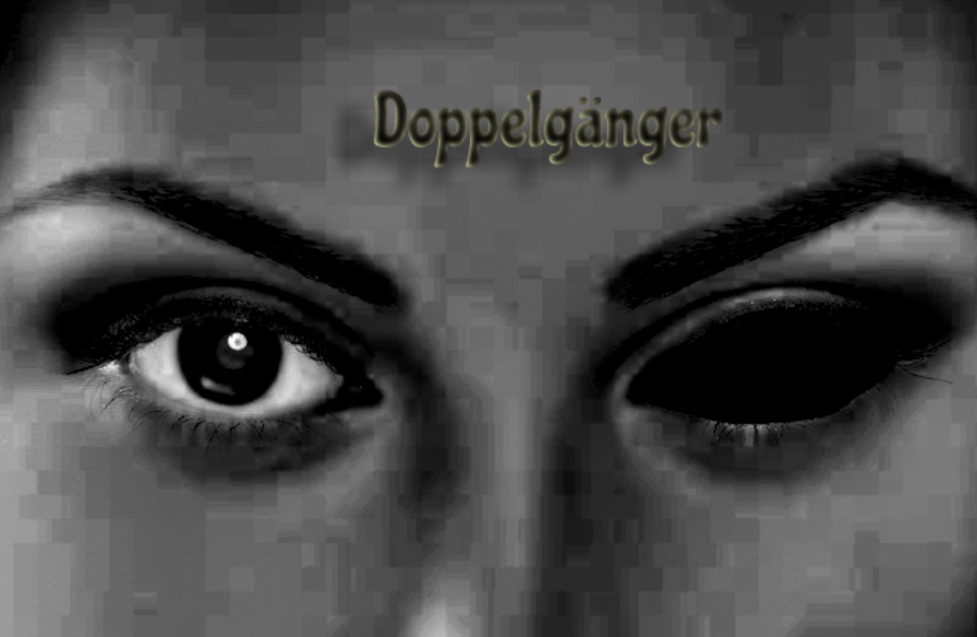
Doppelgänger

Slide 2
Idea
My idea is to create a short film 3-5 minutes long about a Doppelgänger.
For this project I will have certain scenes in my film where the reflection of the protagonist is doing different actions to what the protagonist is doing, for example in one of the scenes I want to create a scene where the character is washing her face but the reflection just stares at her then the reflection resumes and continues to do what the person is doing,

Slide 3
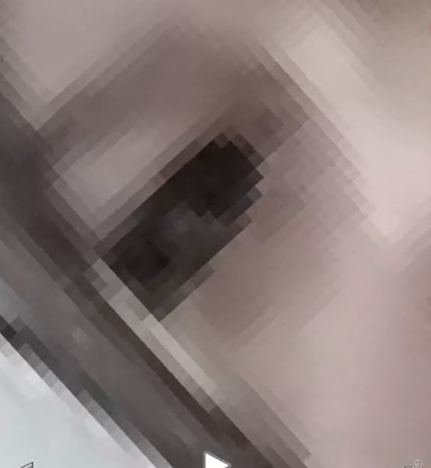
Aims
My aims in this project is to show off how I can combine film and animation together, however in this project the animation is going to be mostly used as effects such as black eyes. I am also looking forward on my story telling , because in this film there is no dialogue I want to make it super clear on what is going on just by their actions.

Slide 4

Intentions
The client I'am working for is Deer Shed who is hosting a festival, the theme of this festival is pocket planet, therefore I decided to create a short horror film, the reason is because all festivals have something scary going on, My intentions for this project is tell a scary myth to the children and make them feel frightened. My goal is to ultimately develop an atmosphere that pu The client I'm working for is Deer Shed who is hosting a festival, the theme of this festival is pocket planet, therefore I decided to create a short horror film, the reason is because all festivals have something scary going on.

Slide 5
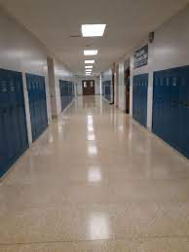
Conventions
Big houses, wooded landscapes, warehouses, schools, and hospitals are common locations in psychological horror films. These surroundings give the spectator a sense of realism, which heightens their terror. They may often relate to the scenario, allowing them to put themselves in the shoes of the characters, heightening the dread element.

Slide 6
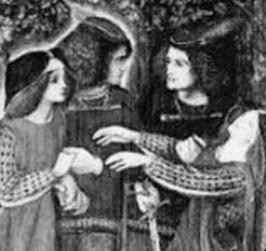
History how does it link back to pocket planet
The doppelgänger was considered an omen or a death sign by the Germans. Some people believe the doppelgänger was an attempt by the ghost to counsel the person they had shadowed, while others believe it was an attempt to confuse them by implanting evil concepts into their minds. They were once thought to be sinister, if not downright malevolent. Seeing a double was thought to be a bad omen.
This links back to the theme because tales like these get told to their children as a scary story which they believe in.

Slide 7
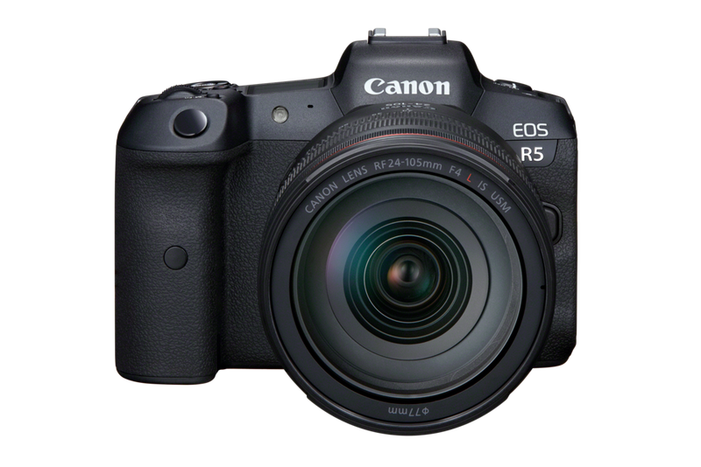
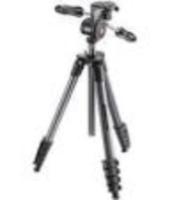
Location/ the equipment I will be needing
The locations I will be recording will be mostly at home and college the reason why I choose these location is because it suites my story line and college/school is one of the conventions
The equipment I will be needing is cameras, tripod and classmates helping me with some camera angles

Slide 8
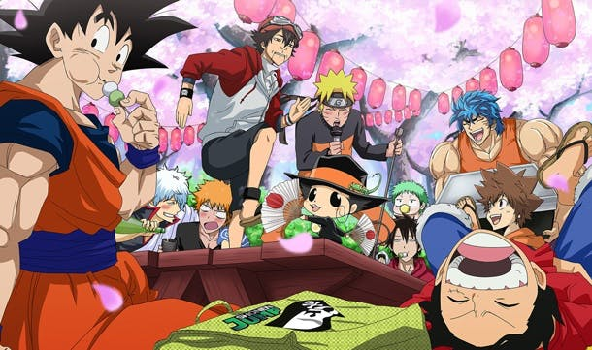
Characters
In this story line there is only one character named Anna, there are no other characters beside her Doppelgänger

Slide 9
Actors
The only characters I will be needing is me, the reason for this is because all my other classmates are too busy with their own FMP I need ed to change the story line

Slide 10
Technical coding
There are going to be a lot of different camera angles, such as a low. There’s another close up shot of Annas boots walking down a long white hallway. When Anna starts running there will be a tracking shot, this is where the camera follows the character from behind or when the character moves forwards, in which case in my film the camera will be following Anna from behind whiles she's running.

Slide 11

Audience
For this project my short film is mostly aimed for children between 12-15, the reason for this is because the Doppelgänger tales are mostly for preteens , I also made few changed to my story line to fit the pg. 12 such as
No gore
No fake knives props

Slide 12
Challenges
For this project I will have certain scenes in my film where the reflection of the protagonist is doing different actions to what the protagonist is doing. I know how to create and edit this part however the only problem is that the timings of their actions sometimes doesn't work out well, for example in one of the scenes I want to create a scene where the character is washing her face but the reflection just stares at her then the reflection resumes and continues to do what the person is doing, if I don't do this perfectly the tings will be off. In order not to mess the timings off I will be counting in my head and keeping the actions to the bare minimum.

Slide 13
Audio coding
Since this whole short film expresses feelings thought body language since there will be no dialogue the audio/song will have to be specific to support the characters emotion

Slide 14
Narrative
My narrative for my film idea is linear, this is because everything that happens in my film is going to be in chronological order

Slide 15
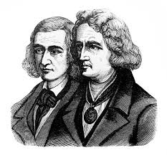
Influences
I was inspired by the Germans myths and the Brothers Grimm this made me think of a story line and make it seem abit twisted and dark but also peg

Slide 16
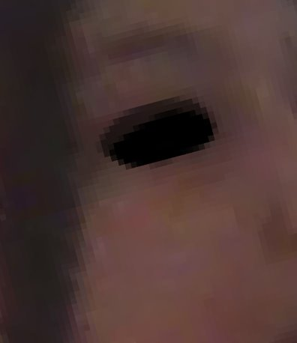
Skills and knowledge
One of my skills is drawing
therefore, I will be applying that skill to my FMP
Editing
Applying it to my fmp

Slide 17
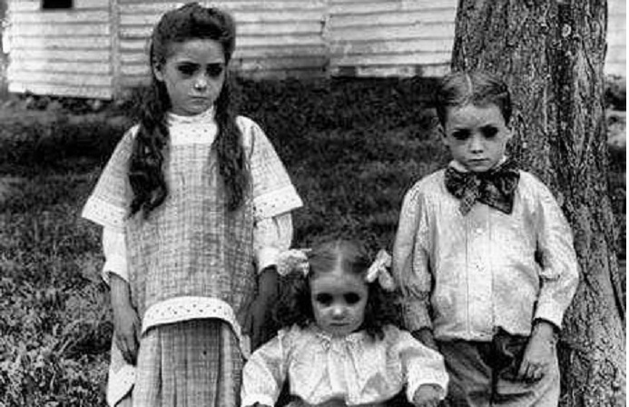
Visual aides
Black eyed children urban legend stories/

Slide 18
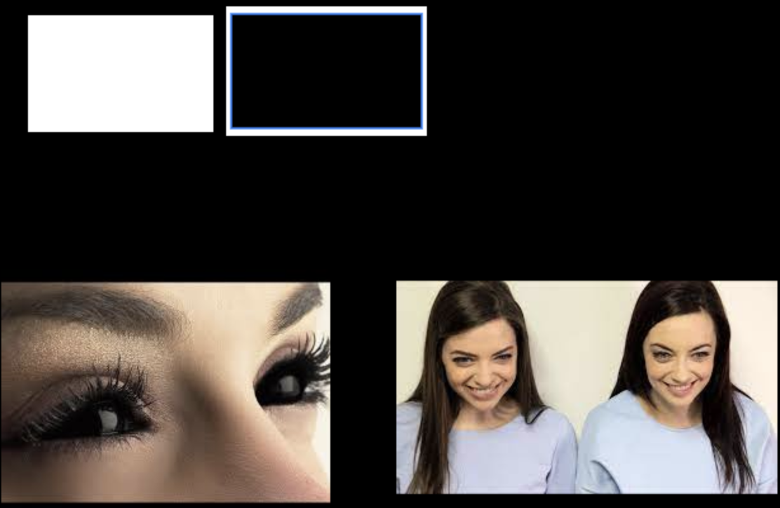
Mood board

