Slide 1
”Time Nomad”
By Max Myers & Salman Shaffique

Slide 2
Project Idea Summary
For my FMP i have been asked to think of a concept of which revolves around the theme Pocket Planet, I am working with Salman on this Final Major Project and we are working in unison to create a Rogue-Like Dungeon Crawler 2D Game, of which will include the relevant elements of the Pocket Planet theme.
The main reason I chose this project in particular is because I have a passion for games, and I wish to further understand as to how they are made and what goes into them, this is something I wish to pursue in my career, as I wish to be a level designer and or a narrative designer for games in the future, whilst the majority of the skills and experiences in this course are oriented around film and media of which is similar to film, I still have a passion for game, which is helpful as alot of the skills gained from the course can be used in gaming also, such as character design and graphic design/sound design.

Slide 3
Skills & Knowledge
The skills I will need to complete this project will be coding, level design and RNG creation, aswell as environmental design, these will be necessary as they are the aspects of the game I will be focusing on, that being coding and game creation.
The skills Salman will need will be pixel art design, graphic design, character creation and prop creation, these will be necessary as he is focusing on the artistic part of the game.

Slide 4
The Theme
The theme of my game will be oriented around a time jumping nomad who is stuck in time, the game’s premise is that the character is hopping throughout time and exploring different cultures as they go along, using different elements to their advantage to try and find a way back to their original timeline.
This links back to the pocket planet theme as the character is exploring different cultures constantly, exploring different environments and fighting different enemies each time they enter a new area, almost as if they are entering a new world.

Slide 5
Audience/Demographic
The target audience of my game is 9+ as in line with the Deer Shed Festival family element, I will ensure that the game is PG in all areas and shows no explicit content, to strengthen this target audience demographic I will keep all aspects of the game accessible to all players so they can all experience the same game, this will be essential as it allows the younger players to have a chance.
This ties into the demographic for Deershed as it includes a large amount of younger audiences, which will also be able to access our game.

Slide 6
Research Methods
I intend to use both Primary and Secondary research in my project, the Primary Research I intend on using are as follows, Game Testing/Analysis, Focus Groups, Interviews, Surveys, Questionnaires and In-Game Photographs. The Secondary Research I intend on using are as follows, YouTube, Websites, Internet, Documentaries, Podcasts and Dev Diaries.

Slide 7
Planning & Production
The game we intend to create will be a 2D Rogue-Like Dungeon Crawler, we aim to incorporate complex RNG mechanics, randomized in-game features and custom AI and player Sprites, animations and sounds for each individual action, the game will be created using the Unreal Engine, which is accessible on college computers and on my at-home computer, production will be split down the middle between me and my Co-Developer Salman, I will handle the coding, level design and creation and AI movesets, and Salman will handle the graphic design, sound design, character sprite creation and environmental sprite creation.

Slide 8
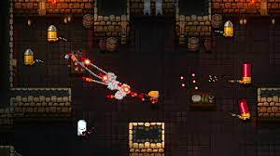
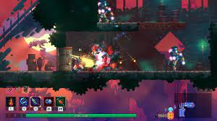
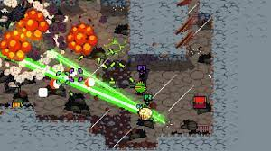
Visual Aids And Examples
I have compiled a few games of which are similar to the one we intend to create.

Slide 9
Evaluation Of Our Project
In conclusion our project is a 2D Rogue-Like Dungeon Crawler which is 10+ and is intended for audiences that enjoy fast paced gameplay and challenging enemies and bosses, the game will also include random mechanics such as random items, bosses, monsters and environments.

