Slide 1
She wants revenge
By Salman Shaffique

Slide 2
Plot
When an 18 year old girl named jane was almost burnt alive with her family by a boy she stuck up for she is left with pale white skin and a theist for revenge.
Jane tracks Jeff to the school were 4 friends Corey/Jake/Sam and Colby have been kept behind in a detention and when the teacher miserly diapers the teens are left to fight alone agents Jeff and try and escape the school as Jane and Jeff have a final battle in the school were it all began.

Slide 3
Main Characters
.Jane is an American 18 year old girl from Kansas city she was recreantly almost murdered bye her next-door Naber who is also the same age and goes to the same school. the only thing Jane has got on her mind after Jeff killed her family is to get revenge on Jeff bye killing him.
.Jeff is also from Kansas and when through a traumatic experience were he was almost burnt alive but maged to put him self out before the fire killed him. Out ragged that the bully's who did this to him got away he to toke it out his rage on the world stating whit him self he cut out his eye lash's and cut out a giant smile form one cheek to the other then killed his family including his little brother before wisp iring go back to sleep. After that night Jeff was never seen agine.
.corey/Jake /Sam and Colby are 16 year old that go to the same school that Jane and Jeff when to 3 years before. Corey is the funniest out of the group always trying to make people to laugh. Jake is the silly one of the group he tends to make laugh just because how dumb his actions are. Sam is the intelligent one he tends to always have a solutions to problems the group finds them self in. Colby is the social media freak always posting and cheeking his DM'S he is also best friends with sam.

Slide 4
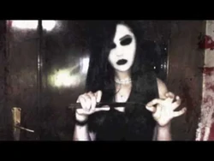
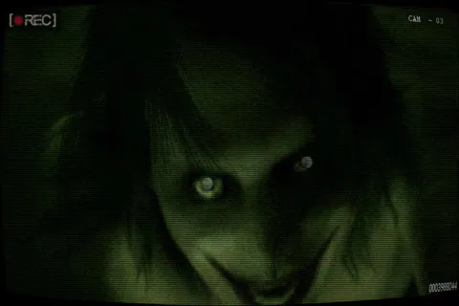
Inspirations

Slide 5
Props I will be using I will use fake blood that I can get from pound land and I will buy to fake nifes besides that no other props are needed

Slide 6
Technical Codes Psychological Thriller)
:Dark Lighting to set a screy mood
:Dutch Angles. will help show the character is going in sane .

Slide 7
Locations
Bradford college will be the location and around on campus the scenes will take place next to the college as well and I plan to have night time sense aswell

