Slide 1
The
Astounding
Greek Creature
By Joseph Colvill
(FMP's Pitching)

Slide 2
The Theme
It is a different planet in the atmosphere. Other things that we cannot explain until further evidence. It is also about space and anti-gravity. It also could be mythical animals and creatures that lived on this planet or another plant. Also, could be about cultures of people who believe in Gods that create mythical creatures.

Slide 3
My General Idea & My Skill & Knowledge
The general Idea is mystical creatures and moves it to create anime and to add sound how they could sound like. I will create into short scene or film of all the Greek mystical creatures. To add to that I might male what the earth will look like in the future.​
My skill that could use doing this FMP is problem-solving just come problem with the software. Also, another skill that might use is management will use because the deadline is 24/05/2022, I have set want and how I will be doing it. Furthermore, I would be using self-confidence because of this FMP that I will be doing on my own.
Finally, My knowledge is that be using photoshop and illustrator to show some of the new techniques that I have self-learn myself. Also, in the software that I am using, I will use it all this year.

Slide 4
Influences Of My Project
The main influence that gives some of the Greek creatures is the assassin's creed odyssey. The reason why it influences is that it set Greek and near the end, you flight some creature.
The main influence for interactive is Black Mirror: Bandersnatch (Netflix Movie). This film has interactive to show what their life is like in different versions.

Slide 5
The Audience
The main audience for my FMP is anyone who loves mystical creatures. Also, for any gender, age and does have some education to learn thought my FMP because teaching some R.E for Greek ethnicity. Furthermore, teach people that do not know what the Greek Mystical creature is, and how to create them (Gods).

Slide 6
The General Planning, Production & Post-Production
The general plan is after this pitch, I will start to hand sketch what the creature looks like and the background. Then, after the Sketch, I will try to replicate it on Abode Illustrator and Photoshop. Furthermore, after all, try to make an interactive scene be using Adobe Premiere Pro. Doing this time I will have taken screenshots of the work that I did and if there is any problem that comes into doing this FMP. Also, through all of this, I will be using the action plan to keep track of my progress through this FMP.

Slide 7
The Research That I Could Do … & The reference
I will gather research is through questionnaires and then gathering them to show static in a bar graph. It is primary research and two questionnaires, the first be on Greek letters and the second will be Greek mystical creatures.
I could gather facts and static off-website and out of books. I will reference the sources be and links to the website or to the book's title and authors with the date of release.
I will be using some image of the mystical creature as reference how they look like and act like. Also, I will be using YouTube for some of the sound reference give me some idea of the sound of them.

Slide 8
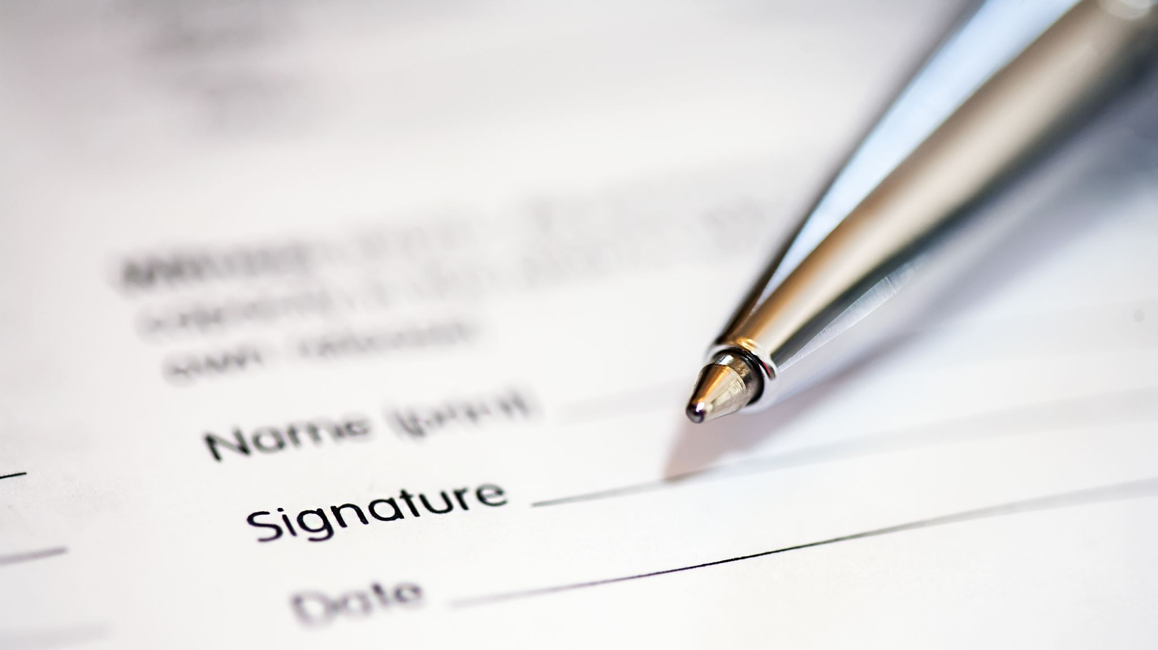
To Summary It All Up

Slide 9
Thank you for listening if any questions to ask feel free to ask them.

