Slide 1
The Poster Example
By Joseph Colvill

Slide 2
Titanic
Will the titanic get in the Ice Berg
Also The titanic going under ocean
The “titanic” word are sinking because of the going under ocean because of the ice berg
The “Ice Berg” word is that titanic run into it because come out of the blue.
Color of blue mean that Ice berg come out of the blue because it was fog

Slide 3
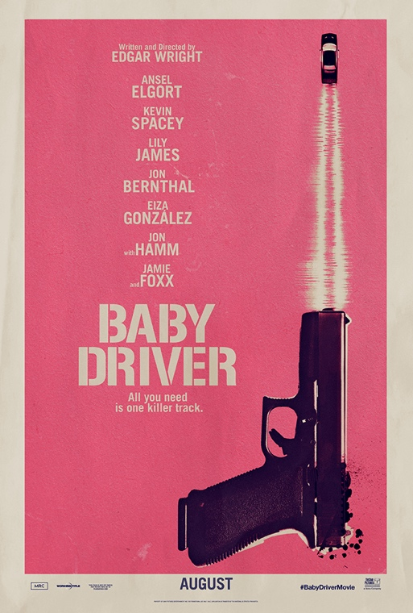
Baby Driver
Main character is driver and gun that shot the car out because the main character the driver get amazing skill as drive.
Image of the gun mean it is action and group do heist with the driver.
Color of the red mean that main character is indanger because of the job that he have be doing.
Car is imagine if bullet that come out gun.
Type is all way down.

Slide 4
The invisible man (original)
The word is bit tilt to the left (title)
At the last thing what happened to the invisible man was be on
fire that why the color was orange.
In background it chemistry the man was science.

Slide 5
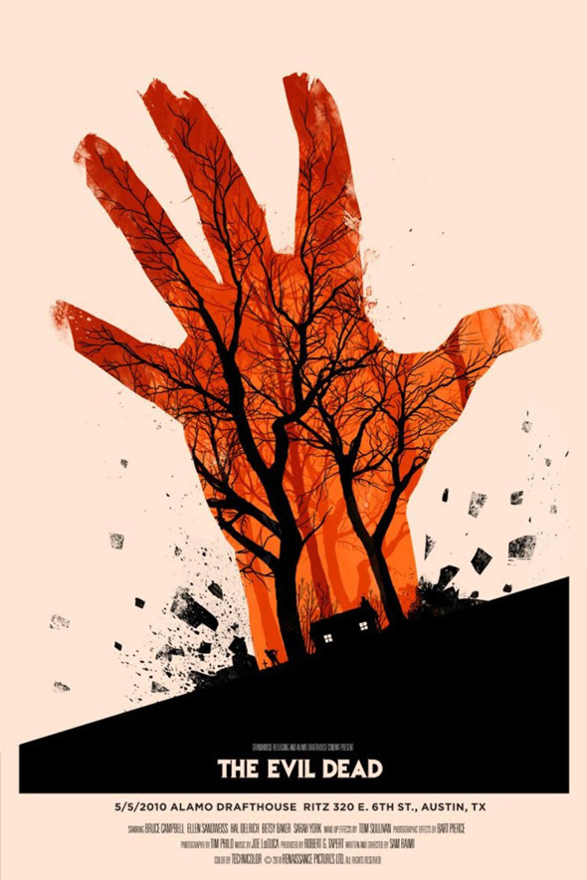
The Evil Dead
Image of woods and house was where base at
The image and color mean first zombie was bit on hand and
Red mean danger.
Also in future main character get his hand cut off.
Text is on line but the ground is tilt.

Slide 6
Joker
Word that is in the body is caught phase in the movie.
Color of red mean he is craze plus the phase “comedy” look
Crazy text
Shadow of the main character color black go dark place.
Word are still stand up.

