Slide 1
Project Pitch

Slide 2
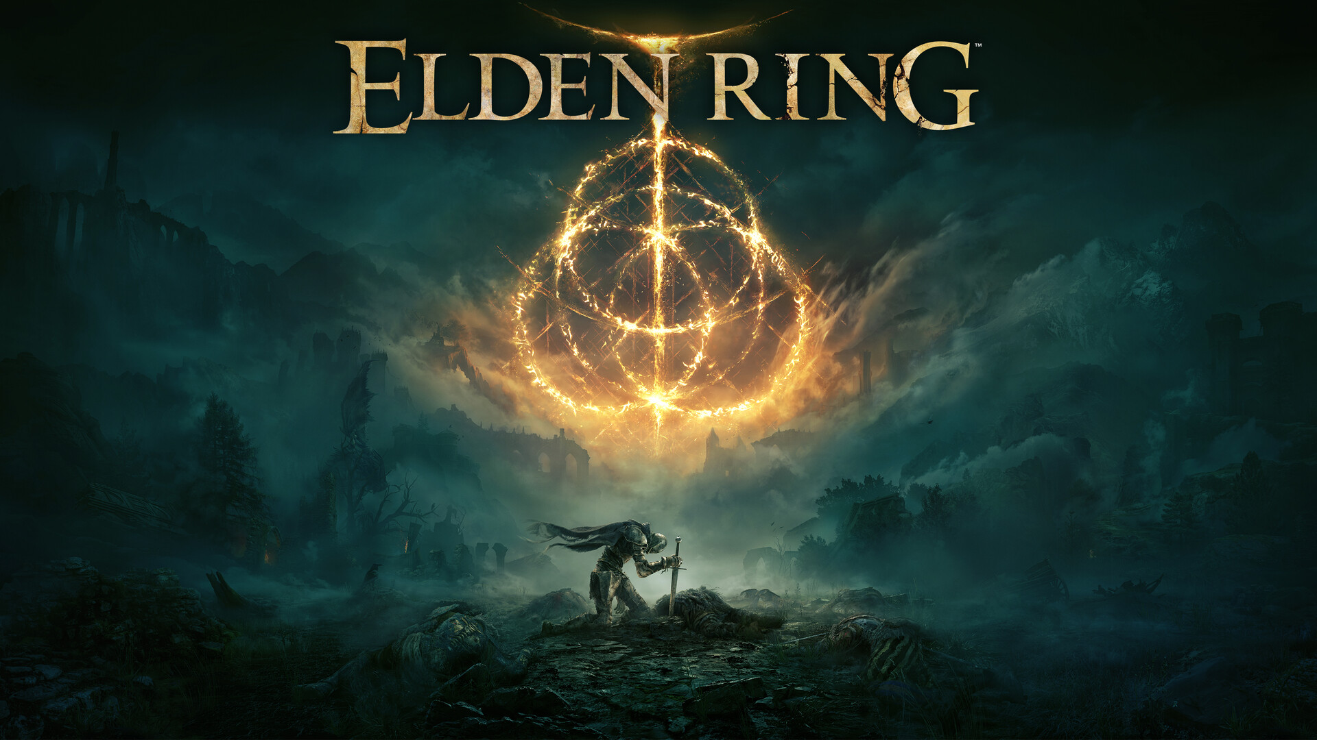
My idea (concept art)
So, my idea I plan on creating concept art on as I personally really like the art style of the game and genre then many of the other things that I could do instead here are some images to show the art style the target demographic for my project is pretty much everyone since I don’t see why all audiences can not enjoy this. As my animation will be for everyone

Slide 3
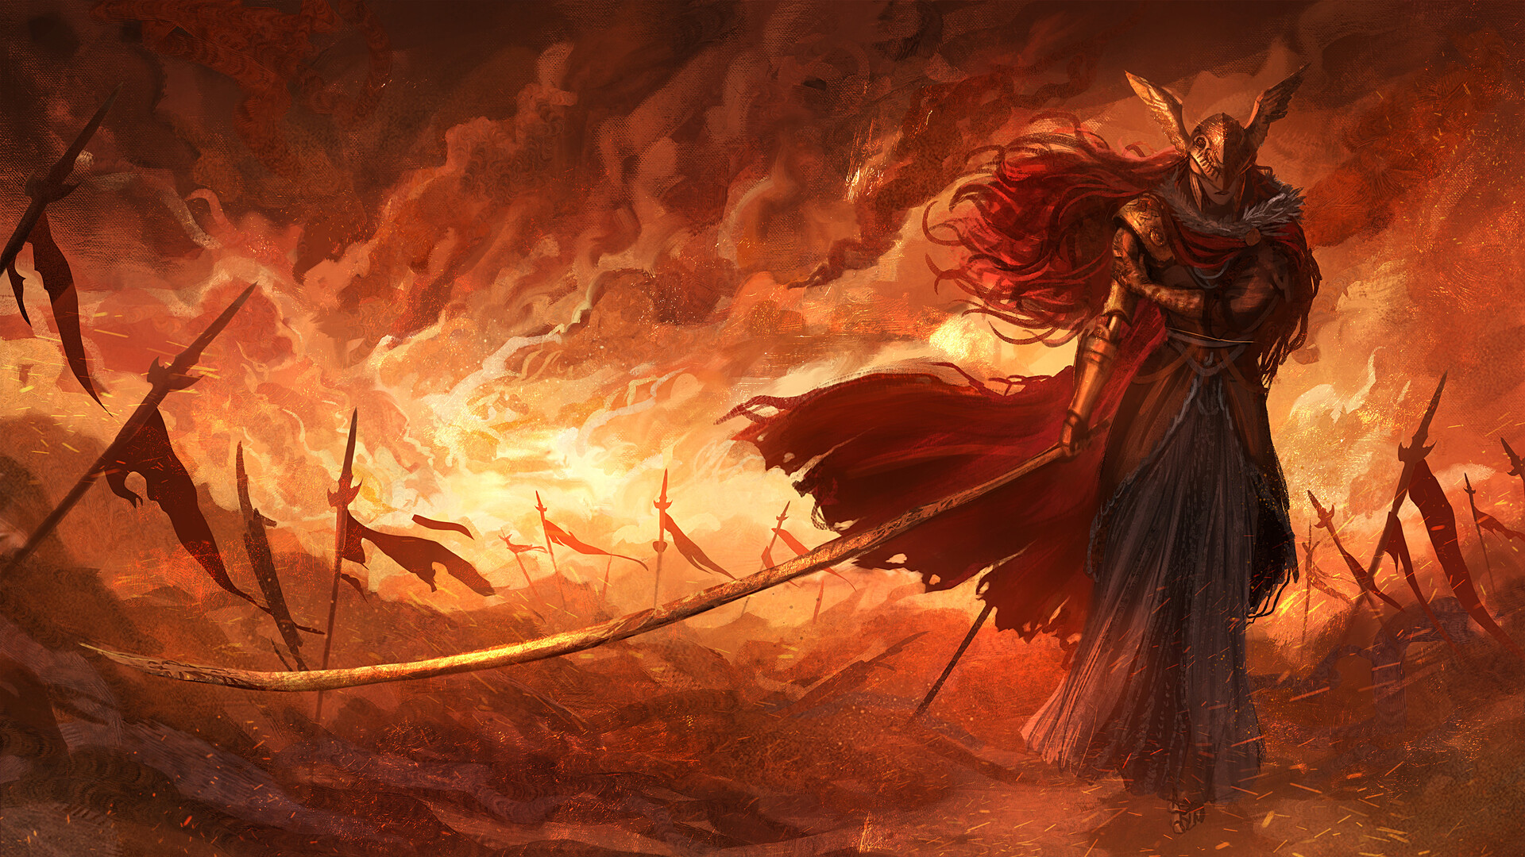
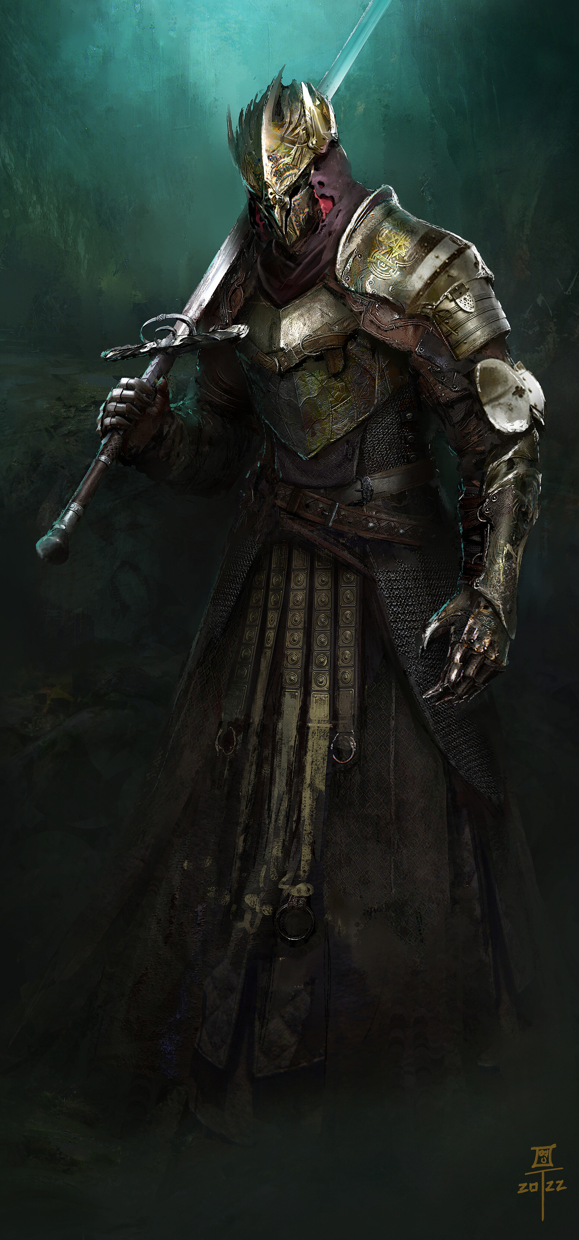
My influences
So my main inspiration for my project is a game called Elden ring as it is a recent game that has just come out and I really enjoy the art style of the game and I have already seen other people's fan art of the game and this kind off inspired me to create my own as I really enjoy the art style and I do want to create some art/animation on medevil sort of things.

Slide 4
My role
So, my plan for the project is too first look at other various pieces of work so that I know what I want to create then I will first begin building in illustator.

