Slide 1
Fmp research

Slide 2
Where I got my ideas?
So for my fmp research I looked around on a lot of different websites such as artsation Pinterest and other sites that find it easy to access art these helped me be able to produce what types of images I could edit and create with some of my inspiration being on this page

Slide 3
Inspiration
I decided that I wanted to do pixel art on Elden ring. Elden ring is a medieval style open world game which I personally really enjoyed so I decided that I would want to do pixel art on it as when I looked online at other pieces of similar work, I noticed that there was pretty much nothing of Elden ring done in the pixel art style, so I thought that would be a good choice as it could keep my idea fresh and new even though the game is quite popular.

Slide 4
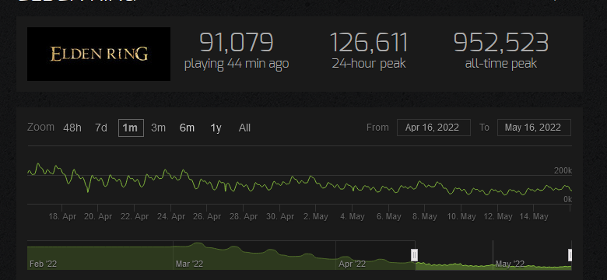
Primary research and secondary research
For my research I wanted to see how popular Elden ring is and how much attention is gained across the internet as it also fits into medieval genre which is also quite popular so I thought it would be a good pick to base my work on as it is very trendy now. Here is a screenshot showing how popular Elden ring was on steam which is the most used pc game distro on the market as u can a massive amount of people played the game when it first launched with nearly a million players and has managed to keep around 100k players even months after it lauched which puts it in the top 5 of all game currently with this means a lot of creators came to create on art on this game because of its popularity.

Slide 5
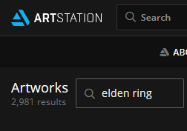
Primary research and secondary research
With the massive attention the the game gain on launch a lot of sites that u can visit such as Pinterest, art station and deviantart etc u will find that there are literally thousands of results all just on Elden ring all about its characters and different sorts of landscapes showing how popular it is really I believe this is because that it is also a medieval type game which is great for artists to create art on

