Slide 1
streaming
By jacob

Slide 2
What is my presentation
My final major project is going to be on video game streaming. I am going to be talking about the impact of streaming on a streamer and audience, as well as what kind of career streaming is.

Slide 3
Why I've chosen this
Ive chosen this subject because I have always enjoyed watching streamers and videos as well as video games so I thought why not combine all three of my favourite things. Due to having grown up with these things I have plenty of knowledge on the subject. I also want to share streaming with others as it is a fun career if you can get into it plus when possible you can turn your streams into videos and upload the to youtube or leave them unedited and upload them as vods (video on demand).

Slide 4
Some of the biggest faces and sites they're on.
Twitch – Ninja, Tim The Tatman, pokimane, TommyInnit, Dr disrespect, jynxzi
YouTube – I show speed, Tim the tatman, dr disrespect, Ludwig
Kick – Aidinross, Iceposieden, Westcol

Slide 5
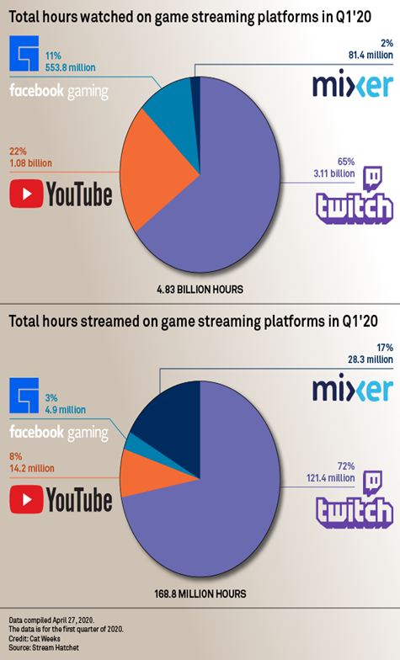
Opinions on major sites
Twitch – twitch has changed a lot recently including revoking the 70-30 contracts for streamers and replacing it with a 50-50 split after the first £100,000 this has caused a lot of streamers to think about switching to another streaming platform after contracts are up. They also feel like they’ve never treat any streamers big or small very well using them and dumping them to the side.
YouTube – YouTube seems to be better in most ways some streamers and youtubers have had to fight for better conditions/pay or others but YouTube have always sat down and listened to any complaints youtubers and streamers and tried to either fix them or come to a middle ground with them. They are also still offering the 70-30 split with streamers and YouTube partners.
Mixer – mixer feels like a whole lot better of a place to be as it clearly outlines any guidelines on toxic behaviour and that it will not be tolerated although the revenue you make is unknown unless you can see your own revenue as not many streamers from mixer have come forward to talk about their revenue this means streamers migrating from other sites could take a huge loss in revenue or a massive boost.

Slide 6
Any questions?
Thank you for listening to my presentation

