Slide 1
My Pitch and proposal

Slide 2
The main idea
My main idea is to research different mythology and folklore and combine my own views and style into one or two creatures For this I will have to have an understanding on the selected gods/myths as well as understanding dossiers in general to create one for my creature/s.
I will create a form of dossier for these creatures I create on photoshop and lightbox. i will find a skeleton image off of the internet print it out then use the light box sketch over it on a new piece of paper while adding things I want to include to the creature. I will then scan the sketch onto photo shop outline it section by section with the draw option. Next I will experiment on each section with different designs and different brushes that I may download to find the best outcome and will use that one on the final design.
When the creature/s is completed I will then work on the background which I am hoping to create a worn out and old looking sketchbook page to give off an authentic look. I will then include some background information/insight to give the viewer a deeper understanding of the piece/s itself.

Slide 3
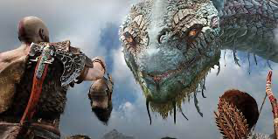
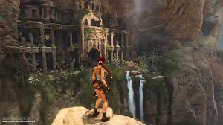
inspiration
I've drawn my inspiration from certain video games like god of war and tomb raider. I've always enjoyed playing these games and enjoyed the theories behind these games.

Slide 4
research
How many people still believe in Greek mythology? https://www.quora.com/Do-people-still-worship-the-Greek-gods
In Greece, around 60.000 to 70.000 still believe in the ancient Greek gods.
Do people still worship the Norse gods? https://www.quora.com/Do-people-still-worship-Odin-If-so-how-and-why
Yes, Iceland recently declared the worship of the ancient Norse pantheon a religion.
Do people still believe folklore stories? https://www.thetravel.com/folk-tales-around-world-locals-believe/
Though people are more sceptical than they used to be many still believe in folklore tales.
https://www.worldhistory.org/Jormungandr/
https://www.history.com/topics/folklore/history-of-the-werewolf-legend

Slide 5
Target audience
My target audience is 18-24 because I believe this age range would know more about folklore mythology and would be more interested in the subject as well as teenagers, young adults, adults and anyone interested in playing games or archeology which includes a wide variety of the planet.

Slide 6
Side idea
If you dislike this idea I can do different MacDonald's menus from around the world.

