Slide 1

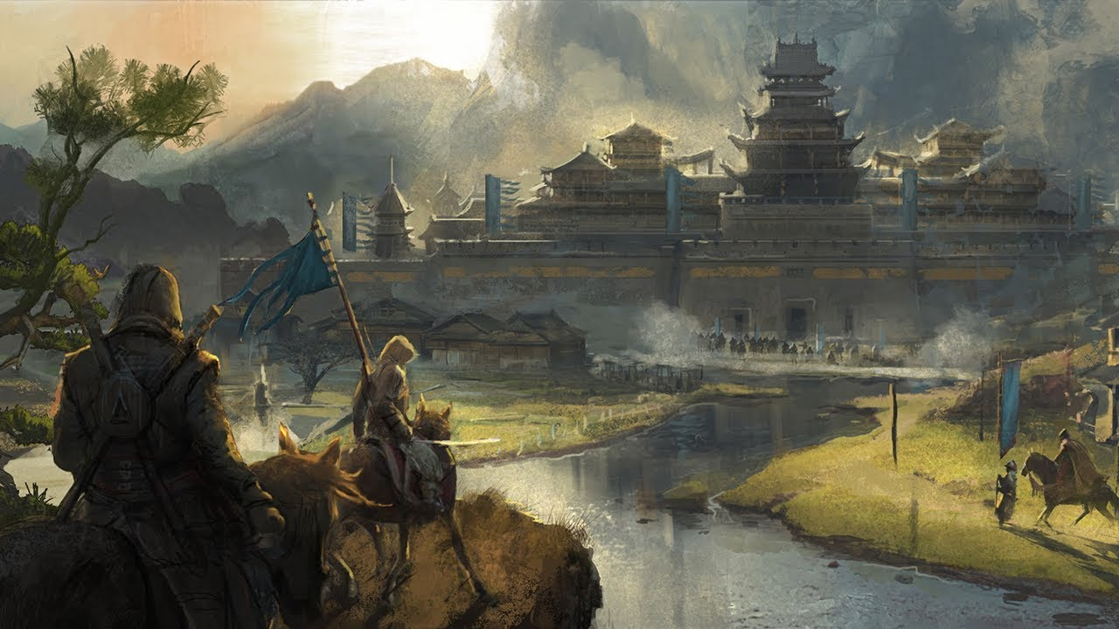
Feudal Japan concept art

Slide 2


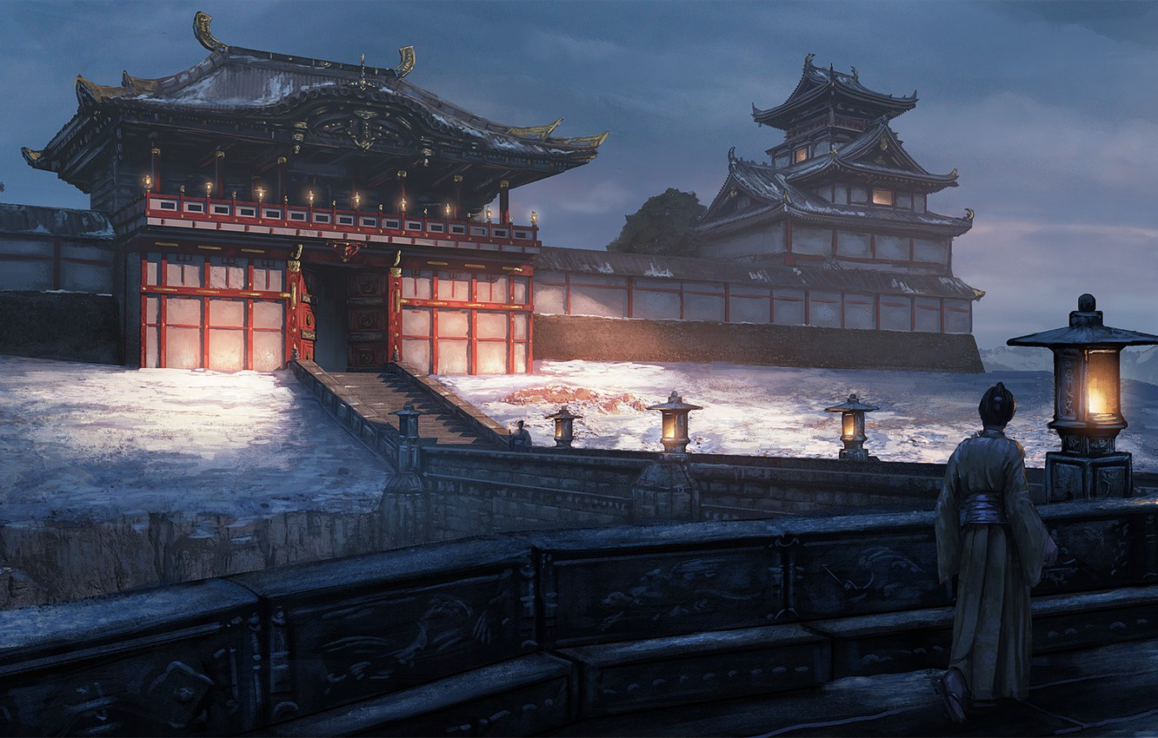
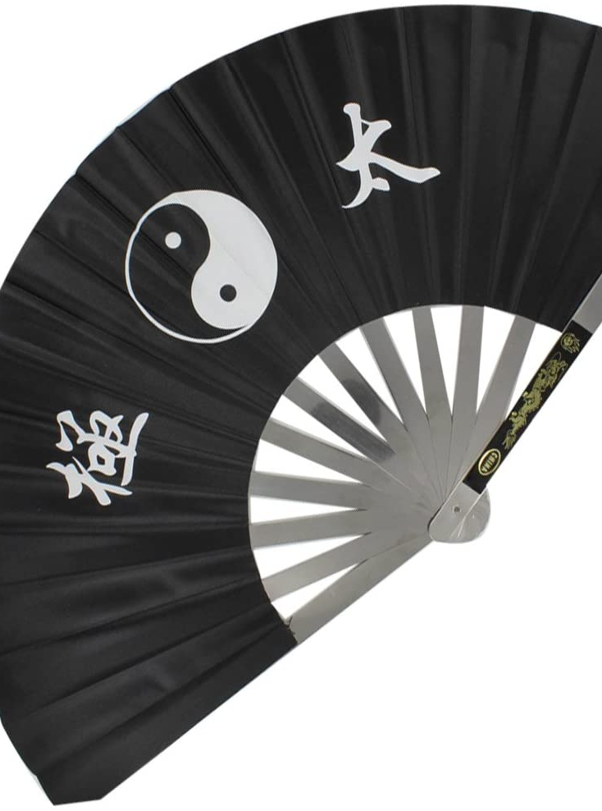

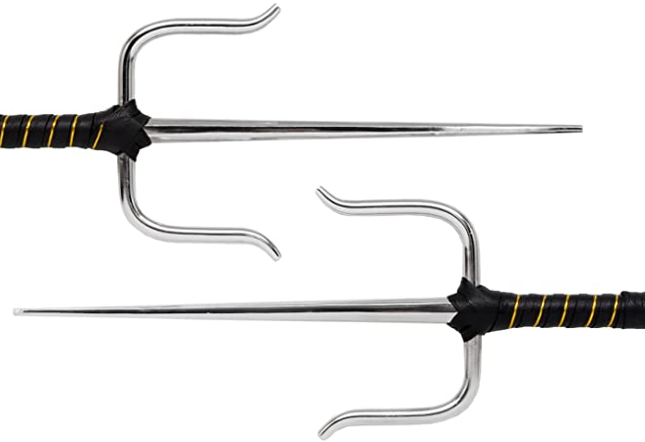
Inspiration
My inspiration for this project comes from me reading about the history of Feudal Japan,
I also like how creative they were with their military hardware (weaponizing fans).

Slide 3

Target Audience
My target audience is going to be 16–25-year old’s as they are probably the most interested in things like feudal Japanese culture, they are also more likely to understand due to their age and I believe that the complexity of the culture and some aspects of it may be too much for younger audiences

Slide 4


Primary and secondary research
For my primary research I will do a questionnaire to 100 people asking them questions about feudal Japan.
For my secondary research I have used a history website and researched the entire history of feudal Japan.

Slide 5


Inspirations
My main inspiration for this project comes from games like Sekiro and Ghost of Tsushima, both games are a good example of realistically showing the weaponry and infrastructure of feudal Japan

