Slide 1
The Hidden Hero
By Kyle S Murphy

Slide 2
Logline
Some secrets are bet kept hidden

Slide 3
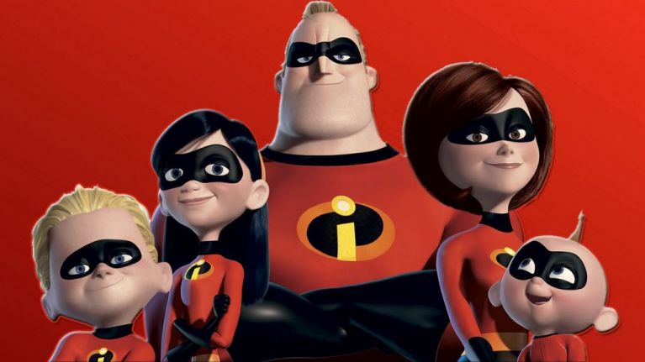
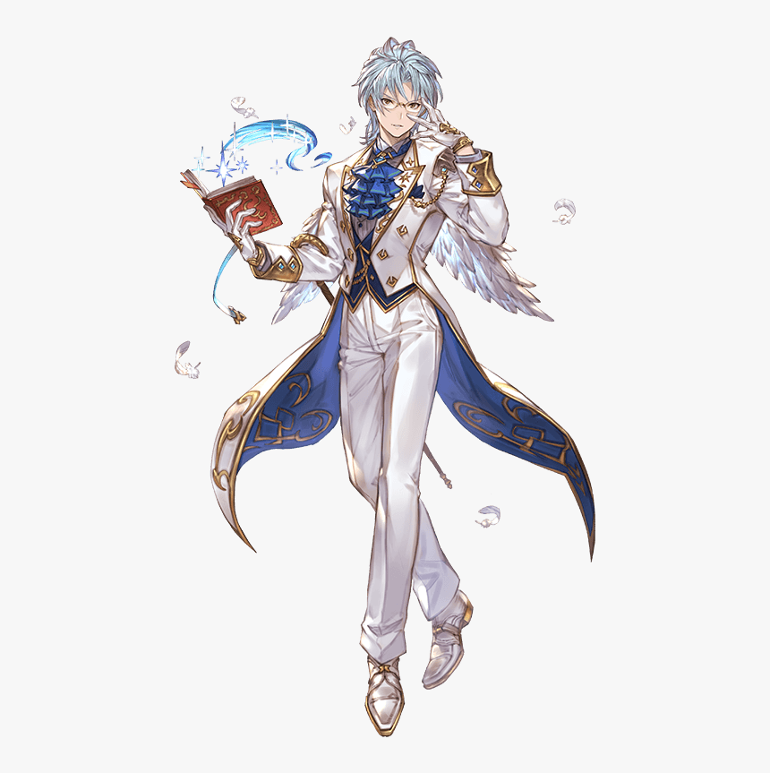
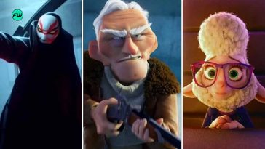
Genre
The genre Superhero Fantasy and the conventions that of the superhero fantasy are super-powe, villain, heroes because these are the qualities within the genre of superhero fantasy

Slide 4
Synopsis
A teenager boy who had to hide his powers unlit his see as someone bullying a another child then he starts his journey to become a hero.
From Creation must come destruction

Slide 5
Characters
Artemis who is the protagonist who had to keep his powers hidden and he got neglected by his parents and he was bullied, his powers are Creation and destruction.
His parent who is the people who neglected their son for not having powers aka Mom – Jill Ember and Dad- William Ember
His Bullies who will but the people to push him to use his power later on are Bully 1- Samael Evans, Bully 2 – Jack Marks and Bully 3- Bobby Milles.

Slide 6
Filmmaking elements
The elements I be using are flashback to show how the protagonist tram of his past because of the bulling and neglected and how that change and now he is using his power now and also using a linear narrative to show how the protagonist of his journey. The shots I be doing on my movie

Slide 7
Conclusion
The conclusion of my short movie is that Artemis the protagonist uses his now using his power to save people from the villains or the bully's and his is also start his journey to become a hero that he wanted to when he was younger and he has new parents that will always love him now.

