Slide 1
POCKET PLANET
Deer shed Investigation
LEVEL 2 CREATIVE MEDIA PRODUCTION & TECHNOLOGY
Click t add text

Slide 2
Task: using the heading within the PowerPoint, investigate the Deer Shed website to gain a wider understanding of the audience the festival attracts. Please show both visual and written examples for each heading and make your own comments on creative ideas, visual designs and activities that could spark your own art/design/production direction.
Music
Jazz music-
Country road songs
Rap songs
Thrilling

Slide 3
Camping
Tangerine fields-affordable tent houses with families up to 8 people
Vip showers and toilet’s, away from the general facilities.
Pamper tent (power sockets, hair dryers, hair straighteners' and mirrors
Camping for kids and adults.

Slide 4
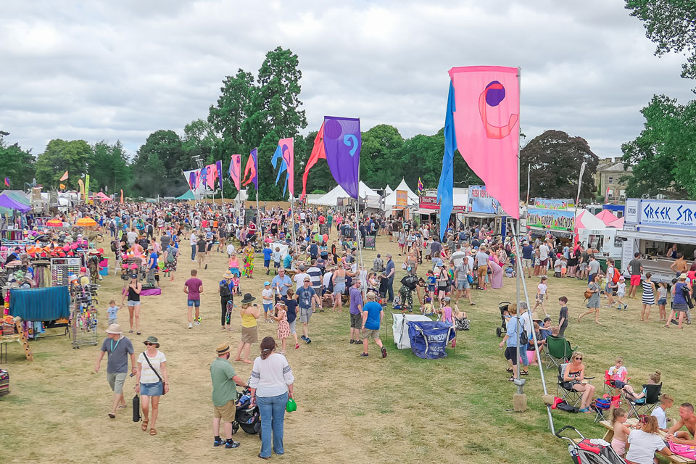
Food
The food run separate’s the main stage in the dock area from the area containing
As you can see from this image there’s also a few food stalls where food is made already for you.Theres also a variety of foods such as Indian, American and African.

Slide 5
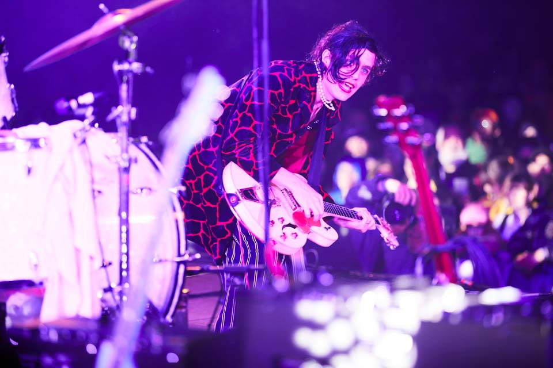
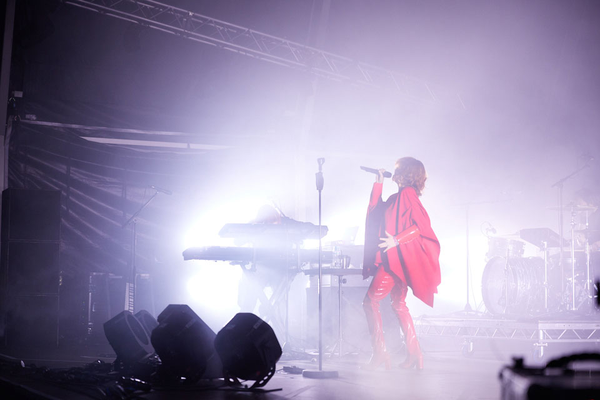
Live Shows
Leeds live festival
Live singing for adults and kids, favourite singers to favourite rappers its all here live in leeds.

Slide 6
Art
Activities taking place such as pottery making
Fun activities to do with adults and kids

Slide 7
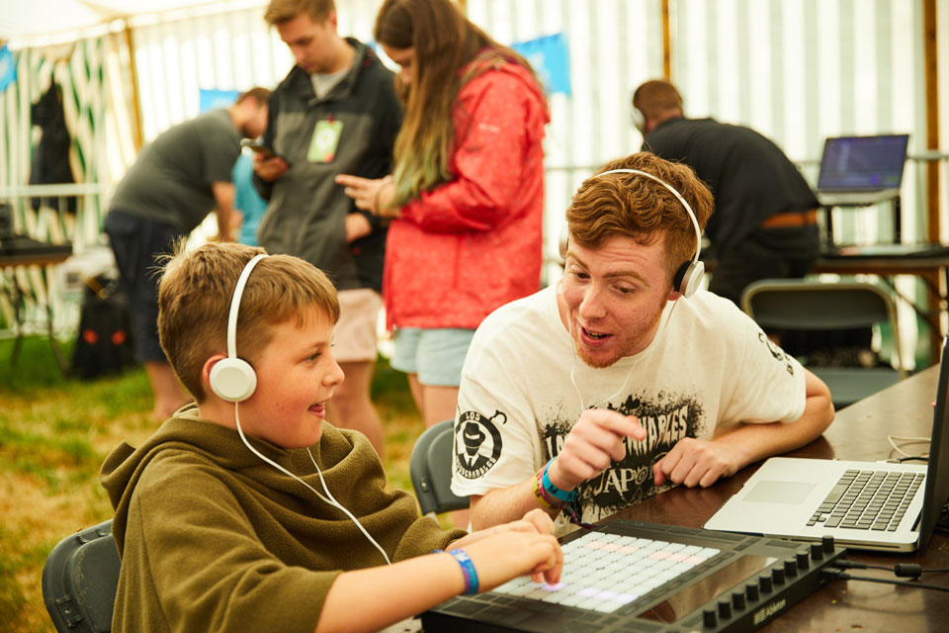
Technology
As you can see in this image technology such as computers and radio players are available to use and create your own music with.

Slide 8
Workshops
Clean or messy arts and crafts along with a variety to pick from there’s also many outdoor sports for the kids such as woodland activities. Its a good physical experience whilst your here
There’s many things to choose from for kids and adults

Slide 9
Ethos: What's meaning behind Deer Shed?
The meaning of all this Is to persuade people to come and try this place out, theyre advertising the best bits to get people to come and visit its also a good opportunity for kids to come and enjoy

Slide 10
Who are the sponsors?

Slide 11
Age range
Kids under 16 must be accompanied by atleast 1 adult over 21
Any additional info:

