Slide 1
Time walker
A working title
A short game for my fmp

Slide 2
My game
For my idea I am making a short educational game with the theme in mind of “pocket planet” and since we working with deer shed festival that house 10,000 people with most being family I decided to make that game more educational
For what my game is it about a you the character walking though curtain point of history/culture like a story book as the narrator talk about the topic

Slide 3
Why I chosen this idea
One of the biggest reason on my I chose this is that I want to created game for a career and making a short educational game for the festival seem to be the best way to go
I have gotten many skill in my nearly 4 years in college with some with art and design, film and others
And the final reason on why I wanted to make a game is for experience and the how challenging the game is

Slide 4
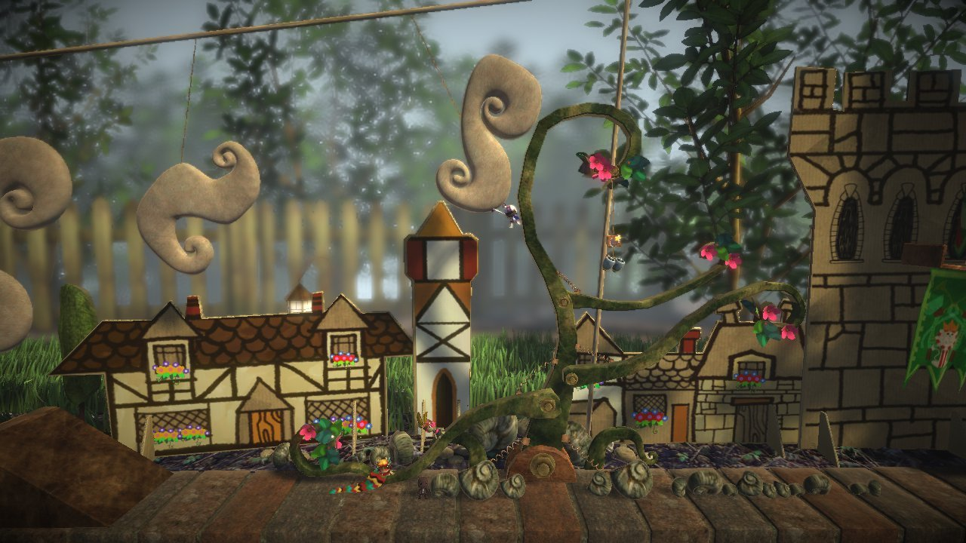
Influences
Some of the biggest influence that had for the game was ”little big planted” and the reason for this is the used of materials and I want to add that aspect into the game
Another influence that I had was “paper Mario” as I like the look on the character and the white line around the character as well

Slide 5
How the game will play and look

Slide 6
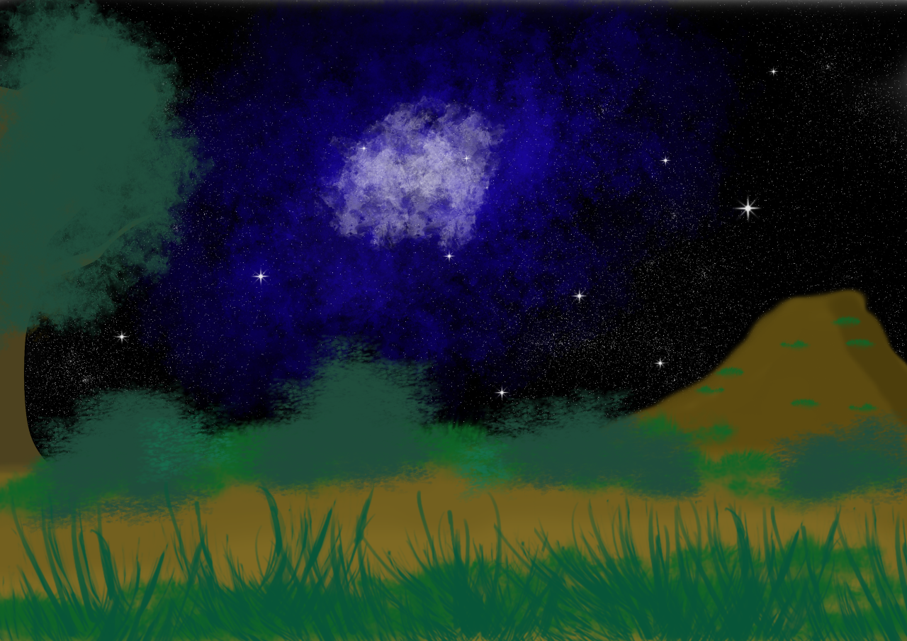

Slide 7
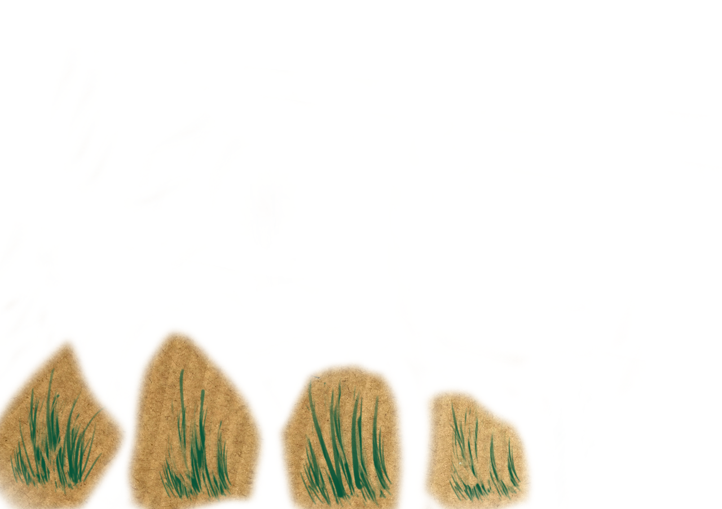
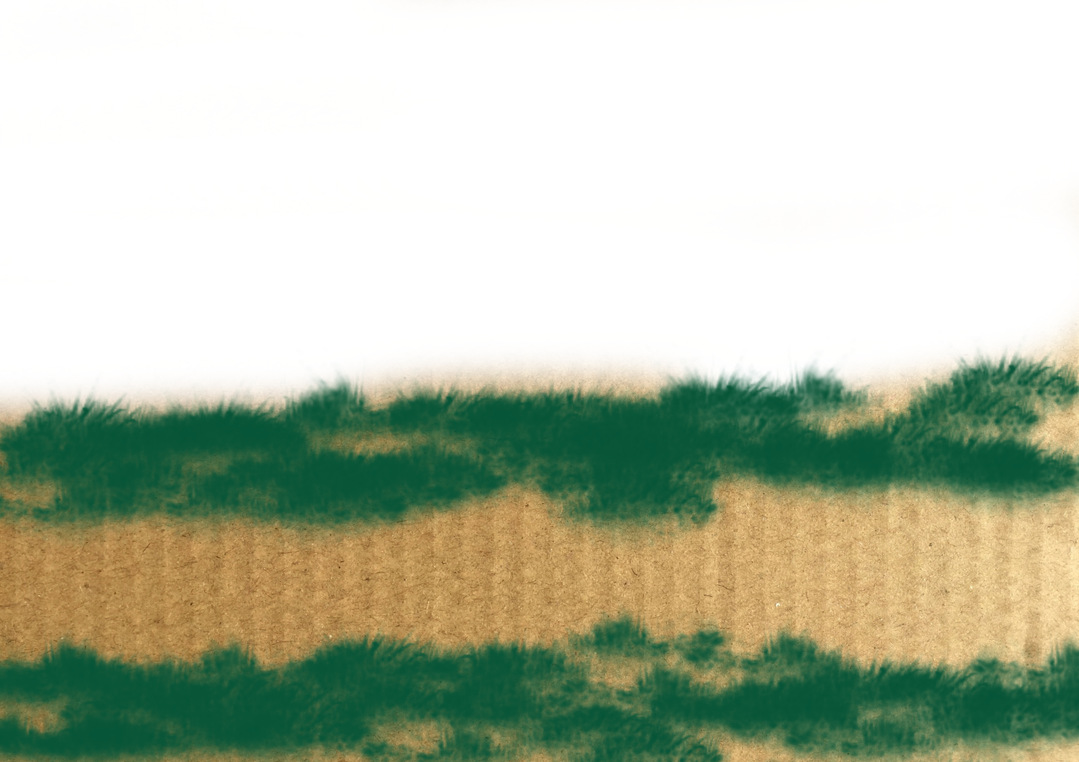

Slide 8
My role
Since I'm working alone on the task I got a lot of work that will need to be done as I will need to do the research, planning, production & post production
Research into history and culture
Planning when the work need to be done
Production on the work
And others

Slide 9
Any question?

