Slide 1
Project 5 Proposal
By Jensen Barnes & Lea O’Callaghan
Jensen
Lea

Slide 2
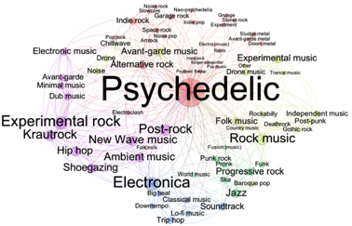
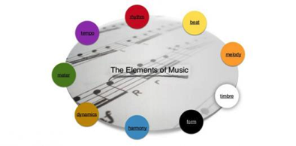
Project Concept
We will create an EP for our collaborative project
It will consist of at least 3 tracks
Each of which will showcase our different strengths
Research
Elements of music
Different genres
Resources
DAW
Recording hardware
Promotional material
Release Platform

Slide 3
Evaluation
Lea
Composing
Arranging
Jensen
Production
Recording
Documentation
Scrap Books
Screenshots
Typing
Audio
Video

Slide 4
Action Plan
Research
Techniques
Genres
Brainstorming
Lyrics
Structure
Tonality
Composing & Producing
Composing
Arranging
Producing
Recording
Mastering
Promoting
Online
Offline
Releasing
Streaming
Physical Copies

Slide 5
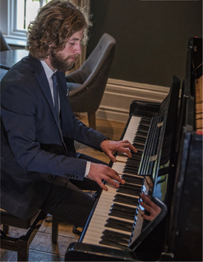
Research
Interviewing
Heather Melgram
College Tutors
Websites
Youtube
Art Of Composing
Music Radar
Production-Techniques
Renegade Producer
Etc.

