Slide 1
Story board
For documentary

Slide 2
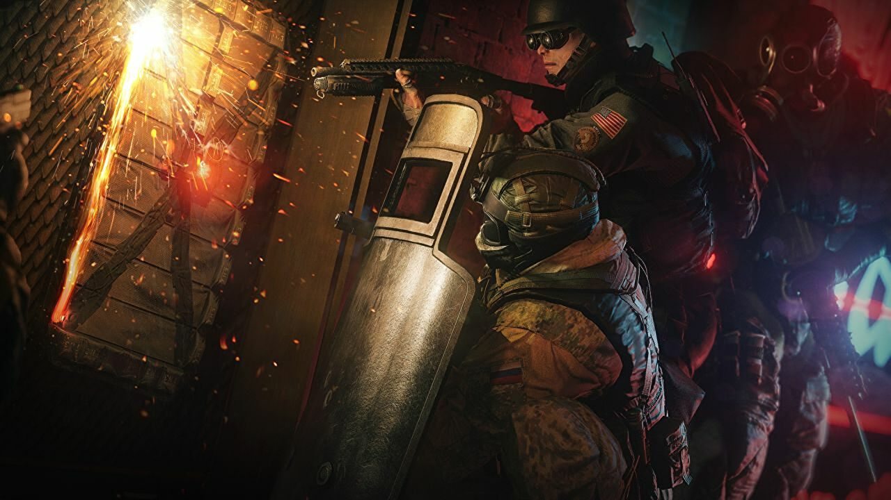
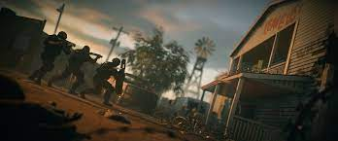
Rainbow six siege
I will use situations gameplay and try to make it as dramatic as possible. I will change my playstyle to keep the game looking boring and have it looking more tactical.

Slide 3
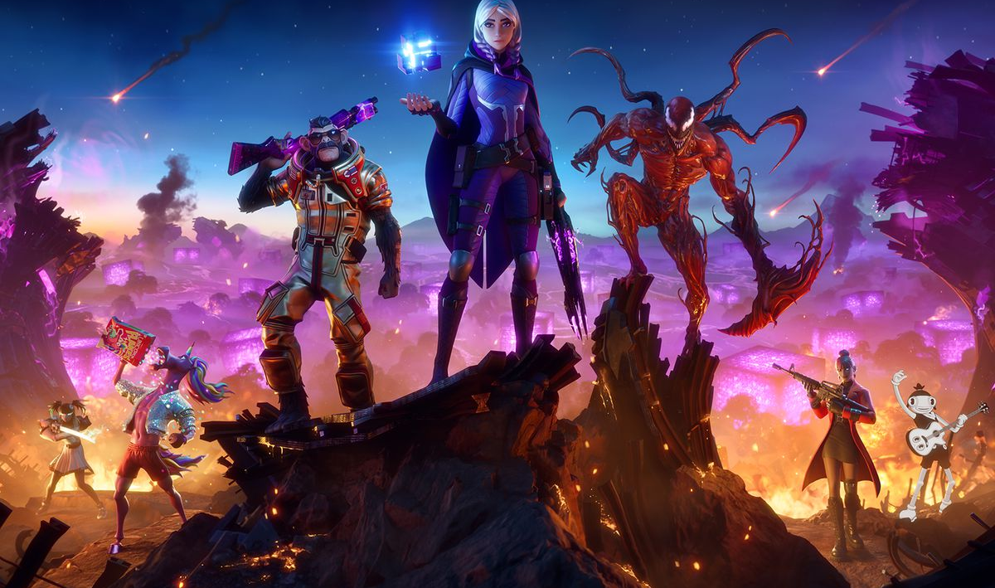
Fortnite
I will use shots of the character in foreground with a beautifully designed background. The background can be sky boxes or passive gameplay watching others fighting in the game. As if it is found footage from a battleground.
Something like this.

Slide 4
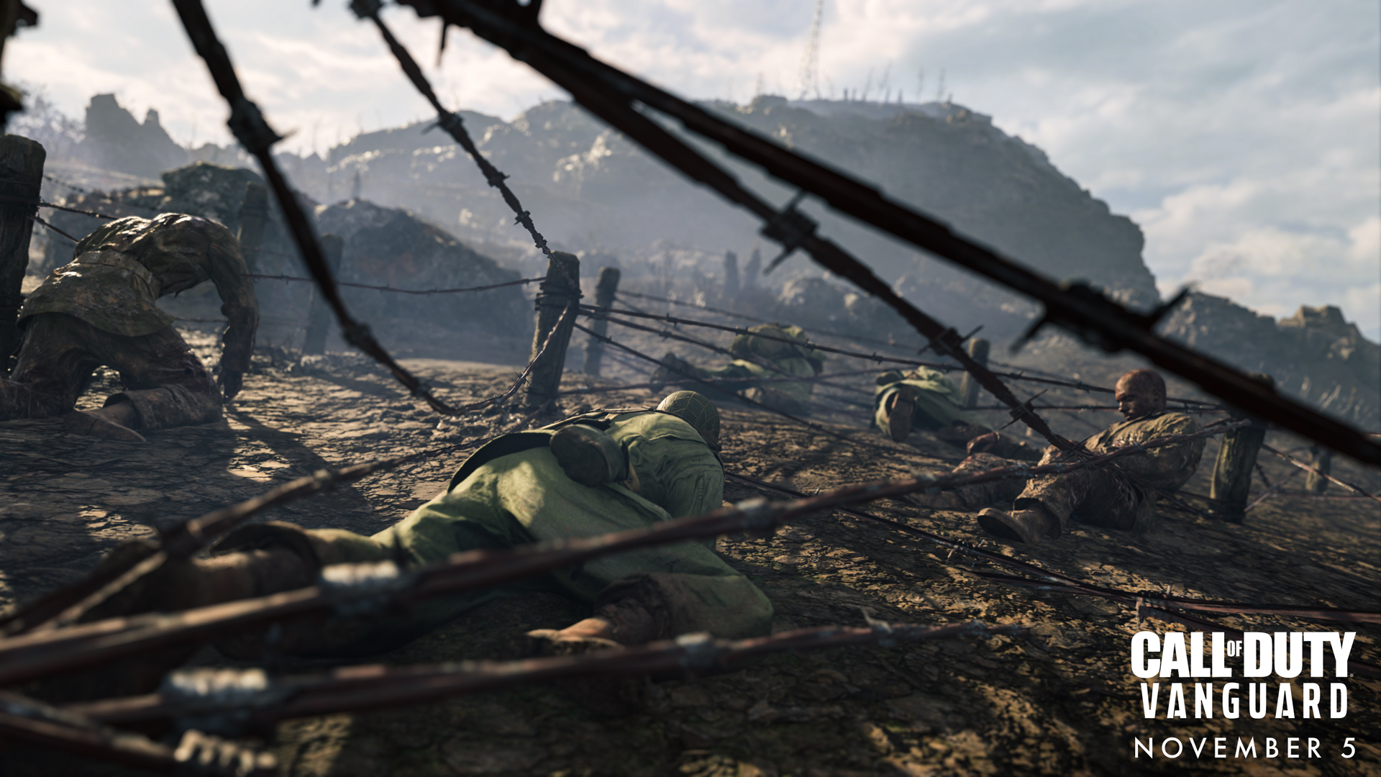
Call of duty
I will be using campaign footage. This is because call of duty is known for its over-the-top campaigns. There is always something cool and interesting visually happening.

Slide 5
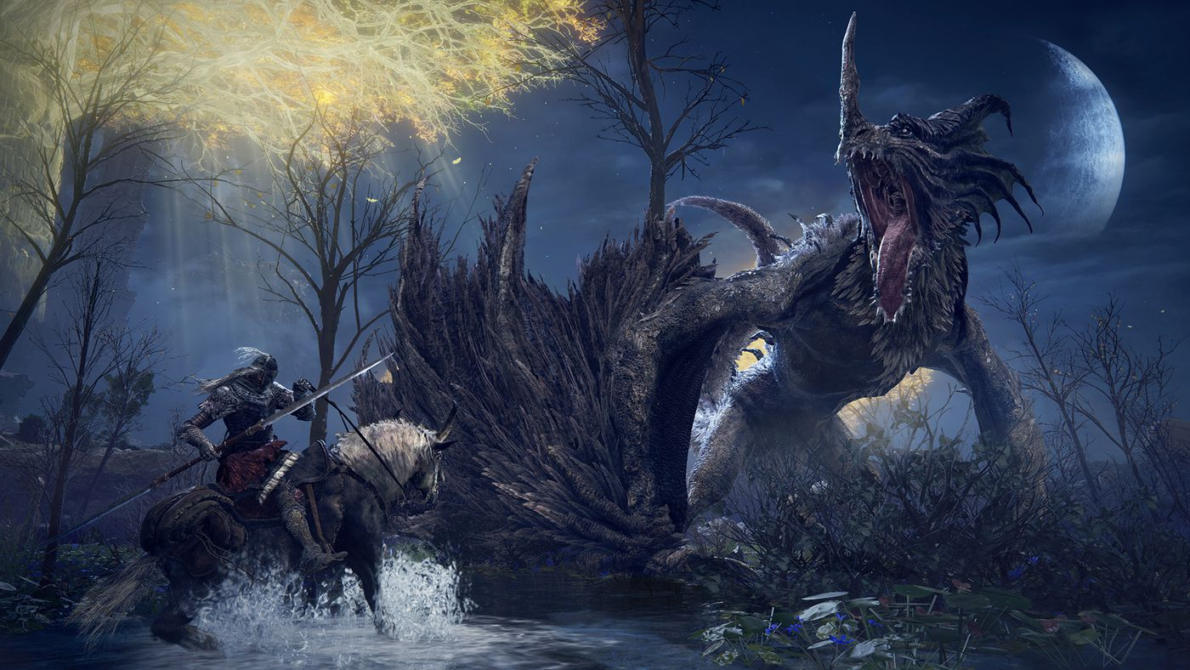
Elden ring
I will be getting large scale shots of things like bosses. I will use these shots and edit logos for the players and the developers onto them. For example, at the start of the documentary the huge monster will represent the developers but as the narrative twists it will be reveled that the players are the fierce monster. Showing that players can be over the top and/or the problem.

Slide 6
FIFA
FIFA will be trailer footage because I refuse to own the game. This is due to its clear cash grab nature with no innovation.

