Slide 1
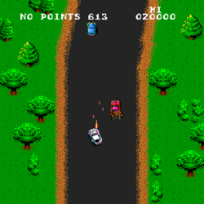
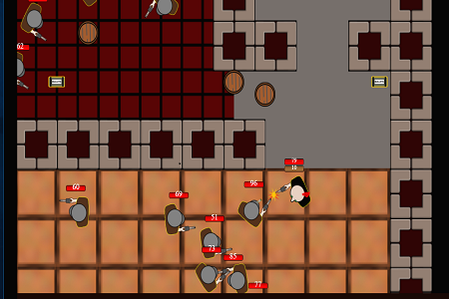
Games level design!
Interests: my interests are in the gaming industry. I would like to do 3D modeling, creating my own smaller games and maybe sound design but overall I would be interested in taking part in all production teams in games.
Ambitions: my main ambition is to be able to learn the industry enough to be able to feel comfortable making a whole game from scratch including sound, graphics, models, textures and mechanics.
Interests ambitions and general ideas!
Intentions: my intentions for my final major project is to have a top down shooter that is in a playable state with sound. I want to be able to continue to expand until I feel it is complete.
General ideas: my ideas for games have core main things in common and that is a focus on being unique and fun. I do not want to do games design to make knock off copy games of what are popular at that time. I also would prioritize the enjoyability and replay ability of a game over grind and trying to be over ambitious. Working off of that the phrase ‘pocket planet’ can be taken quite literally. My idea for a game would be set in a higher beings pocket where the character would learn of his existence and spend the game trying to escape and venture out truther into the universe. The higher being would be aware of what the main character is doing and send enemies to stop the player. The player will have to fight enemies and find the way to escape, if he can! It will be a sif-fi action top down shooter

Slide 2
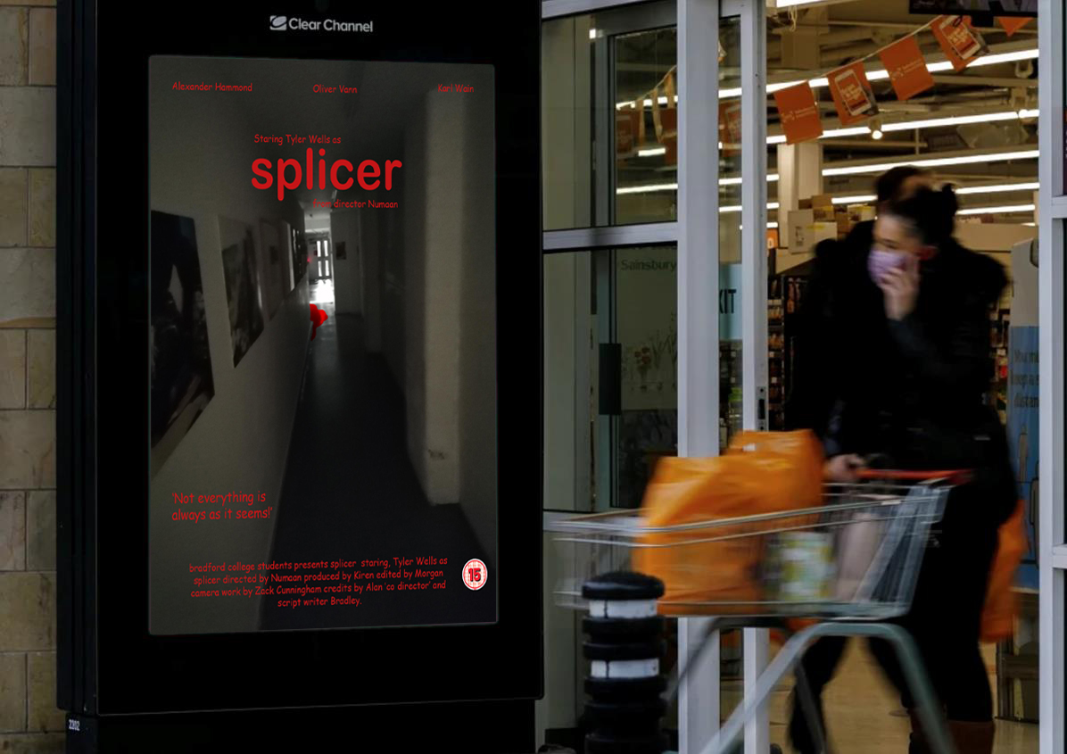
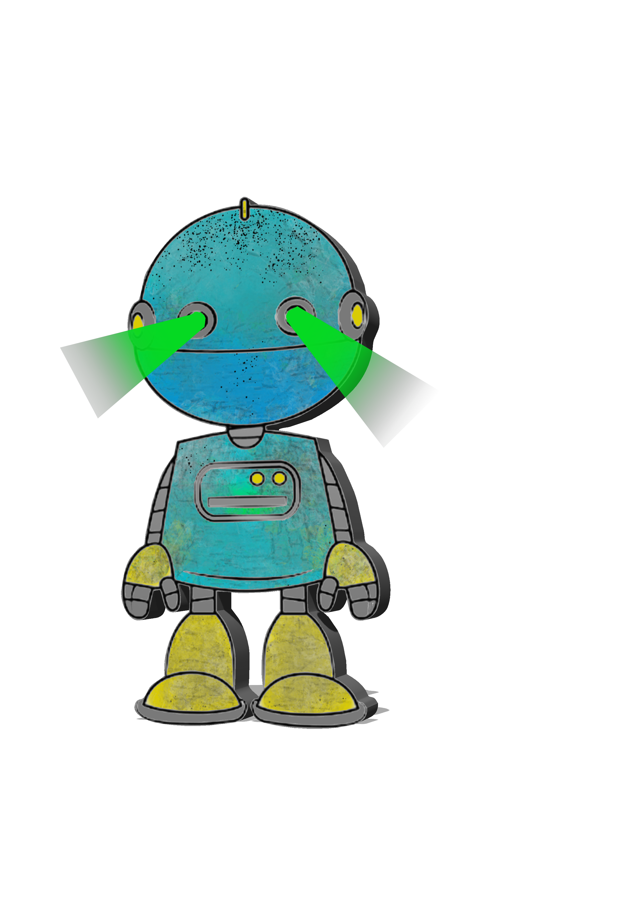
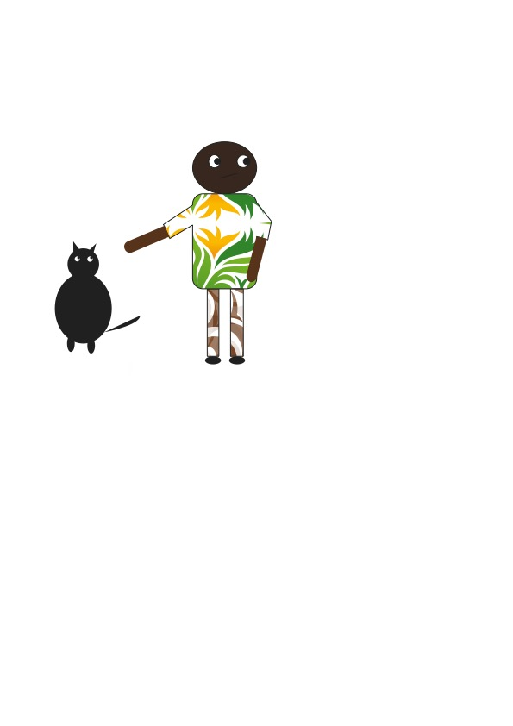
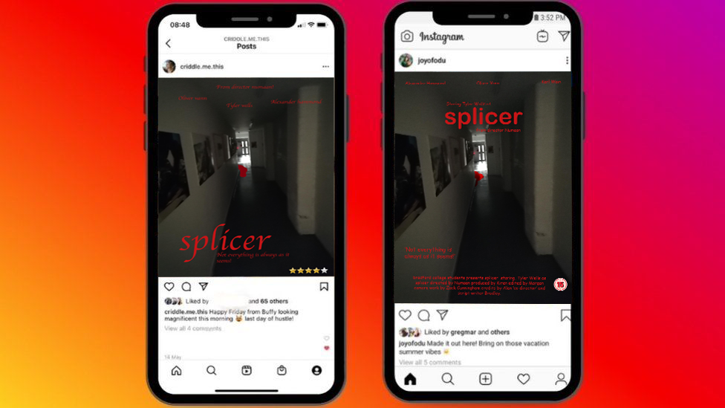
Skills assessment
I have played games and been interested in how they work since I’ve been young resulting on an overall understanding on how most games work (playing wise) I pick up a game for the first time and know how to play it because a lot of games follow the same formula. I also know how to use construct 2 and pixel (A sprite creating software) with both of these I would be able to make a top down shooter. I also know how to use garage band which would be how I would create audio. With these three main software's I would be able to make my whole final major project. While being on this course I have also been learning photoshop and adobe illustrator I have done multiple different things in these software's such as these…

