Slide 1
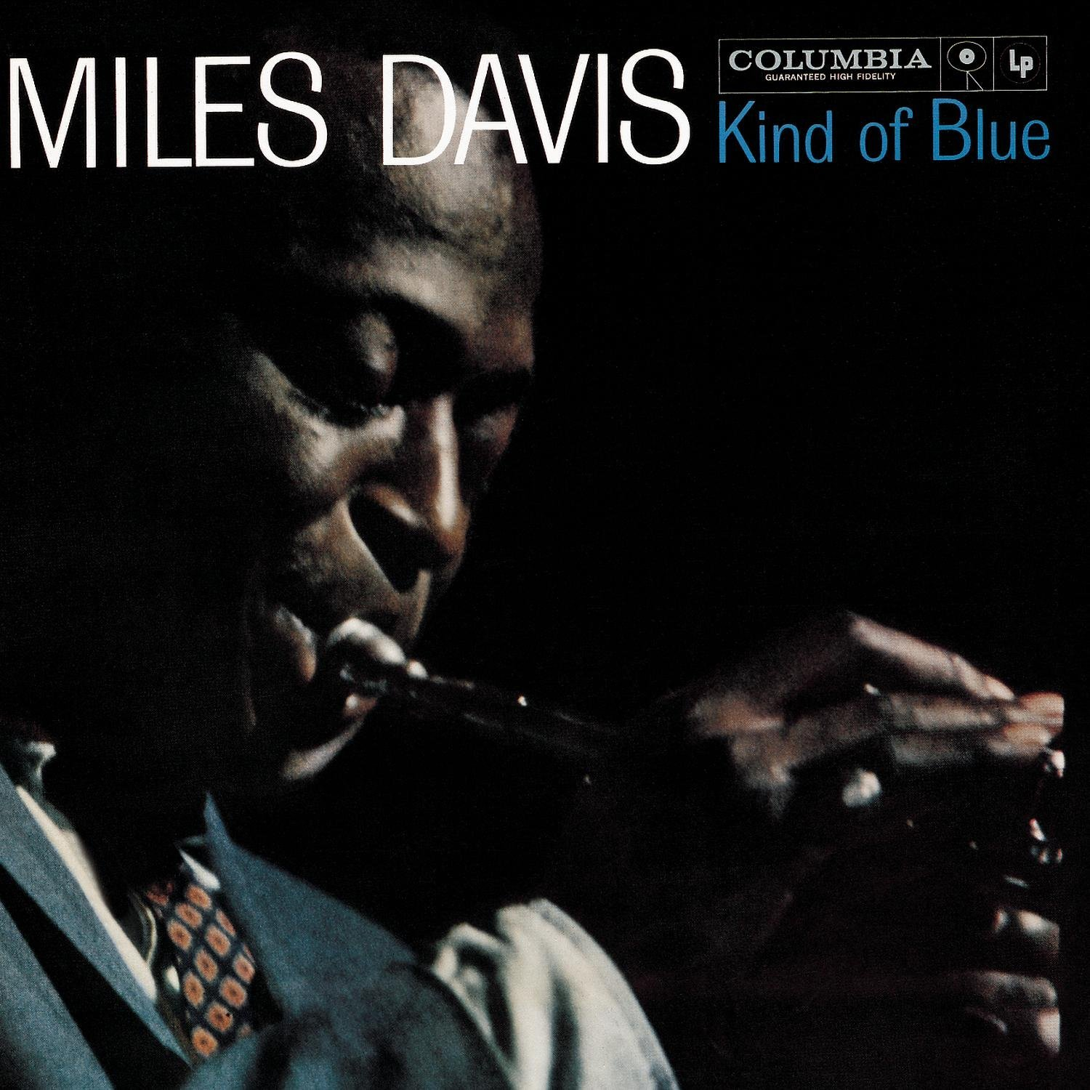
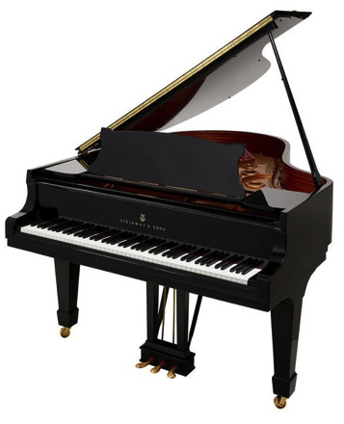
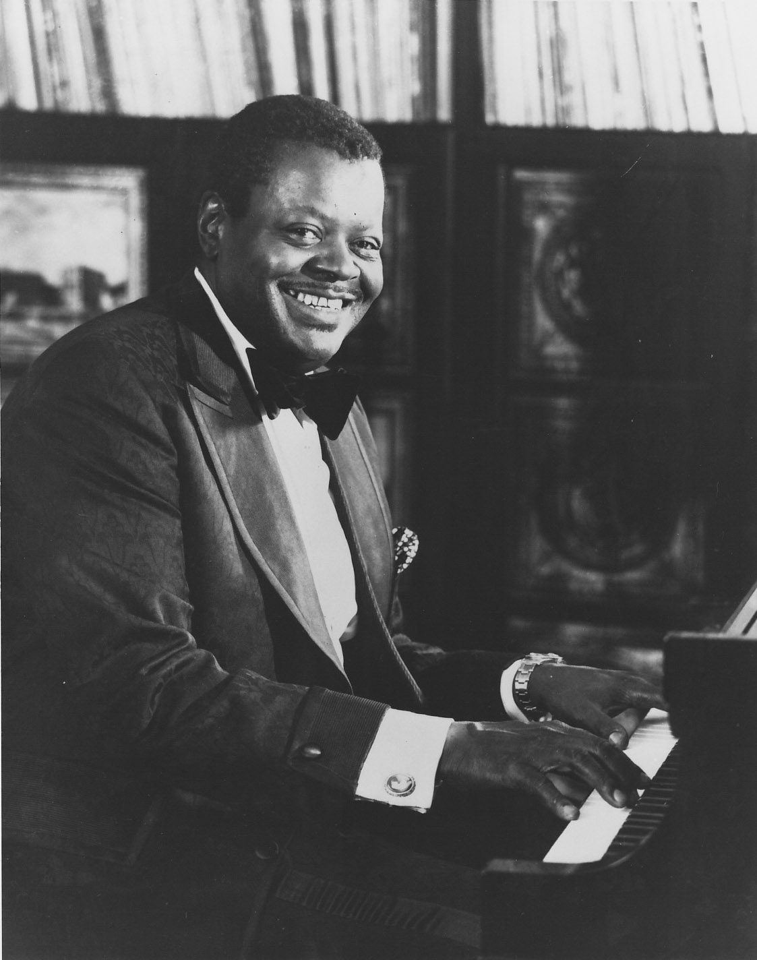
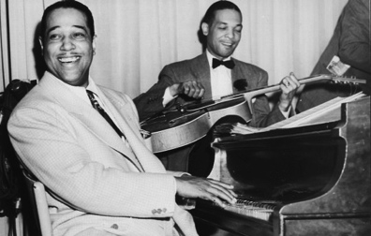
Final Project
Finlay Mactaggart

Slide 2
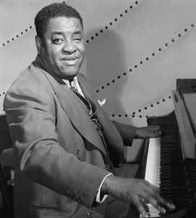
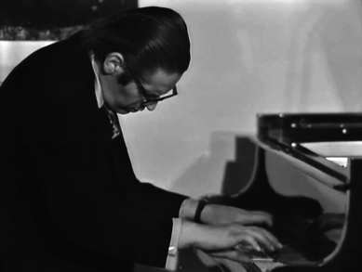
Project idea
Jazz piano repertoire – solo, accompaniment and band
Performance – a few gigs
Promotion – create an Instagram page, final performance
Extras – website + promotional video

Slide 3
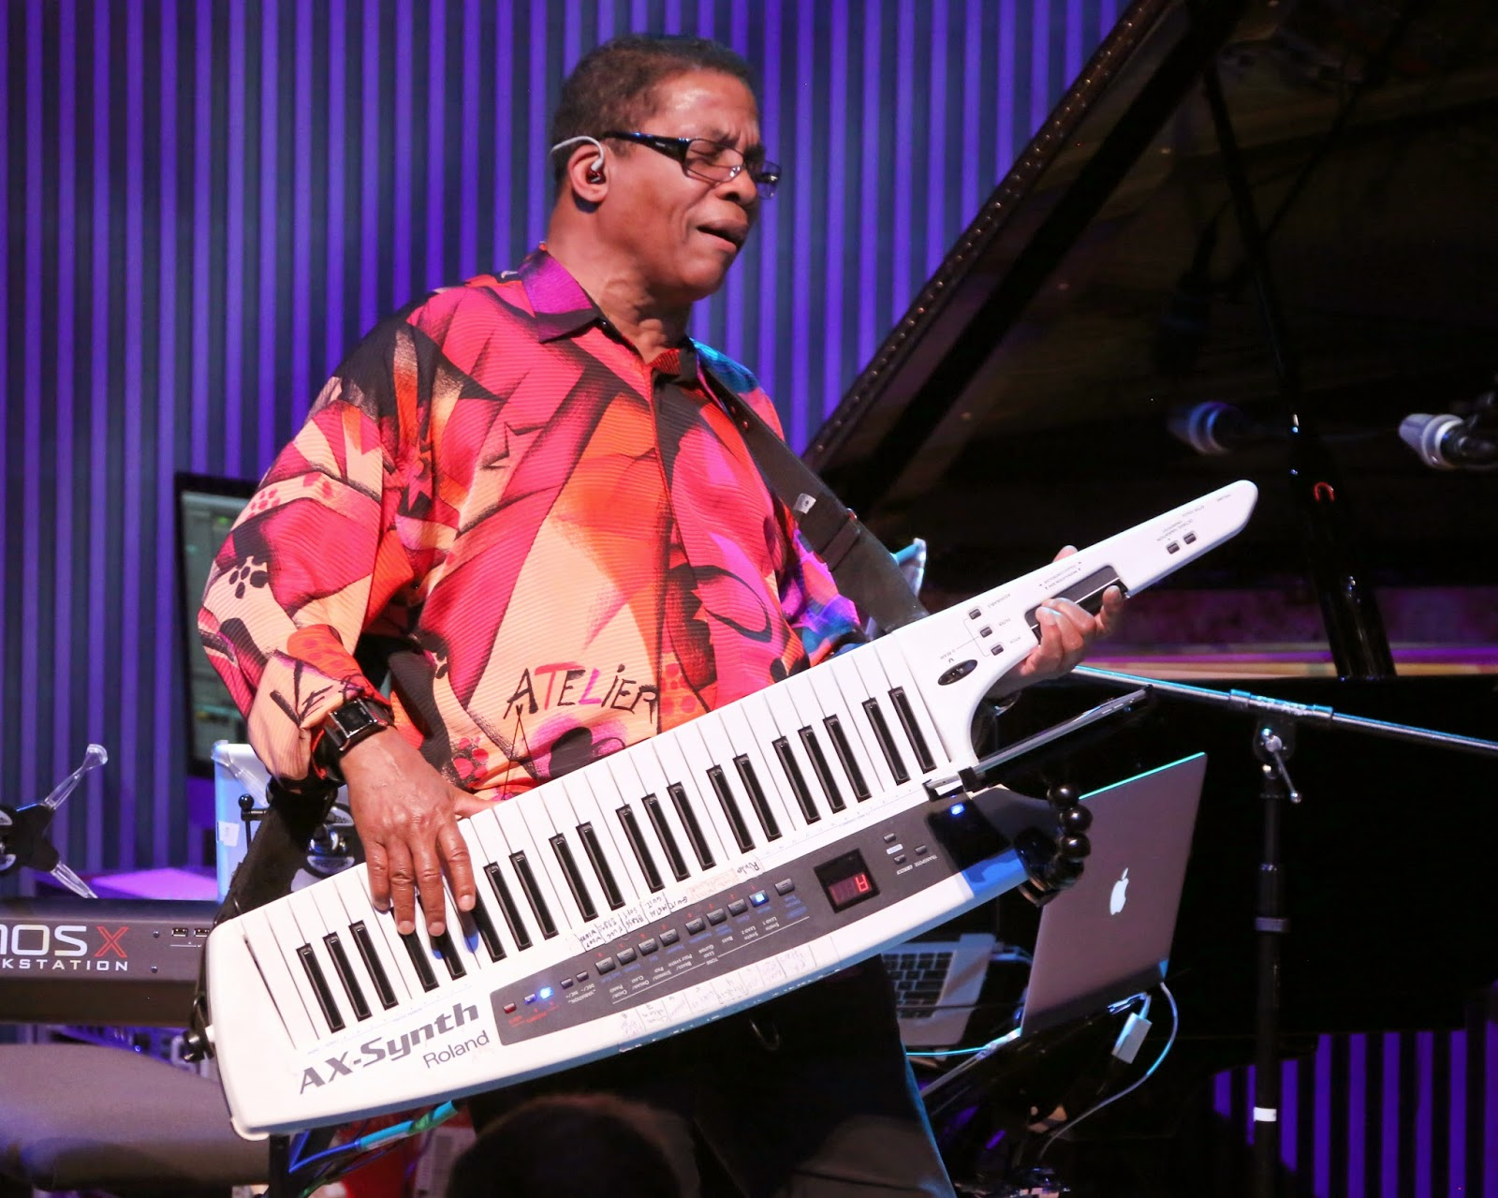
Reflecting on the year
What have I learnt?
Skills I want to work on and improve?

Slide 4
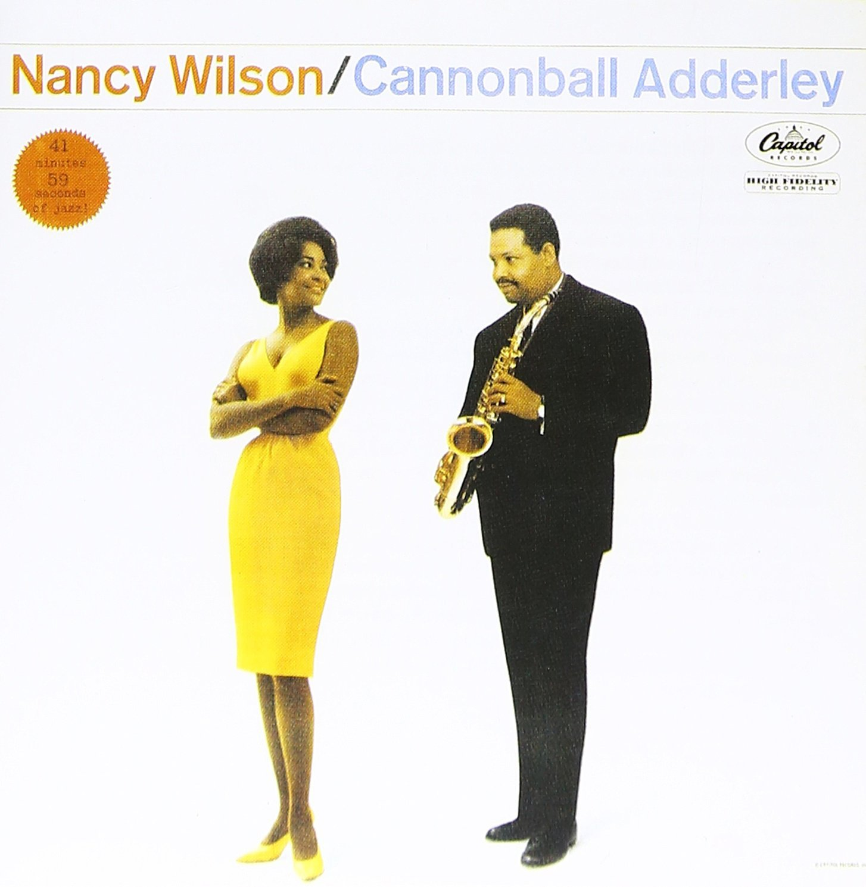
Practical skills
Time management and organization
Arranging and structuring songs
Improvising
Hand independence and using extended chords
Comping and Articulation
Working with a venue
Self promotion

Slide 5
Research and documenting my work
Jazz pianists –Techniques, arrangement and rhythm.
Job opportunities and pathways as a solo performer/ arranger.
Session pianist
Using video, audio and promotional videos + notebook.

Slide 6
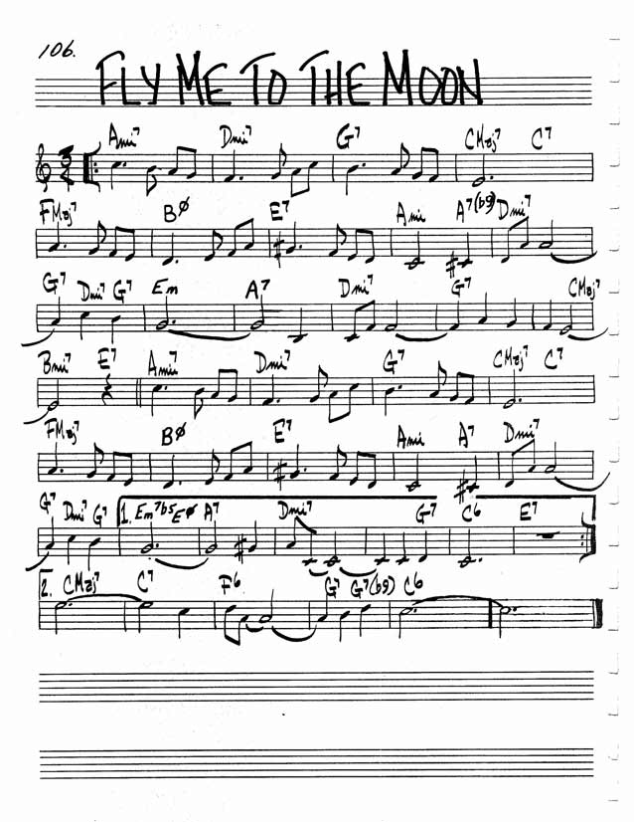
Repertoire
10-15 Jazz standards
Fly me to the moon
Song structure – 3-5 minutes
Fly me to the moon solo piano
Different version of Fly me to the moon
An early version of the set list would include the songs Autumn leaves, All of me, Blue moon, Days of wine and roses, Fly me to the moon, Just Friends, Misty, Satin Doll, Summertime and Take the A train.

Slide 7
Schedule
How I have split up the 9 weeks.
Up till Easter, I will arrange my set list as well as complete my research and enquire about a venue. I also hope to put a band together before Easter and begin to practice a repertoire.
Hopefully I can arrange to do some practice performances around the 5,6,7 week point before doing a final performance in the week before may half term.
I will then have May half term and the week after to evaluate my performance and project.

Slide 8
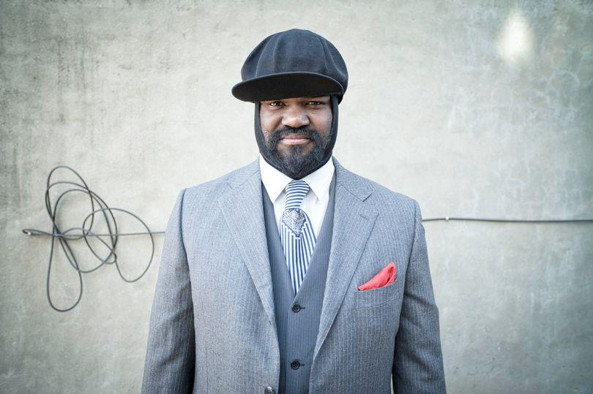
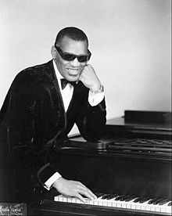
Promotion and final performance
Final performance – venue, setup
Self promotion
In the final performance I could explore a few different styles including Pop, blues and Jazz to create a nice contrast in style.
A few songs I’d like to try

Slide 9
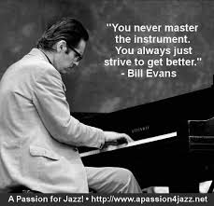
Evaluation
Challenges
Skills I will develop
Questions?

