Slide 1
Final Project Presentation

Slide 2
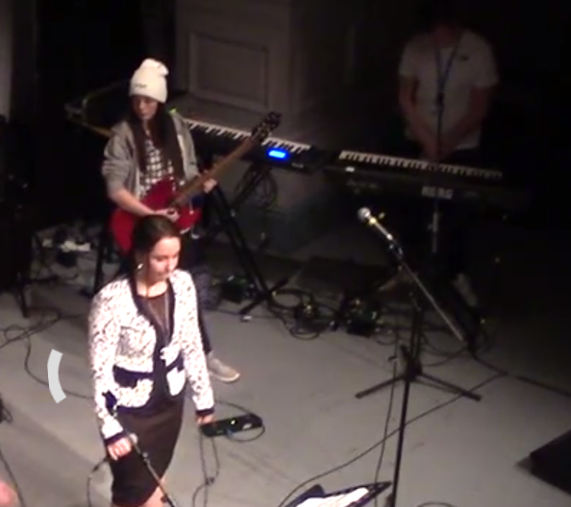
Rationale
Project one Charity Gig – reflection
Skills we have obtained whilst doing this project
Did we enjoy it
How will we put these skills to good use in our final project

Slide 3
Rationale
Project two Sonnet Composition/Band Compositions – reflection
How has it helped us develop as musician
Skills we have obtained whilst doing this project
Did we enjoy it
How will we put these skills to good use in our final project

Slide 4
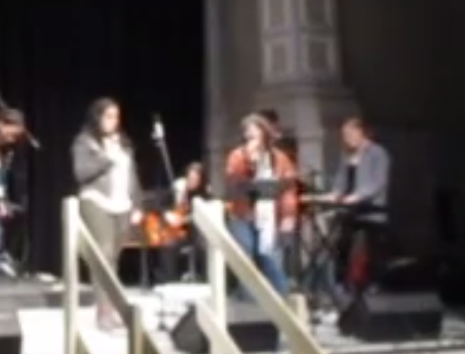
Rationale
Project three Tribute Bands – reflection
How has it helped us develop as musician
Skills we have obtained whilst doing this project
Did we enjoy it
How will we put these skills to good use in our final project

Slide 5
Rationale
Project four Studio Practice – reflection
How has it helped us develop as musician
Skills we have obtained whilst doing this project
Did we enjoy it
How will we put these skills to good use in our final project

Slide 6
Final Project Idea
What we’re doing
Our individual roles

Slide 7
The song Ideas
XXXTENTACION – Orlando
Jeff Buckley – Hallelujah
Childish Gambino – Redbone
XXXTENTACION – Revenge
The Hunna - She’s casual

Slide 8
Target Audience
We have targeted people aged from anywhere between 16 to 25 years of age.
We targeted this age range because the style of music we are making is Hip-Hop / RnB but influenced by indie/rock.
Hip-Hop is very popular right now but we wanted to add something different to it.

Slide 9
Thank You For Listening
Any questions ?

